Slide 1
Chapter 10 Operator Overloading; Class string
C++ How to Program, 9/e

Slide 2
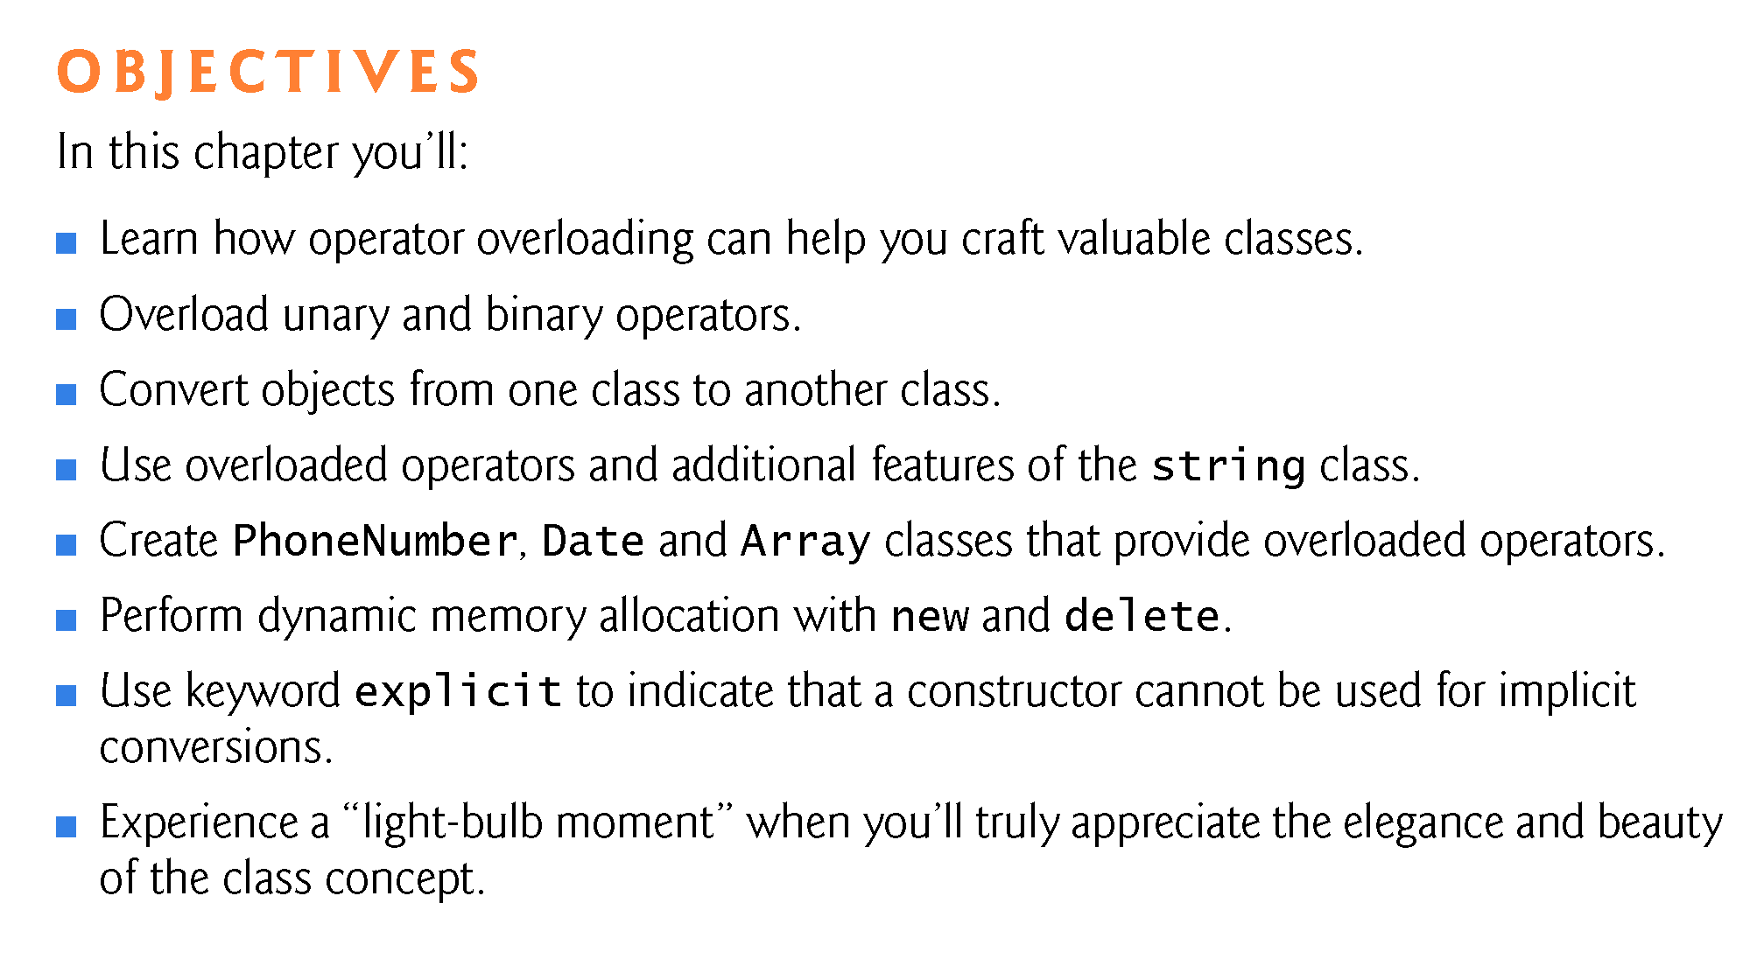

Slide 3
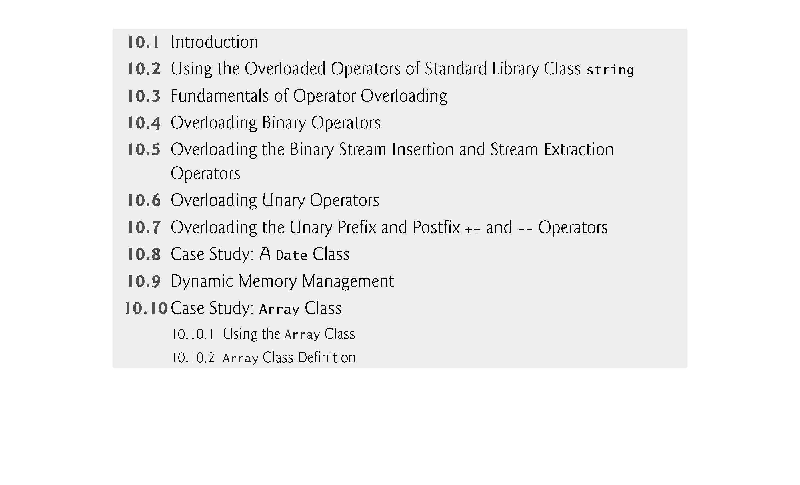

Slide 4
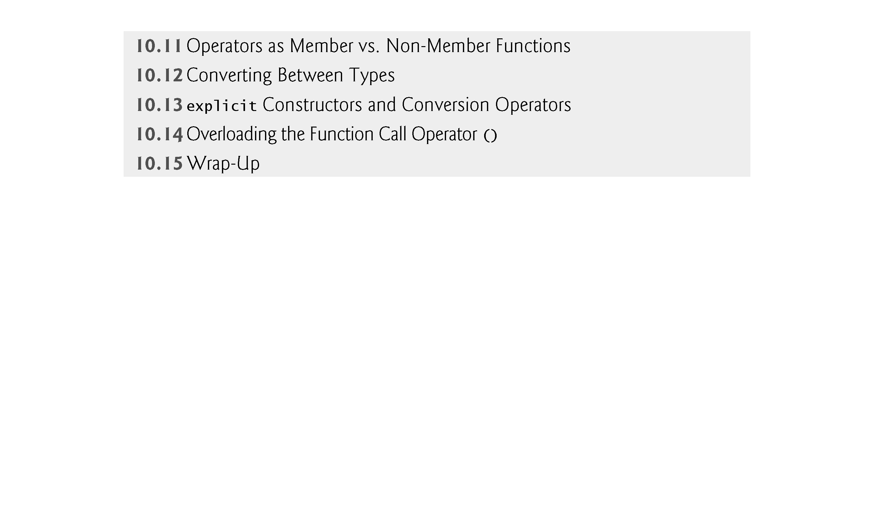

Slide 5
10.1 Introduction
This chapter shows how to enable C++’s operators to work with objects —a process called operator overloading.
One example of an overloaded operator built into C++ is <<, which is used both as the stream insertion operator and as the bitwise left-shift operator..
C++ overloads the addition operator (+) and the subtraction operator (-) to perform differently, depending on their context in integer, floating-point and pointer arithmetic with data of fundamental types.
You can overload most operators to be used with class objects —the compiler generates the appropriate code based on the types of the operands.

Slide 6
10.2 Using the Overloaded Operators of Standard Library Class string
Figure 10.1 demonstrates many of class string’s overloaded operators and several other useful member functions, including empty, substr and at.
function empty determines whether a string is empty,
function substr returns a string that represents a portion of an existing string.
function at returns the character at a specific index in a string (after checking that the index is in range).
Chapter 21 presents class string in detail.

Slide 7
Object Handles
Name of an object
string description; //description is the name of anobject
Pointer to an object
string *descPtr = & description; //descPtr is a pointer to an object
Reference to an object
string &descRef = description; //descRef is a reference to an object

Slide 8
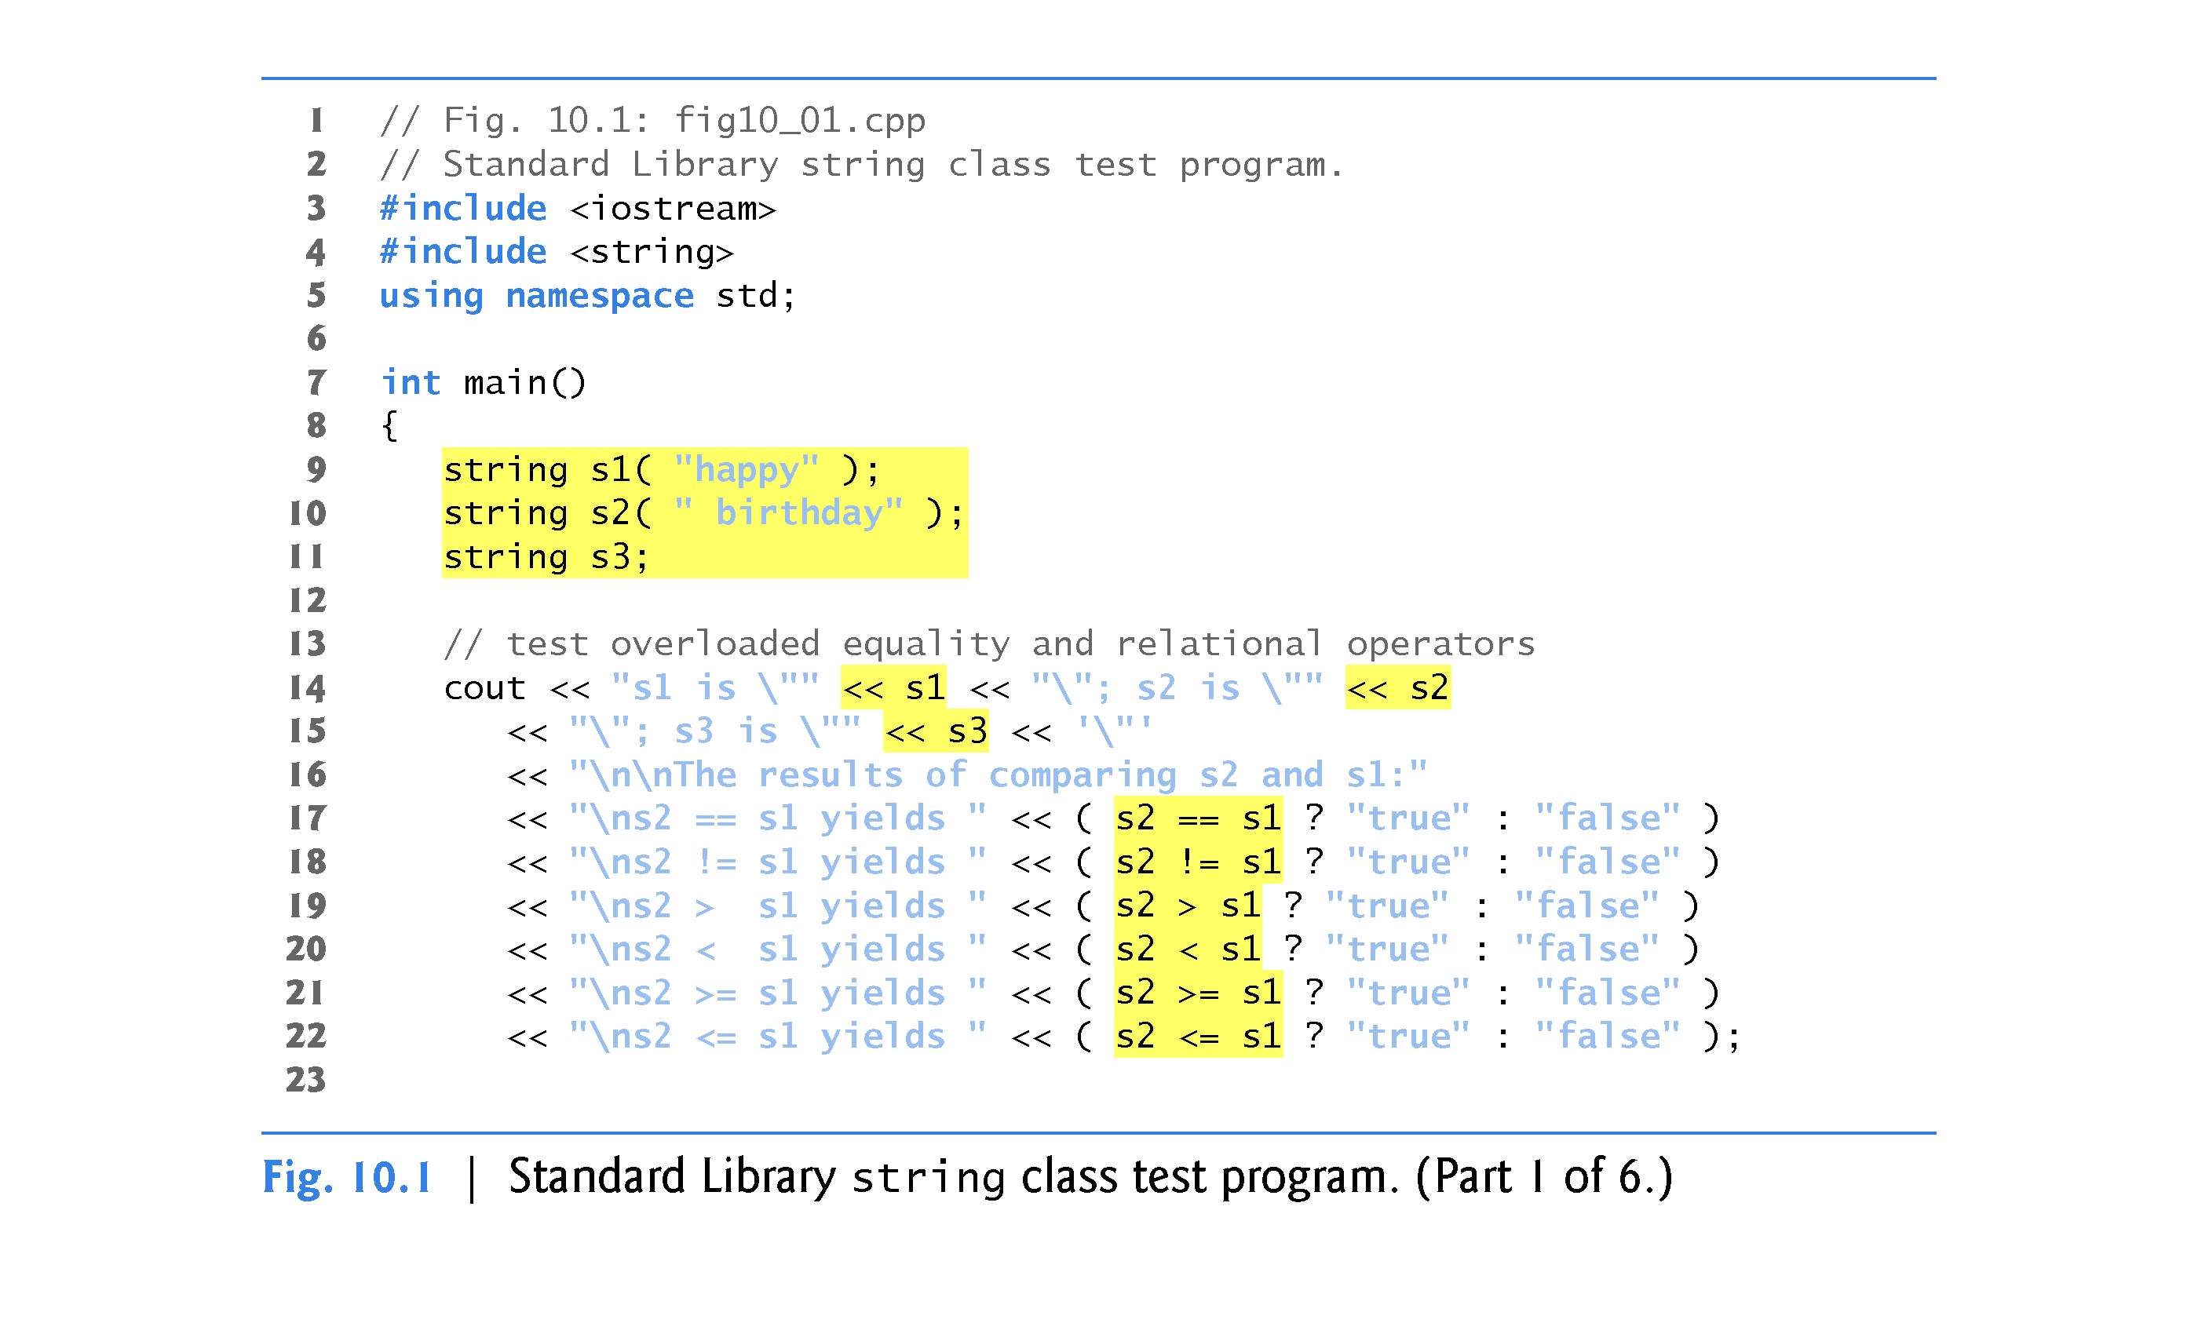
string s10 = “Goodbye”;
S3 contains an empty string.

Slide 9
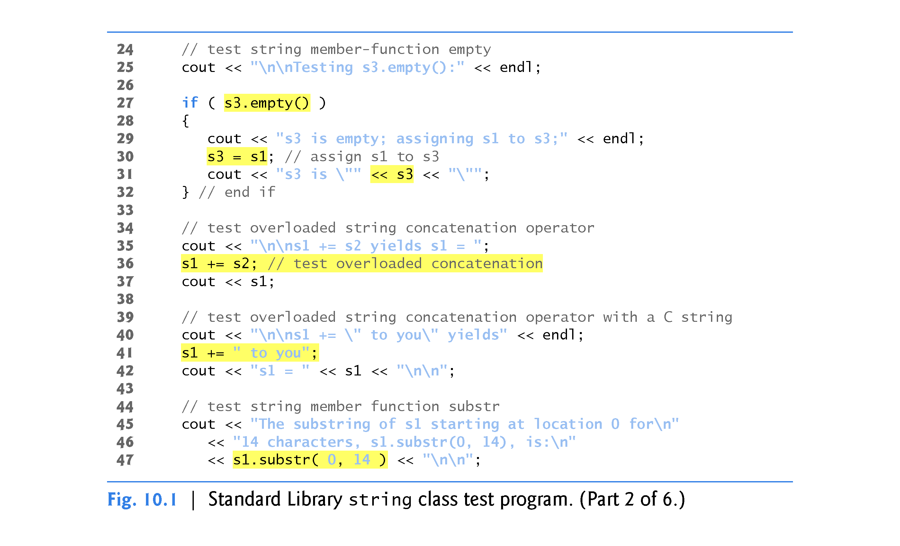

Slide 10
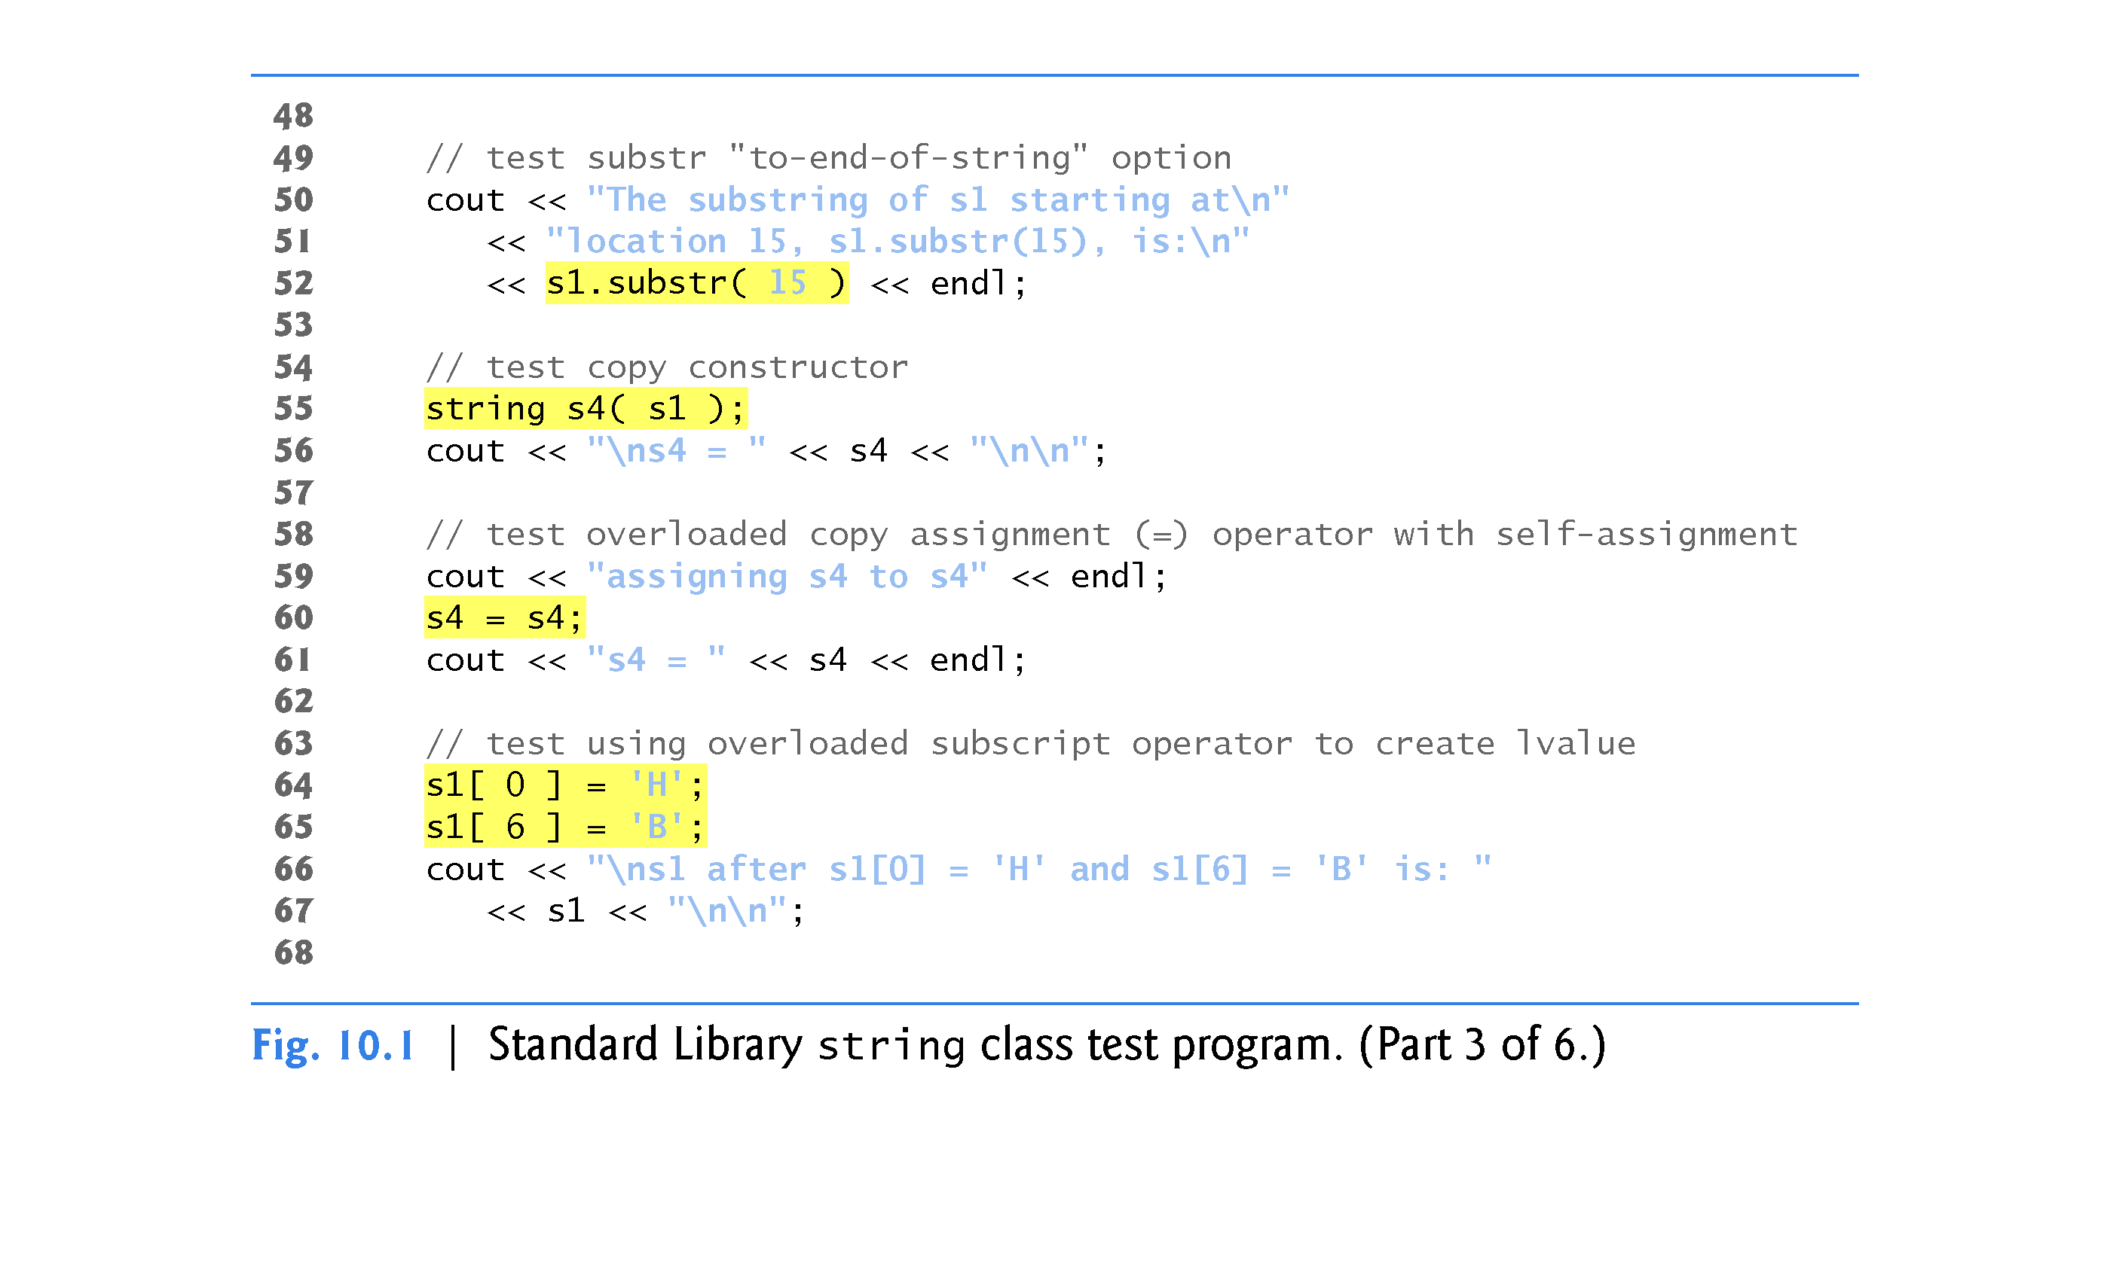
Overloaded substr member function
Note: C++ string objects are mutable!

Slide 11
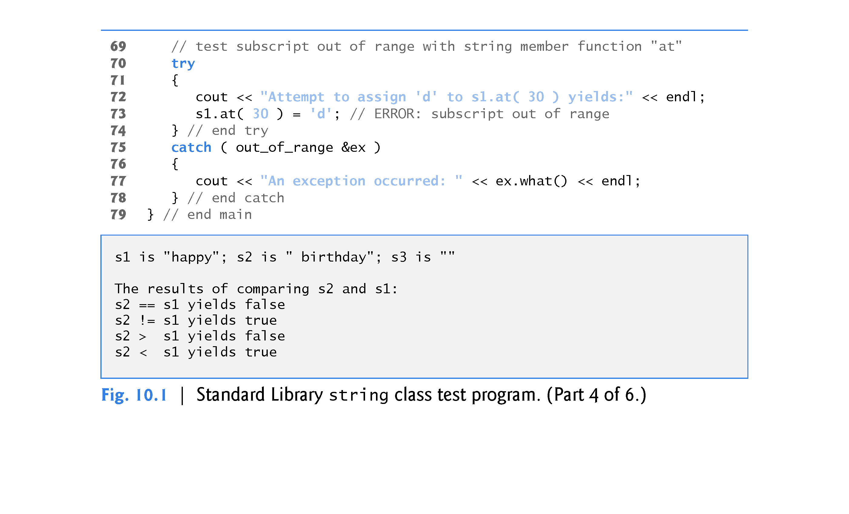

Slide 12
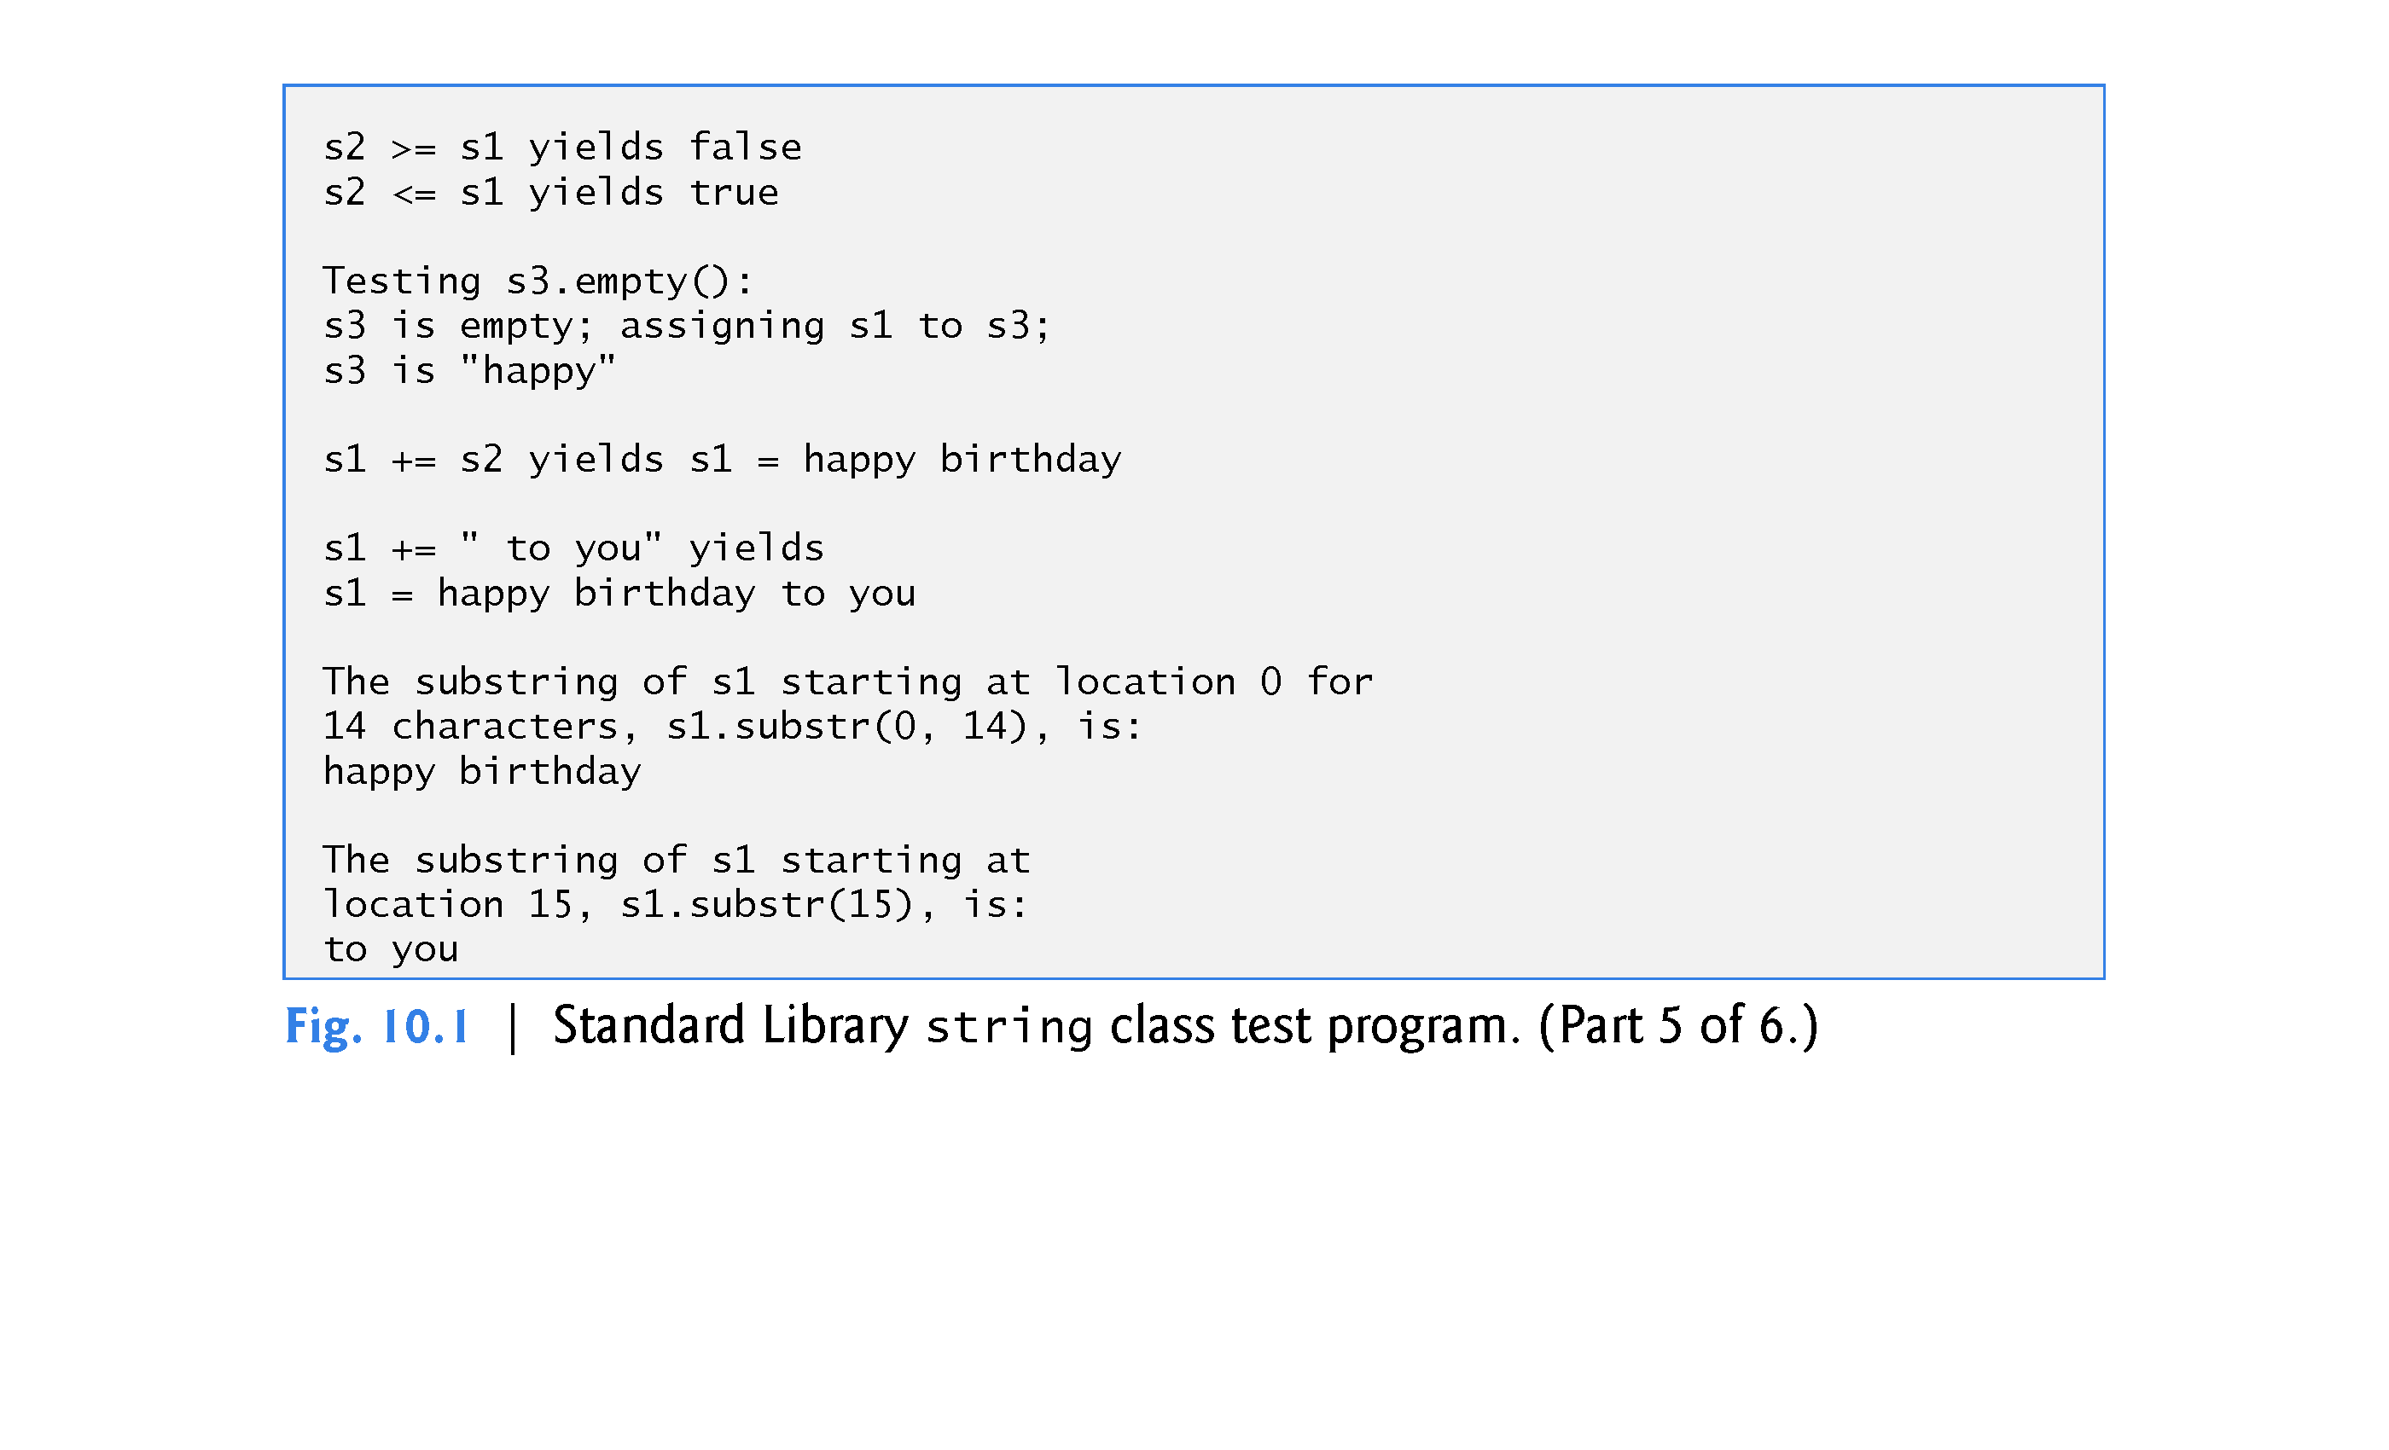

Slide 13
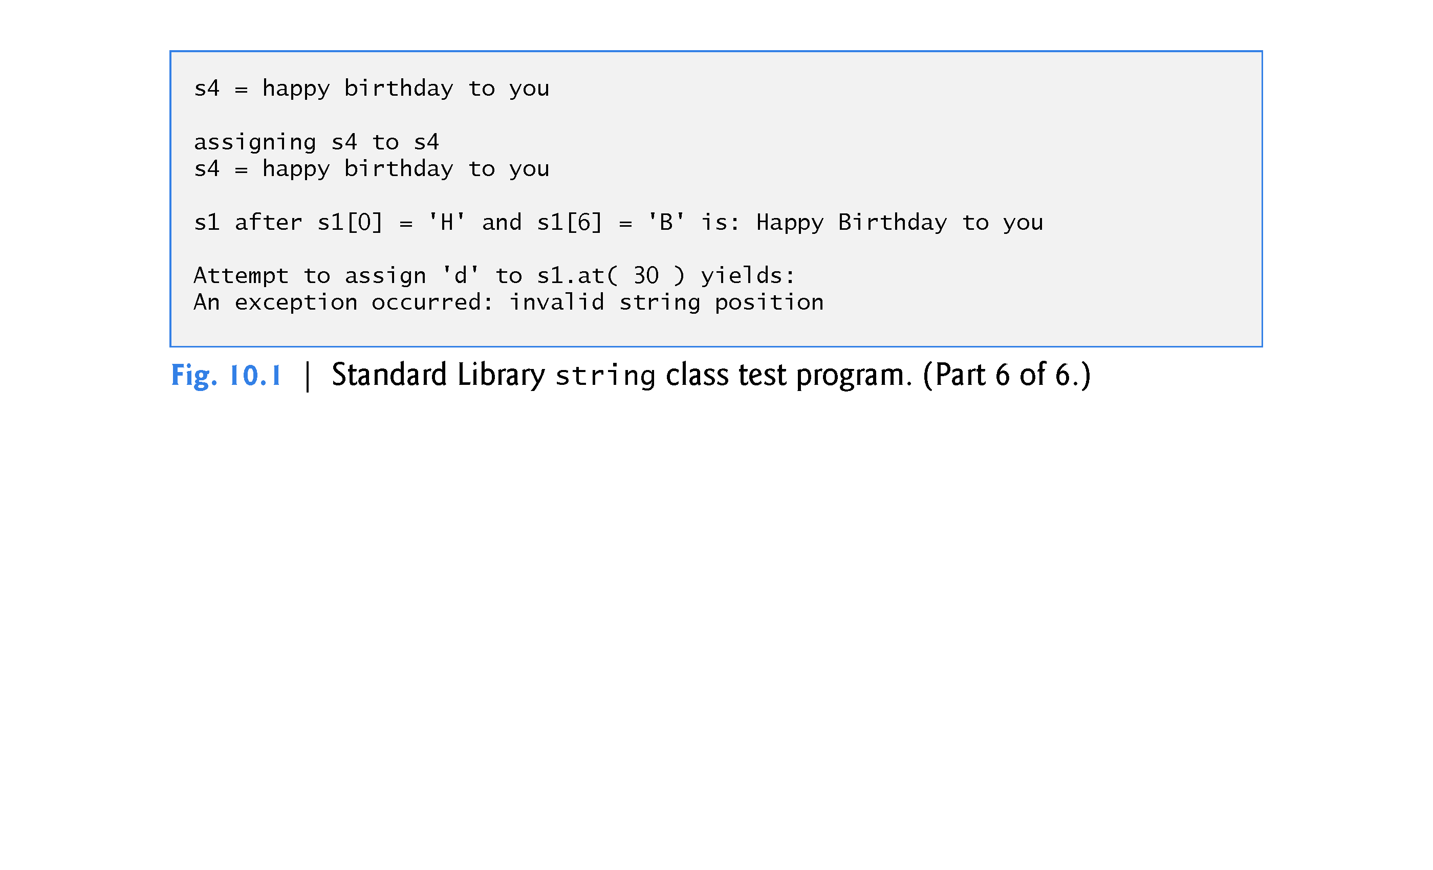

Slide 14
10.2 Using the Overloaded Operators of Standard Library Class string
Class string’s overloaded equality and relational operators perform lexicographical comparisons (i.e., like a dictionary ordering) using the numerical values (ordinal values) of the characters (see Appendix B, ASCII Character Set) in each string.
Class string provides member function empty to determine whether a string is empty, which we demonstrate in line 27.
Returns true if the string is empty; otherwise, it returns false.
Line 36 demonstrates class string’s overloaded += operator for string concatenation.
Line 41 demonstrates that a string literal can be appended to a string object by using operator +=. Line 42 displays the result.

Slide 15
10.2 Using the Overloaded Operators of Standard Library Class string
Class string provides member function substr (lines 47 and 52) to return a portion of a string as a string object.
The call to substr in line 47 obtains a 14-character substring (specified by the second argument) of s1 starting at position 0 (specified by the first argument).
The call to substr in line 52 obtains a substring starting from position 15 of s1.
When the second argument is not specified, substr returns the remainder of the string on which it’s called.
Lines 64-65 use class string’s overloaded [ ] operator can create lvalues that enable new characters to replace existing characters in s1.
Class string’s overloaded [ ] operator does not perform any bounds checking.

Slide 16
10.2 Using the Overloaded Operators of Standard Library Class string
Class string does provide bounds checking in its at( ) member function
function at throws an exception if its argument is an invalid subscript.
If the subscript is valid, function at returns the character at the specified location as a modifiable lvalue or a nonmodifiable lvalue (e.g., a const reference), depending on the context in which the call appears.
lvalue versus rvalue

Slide 17
10.3 Fundamentals of Operator Overloading
Operators provide a concise notation for manipulating string objects.
You can use operators with your own user-defined types as well.
C++ does not allow new operators to be created; it does allow most existing operators to be overloaded

Slide 18
10.3 Fundamentals of Operator Overloading
Operator overloading is not automatic - you must write operator-overloading functions to perform the desired operations.
An operator is overloaded by writing
a non-static member function definition or
non-member function definition as you normally would [friend function]
except that the function name starts with the keyword operator followed by the symbol for the operator being overloaded.
For example, the function name operator+ would be used to overload the addition operator (+) for use with objects of a particular class (or enum).

Slide 19
10.3 Fundamentals of Operator Overloading
When operators are overloaded as member functions, they must be non-static, because they must be called on an object of the class and operate on that object.
To use an operator on class objects, you must define overloaded operator functions for that class - with three exceptions.
The assignment operator (=) may be used with most classes to perform memberwise assignment of the data members—each data member is assigned from the assignment’s “source” object (on the right) to the “target” object (on the left).
Memberwise assignment is dangerous for classes with pointer members, so we’ll explicitly overload the assignment operator for such classes.
The address operator (&) returns a pointer to an object; this operator also can be overloaded.
The comma operator (,) evaluates the expression to its left then the expression to its right, and returns the value of the latter expression.

Slide 20
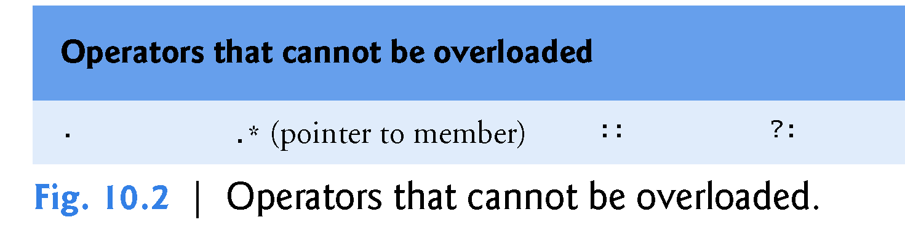

Slide 21
10.3 Fundamentals of Operator Overloading
precedence of an operator cannot be changed by overloading
However, parentheses can be used to force the order of evaluation of overloaded operators in an expression.
associativity of an operator cannot be changed by overloading
if an operator normally associates from left to right, then so do all of its overloaded versions.
arity of an operator (that is, the number of operands an operator takes) cannot be changed by overloading
overloaded unary operators remain unary operators; overloaded binary operators remain binary operators. Operators &, *, + and - all have both unary and binary versions; these unary and binary versions can be separately overloaded.

Slide 22
10.3 Fundamentals of Operator Overloading
You cannot create new operators; only existing operators can be overloaded.
The meaning of how an operator works on values of fundamental types cannot be changed by operator overloading.
For example, you cannot make the + operator subtract two ints.
Operator overloading works only with objects of user-defined types or with a mixture of an object of a user-defined type and an object of a fundamental type.

Slide 23
10.3 Fundamentals of Operator Overloading
Related operators, like + and += must be overloaded separately.
Overloading + does NOT automatically overload +=
When overloading ( ), [ ], -> or any of the assignment operators, the operator overloading function must be declared as a class member.
For all other overloadable operators, the operator overloading functions can be member functions or non-member functions.

Slide 24
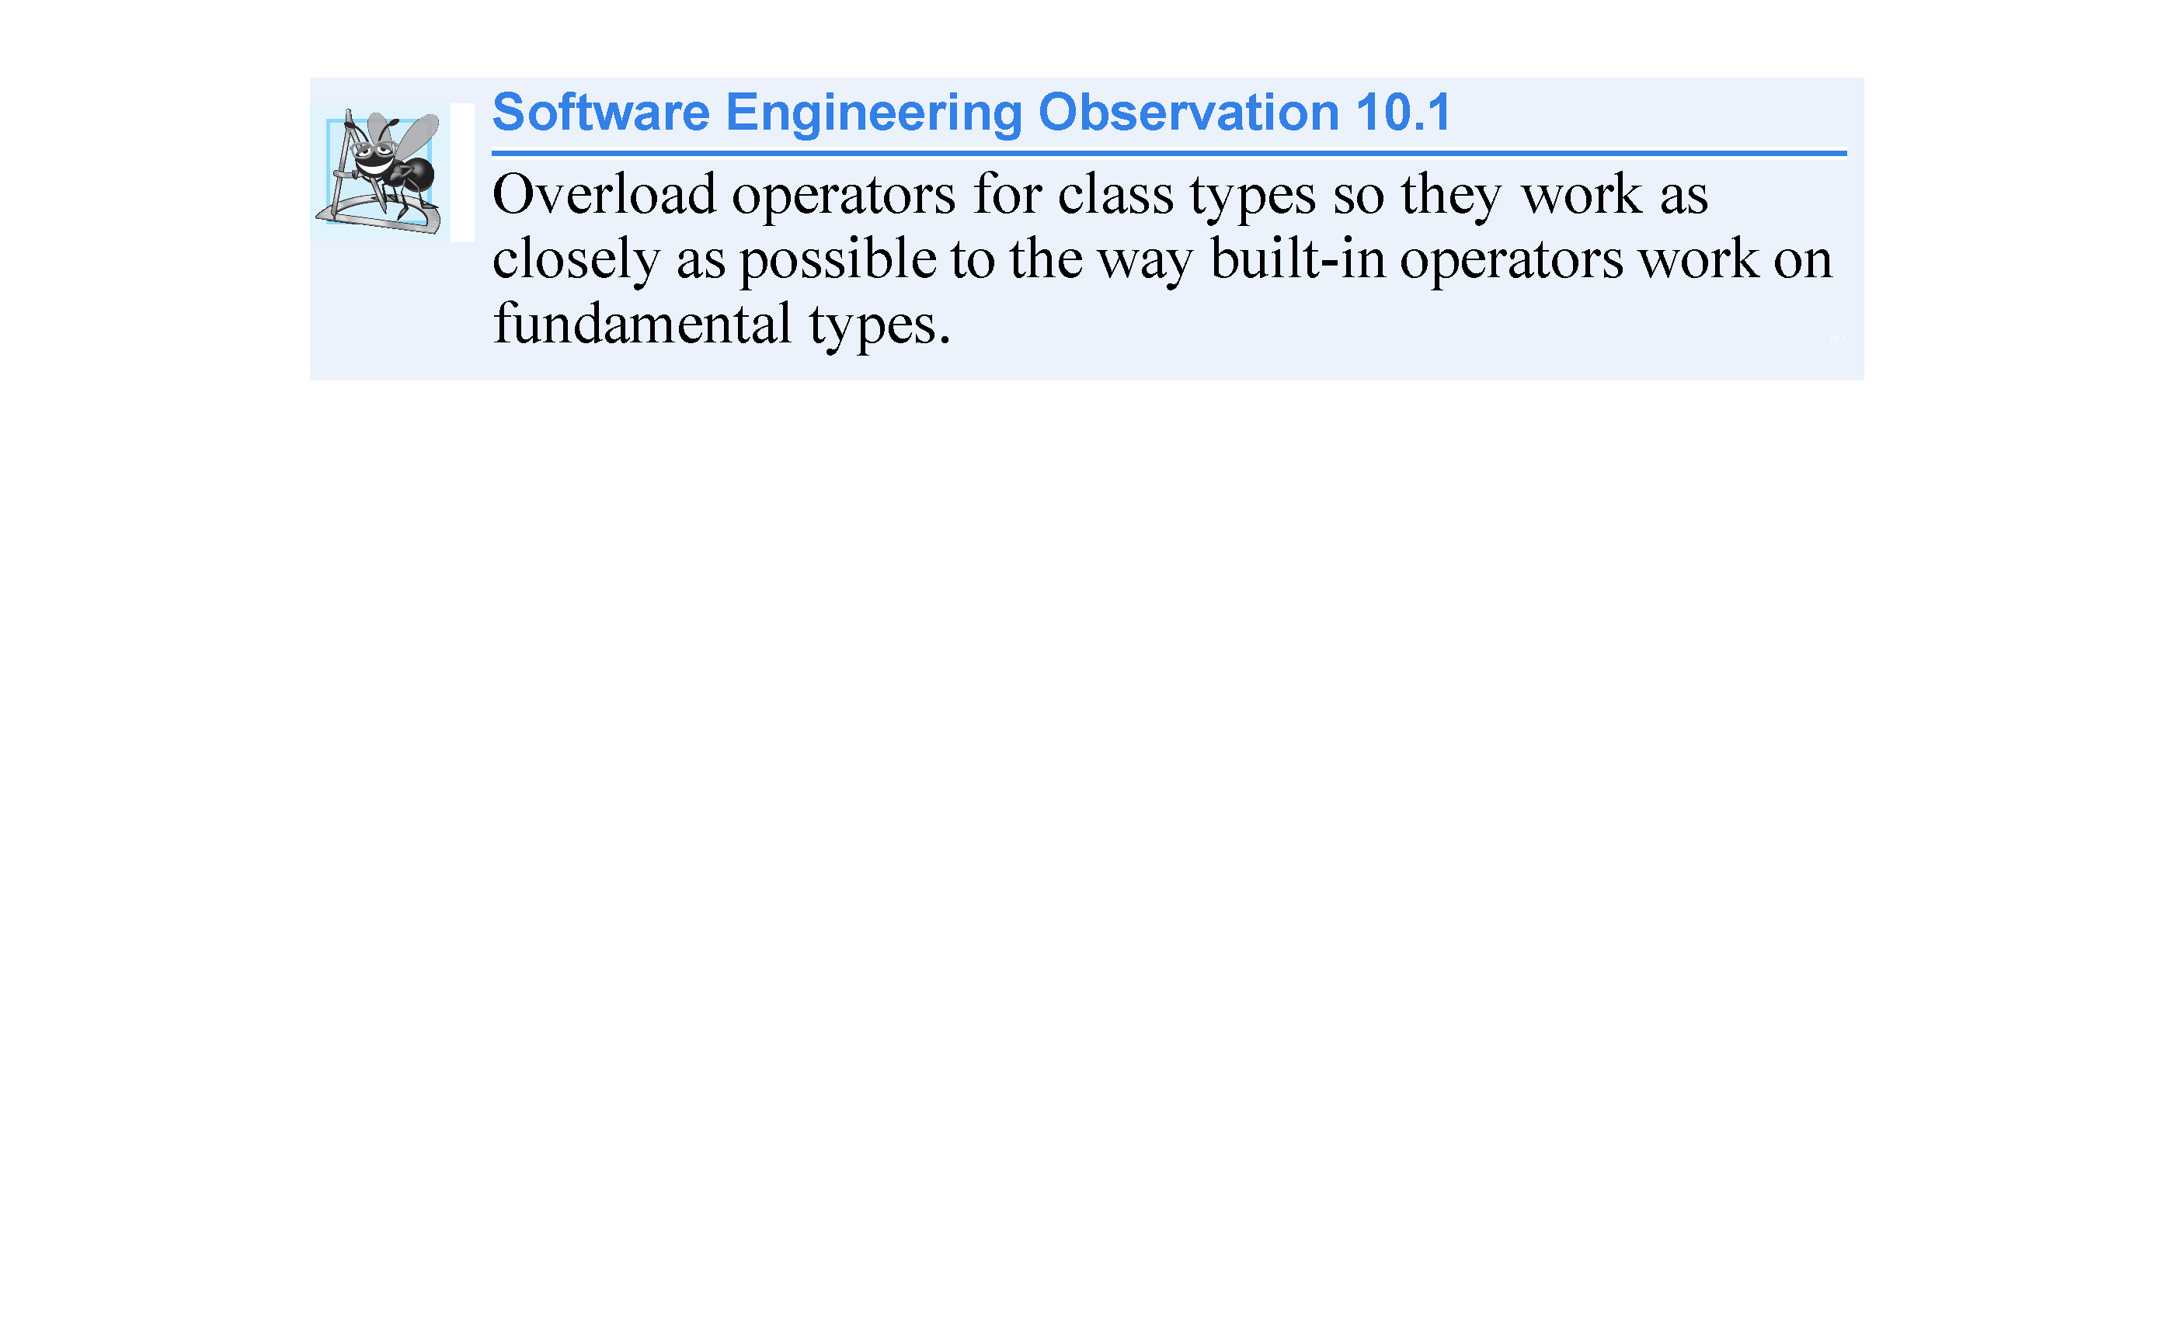

Slide 25
10.4 Overloading Binary Operators
A binary operator can be overloaded as:
non-static member function with one parameter
non-member function with two parameters (one of those parameters must be either a class object or a reference to a an object of the class.

Slide 26
10.5 Overloading the Binary Stream Insertion and Stream Extraction Operators
You can input and output fundamental-type data using the stream extraction operator >> and the stream insertion operator <<.
The C++ class libraries overload these binary operators for each fundamental type.
You can also overload these operators to perform input and output for your own types.
The program of Figs. 10.3–10.5 overloads these operators to input and output PhoneNumber objects in the format “(000) 000-0000.” The program assumes telephone numbers are input correctly.

Slide 27
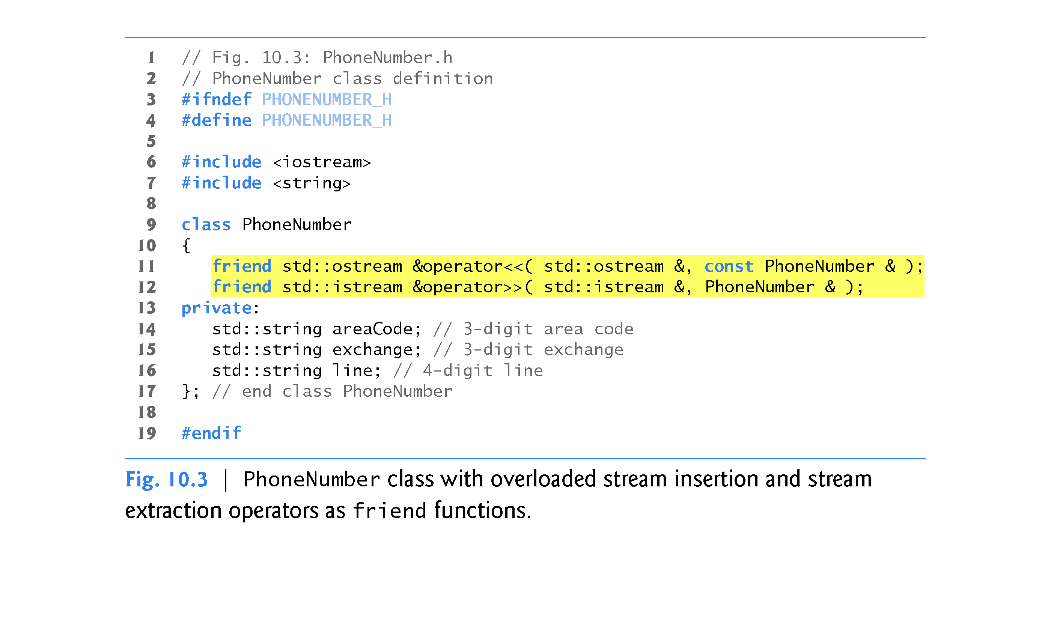

Slide 28
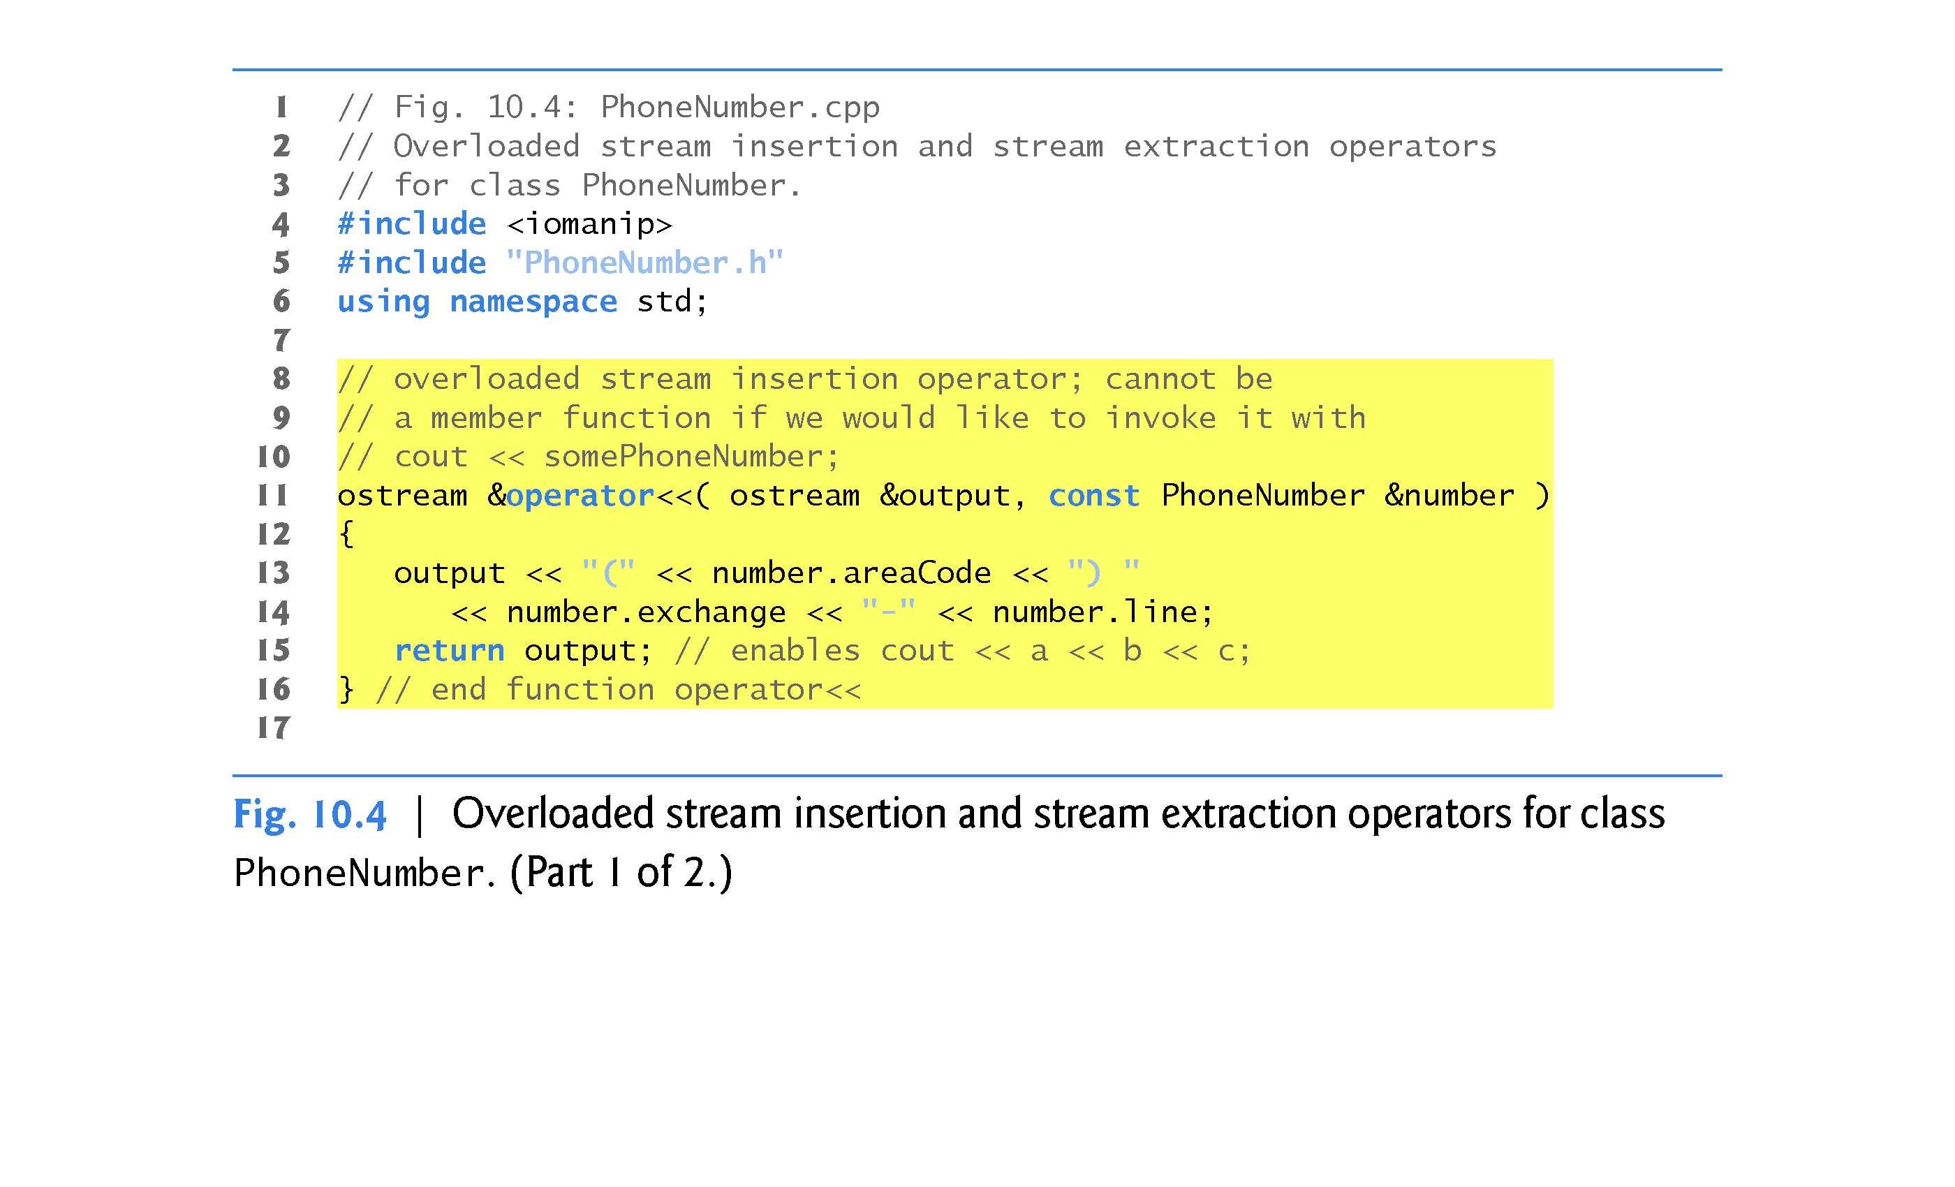

Slide 29
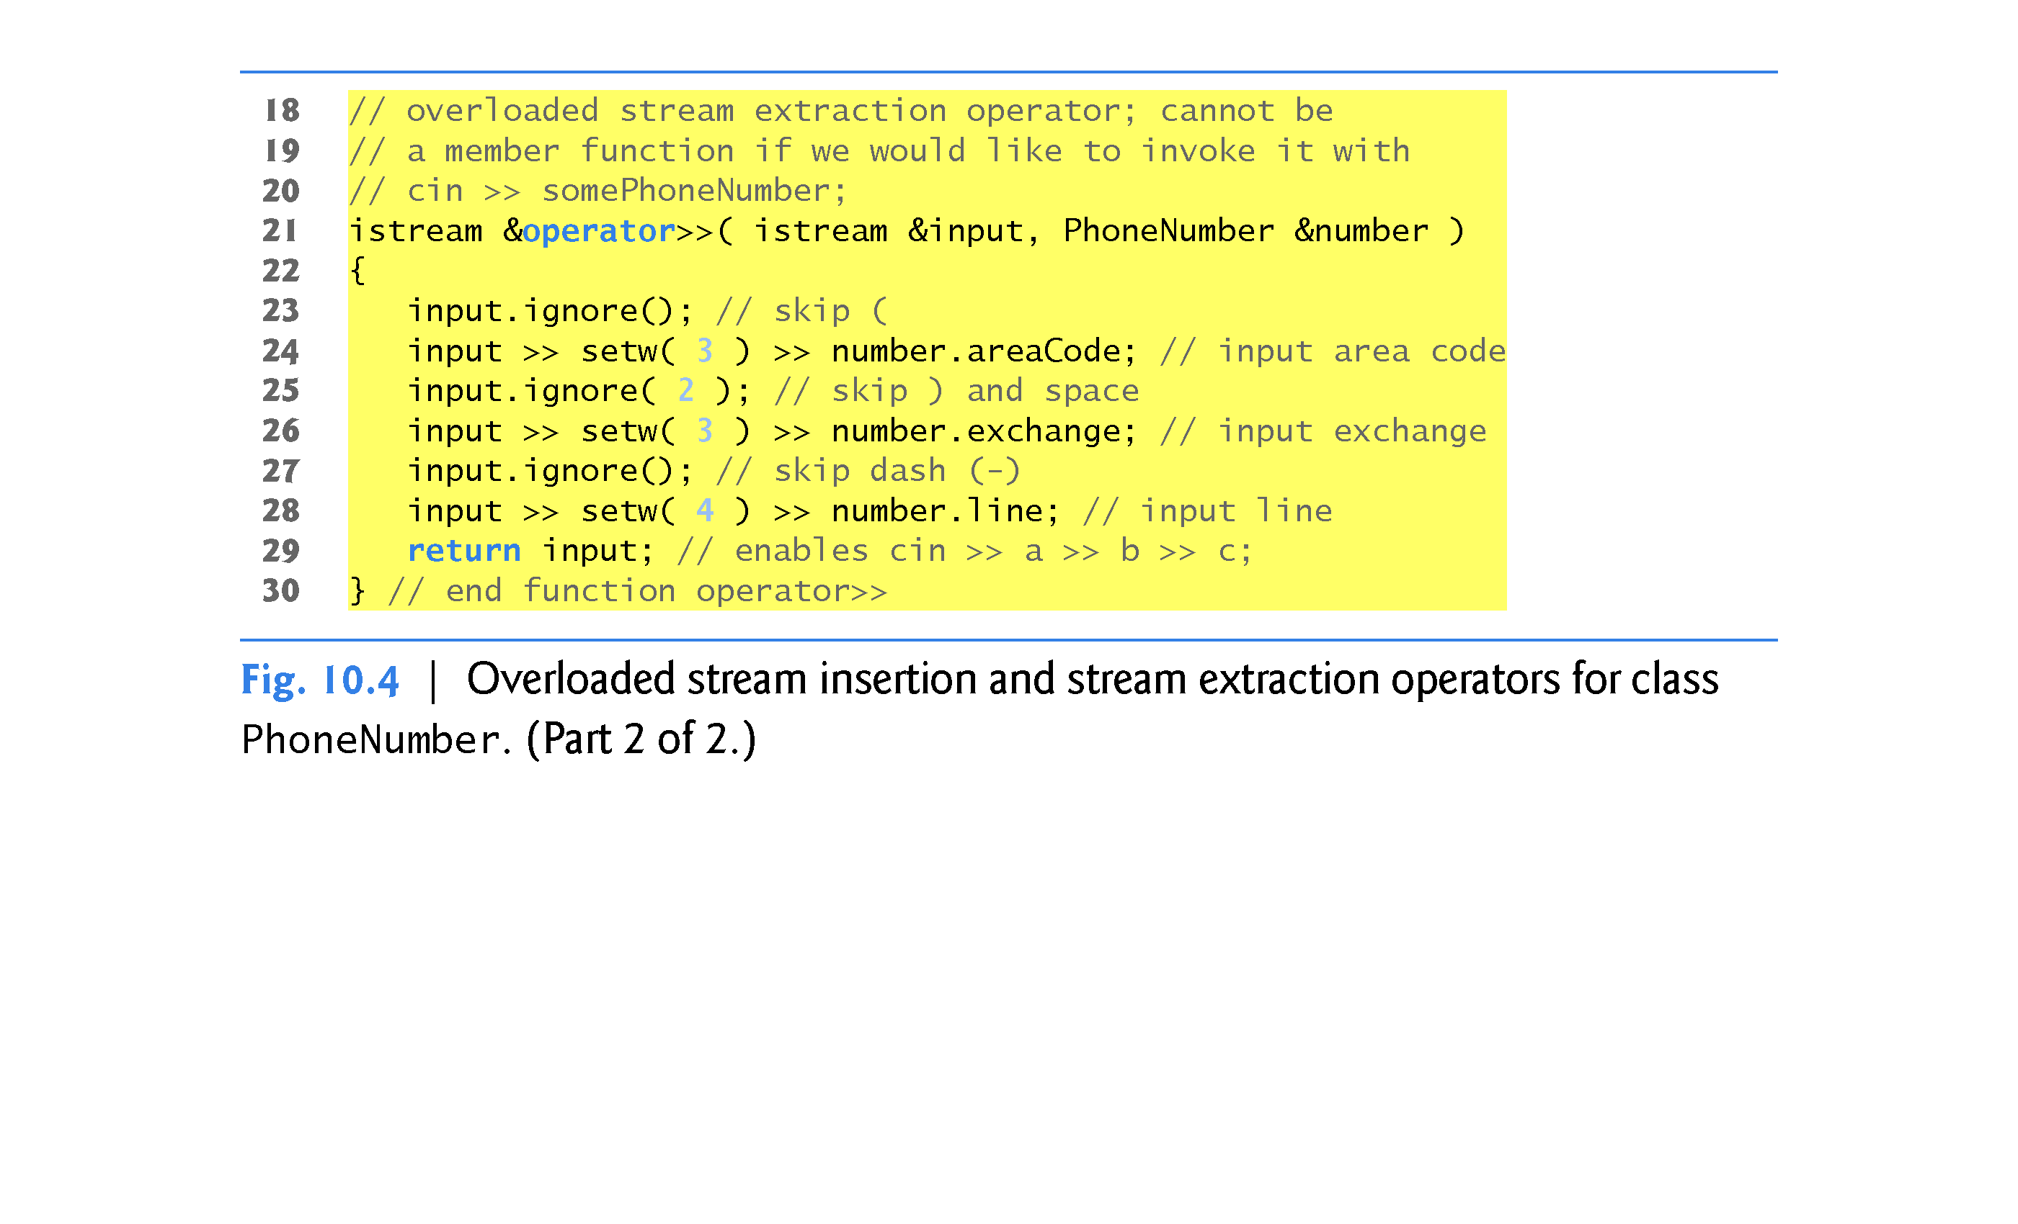

Slide 30
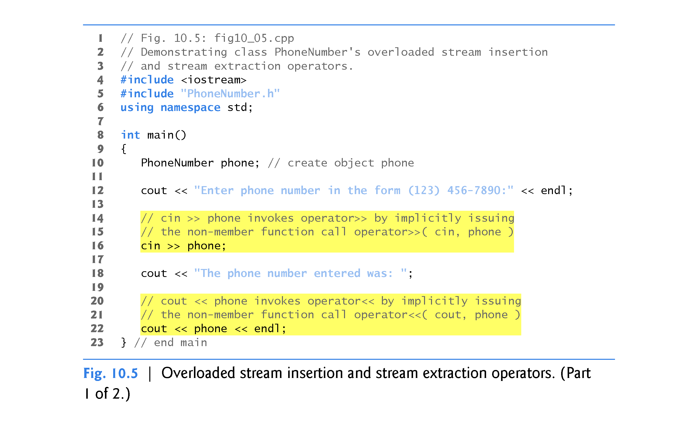

Slide 31
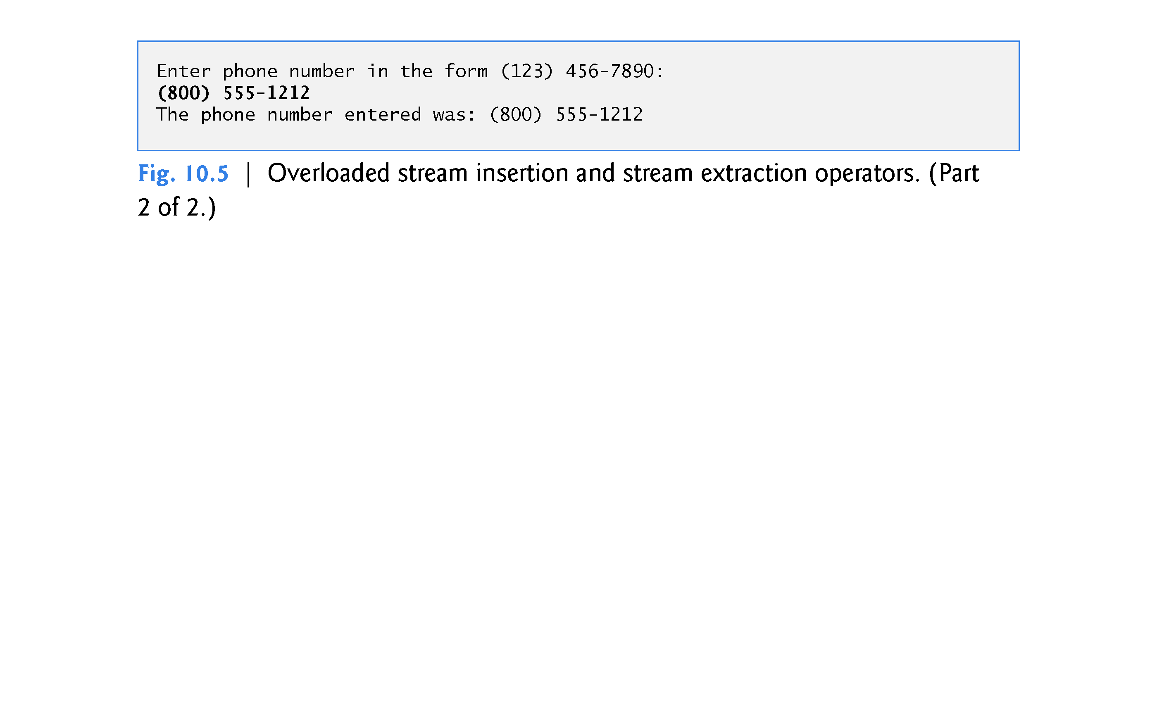

Slide 32
10.5 Overloading the Binary Stream Insertion and Stream Extraction Operators
Overloading the Stream Extraction (>>) Operator
The stream extraction operator function operator>> (Fig. 10.4, lines 21–30) takes istream reference input and PhoneNumber reference number as arguments and returns an istream reference.
Operator function operator>> inputs phone numbers of the form
(800) 555-1212
When the compiler sees the expression
cin >> phone
In line 16 of Fig. 10.5, the compiler generates the non-member function call
operator >> ( cin, phone ); //spaces before/after >> are ok
When this call executes, reference parameter input (Fig. 10.4, line 21) becomes an alias for cin and reference parameter number becomes an alias for phone.

Slide 33
10.5 Overloading the Binary Stream Insertion and Stream Extraction Operators
The operator >> function reads as strings the three parts of the telephone number into the areaCode (line 24), exchange (Line 26) and line (line 28) members of the PhoneNumber object referenced by parameter Number.
Stream manipulator setw limits the number of characters read into each string.
The parentheses, space and dash characters are skipped by calling istream member function ignore (Fig. 10.4, lines 23, 25 and 27), which discards the specified number of characters in the input stream (one character by default).

Slide 34
10.5 Overloading the Binary Stream Insertion and Stream Extraction Operators
Function operator >> returns a reference to an istream object (i.e., cin) or derived classes of istream [such as ifstream]
This enables input operations on PhoneNumber objects to be cascaded with input operations on other PhoneNumber objects or on objects of other data types.
Example:
int x; double y; PhoneNumber phone;
cin >> x >> y >> phone;

Slide 35
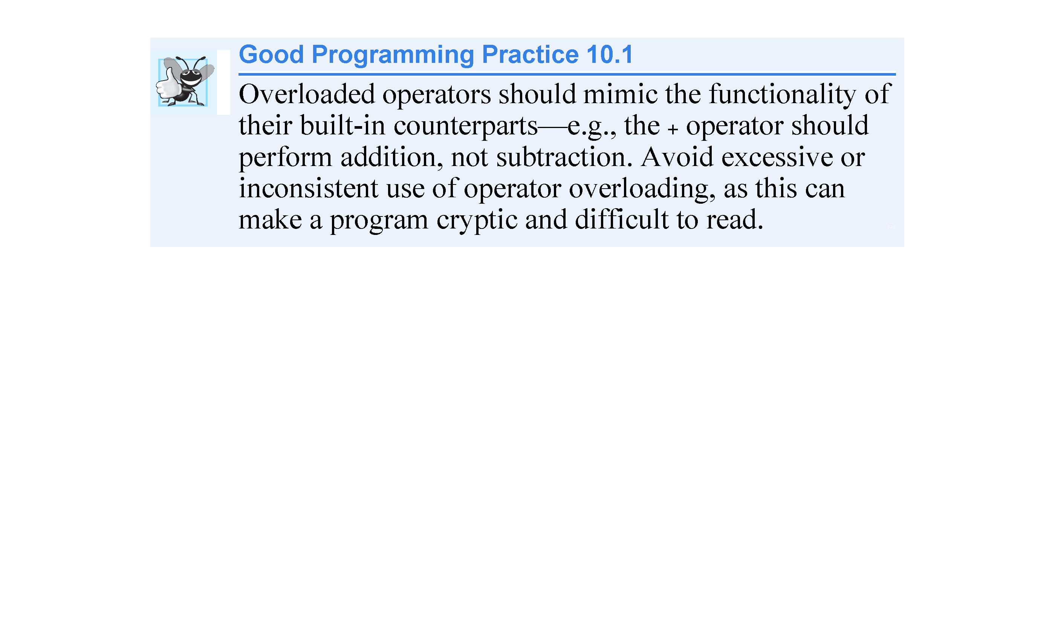

Slide 36
10.5 Overloading the Binary Stream Insertion and Stream Extraction Operators
Overloading the Stream Insertion (<<) Operator operator <<
The stream insertion operator function (Fig. 10.4, lines 11-16) takes an ostream reference (output) and a const PhoneNumber reference (number) as arguments and returns an ostream reference or a subclass of ostream [such as ofstream]
Function operator<< displays objects of type PhoneNumber.
When the compiler sees the expression
cout << phone
the compiler generates the non-member function call
operator << ( cout, phone ); //spaces before/after << are ok
Function operator<< displays the parts of the telephone number as strings, because they’re stored as string objects.

Slide 37
10.5 Overloading the Binary Stream Insertion and Stream Extraction Operators
Overload these operators as Non-Member friend Functions
The functions operator>> and operator<< are declared in PhoneNumber as non-member, friend functions.
They’re non-member functions because the object of class PhoneNumber is the operator’s right operand.

Slide 38
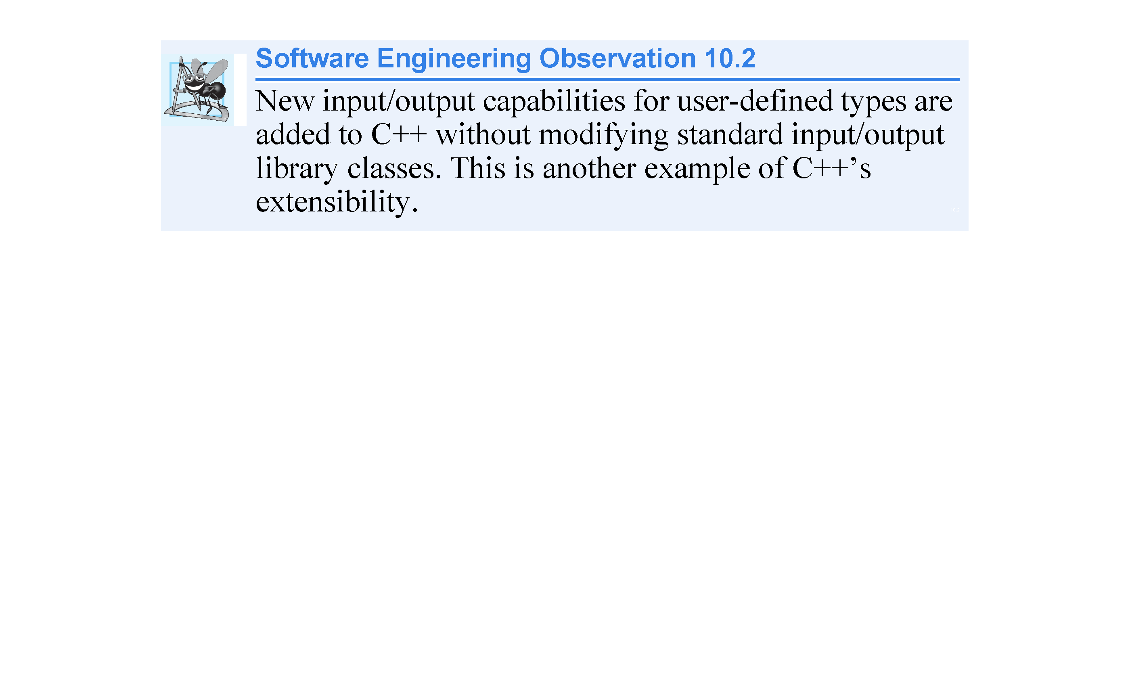

Slide 39
10.5 Overloading the Binary Stream Insertion and Stream Extraction Operators
Why overloaded stream insertion and stream extraction operators are overloaded as non-member friend functions:
The overloaded stream insertion operator (<<) is used in an expression in which the left operand has type ostream&, as in cout << classObject;
To use the operator in this manner where the right operand is an object of a user-defined class, it must be overloaded as a non-member function.

Slide 40
10.5 Overloading the Binary Stream Insertion and Stream Extraction Operators
Similarly, the overloaded stream extraction operator (>>) is used in an expression in which the left operand has type istream&, as in cin >> classObject; and the right operand is an object of a user-defined class, it must also be overloaded as a non-member function.
Each of these overloaded operator functions may require access to the private data members of the class object being output or input, in which case these overloaded operator functions must be made friend functions of the class.

Slide 41
10.6 Overloading Unary Operators
A unary operator for a class can be overloaded as:
a non-static member function with no arguments
a non-member function with one argument that must be an object (or a reference to an object) of the class.
A unary operator such as ! may be overloaded as a non-member function with one parameter.

Slide 42
10.7 Overloading the Unary Prefix and Postfix ++ and -- Operators
The prefix and postfix versions of the increment and decrement operators can all be overloaded.
To overload the increment operator to allow both prefix and postfix increment usage, each overloaded operator function must have a distinct signature, so that the compiler will be able to determine which version of ++ is intended.
The prefix versions are overloaded exactly as any other prefix unary operator would be.

Slide 43
10.7 Overloading the Unary Prefix and Postfix ++ and -- Operators
Suppose that we want to add 1 to the day in Date object d1.
When the compiler sees the preincrementing expression ++d1, the compiler generates the member-function call
d1.operator++( )
The prototype for this operator function would be
Date & operator++( );
If the prefix increment operator is implemented as a non-member function, then, when the compiler sees the expression ++d1, the compiler generates the function call
operator++( d1 )
The prototype for this operator function would be declared in the Date class as
Date & operator++( Date & );

Slide 44
10.7 Overloading the Unary Prefix and Postfix ++ and -- Operators
Overloading the Postfix Increment Operator
Overloading the postfix increment operator presents a challenge, because the compiler must be able to distinguish between the signatures of the overloaded prefix and postfix increment operator functions.
The convention that has been adopted in C++ is that, when the compiler sees the postincrementing expression d1++, it generates the member-function call
d1.operator++( 0 )
The prototype for this function is
Date operator++( int )
The argument 0 is strictly a “dummy value” that enables the compiler to distinguish between the prefix and postfix increment operator functions.
The same syntax is used to differentiate between the prefix and postfix decrement operator functions.

Slide 45
10.7 Overloading the Unary Prefix and Postfix ++ and -- Operators
If the postfix increment is implemented as a non-member function, then, when the compiler sees the expression d1++, the compiler generates the function call
operator++( d1, 0 )
The prototype for this function would be
Date operator++( Date &, int );
Once again, the 0 argument is used by the compiler to distinguish between the prefix and postfix increment operators implemented as non-member functions.
The postfix increment operator returns Date objects by value, whereas the prefix increment operator returns Date objects by reference—the postfix increment operator typically returns a temporary object that contains the original value of the object before the increment occurred.

Slide 46
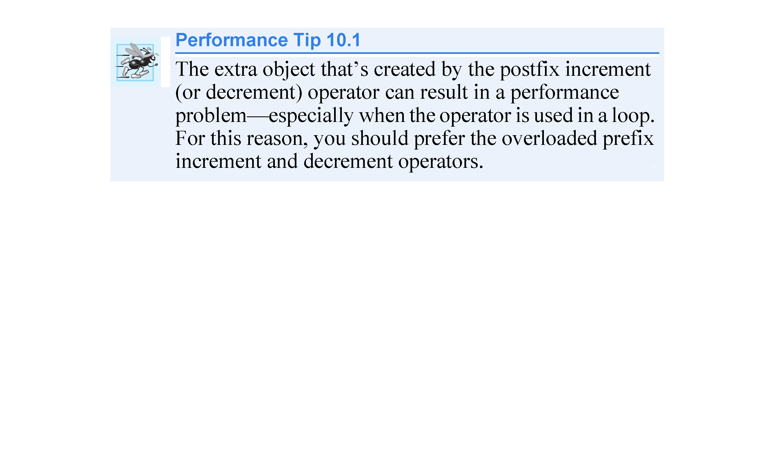

Slide 47
10.8 Case Study: A Date Class
The program of Figs. 10.6 – 10.8 demonstrates a Date class, which uses overloaded prefix and postfix increment operators to add 1 to the day in a Date object, while causing appropriate increments to the month and year if necessary.

Slide 48
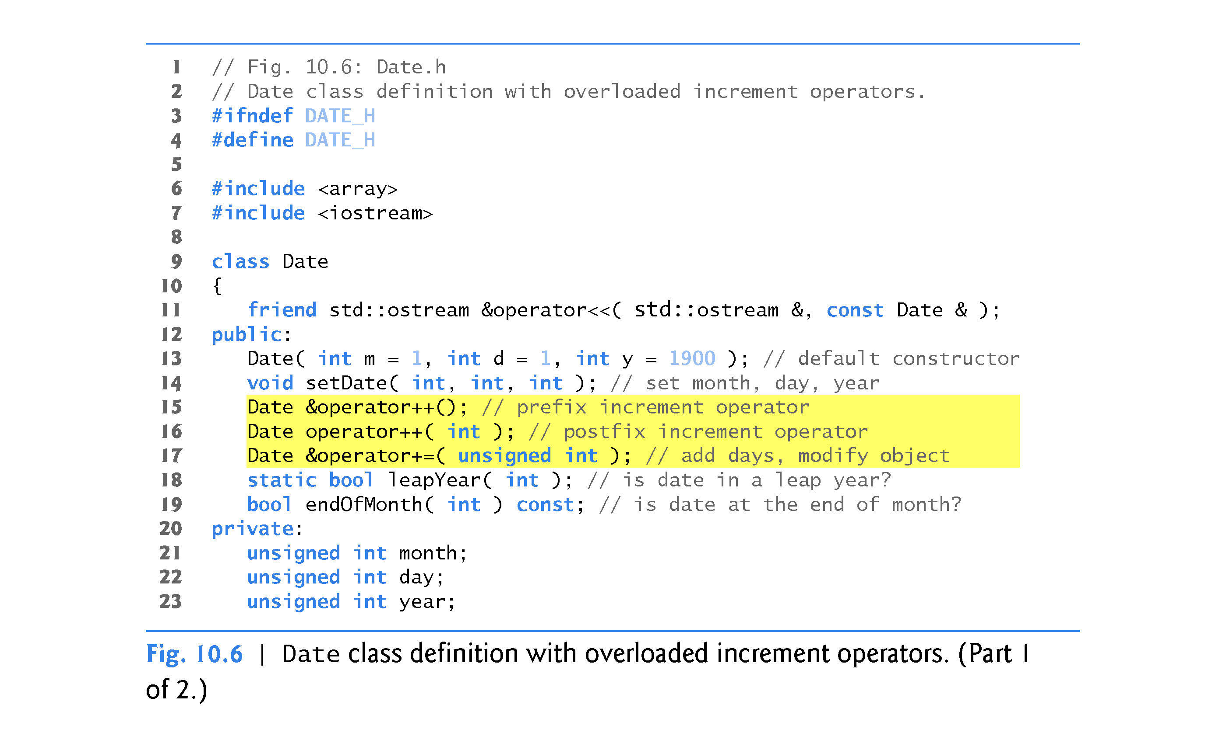

Slide 49
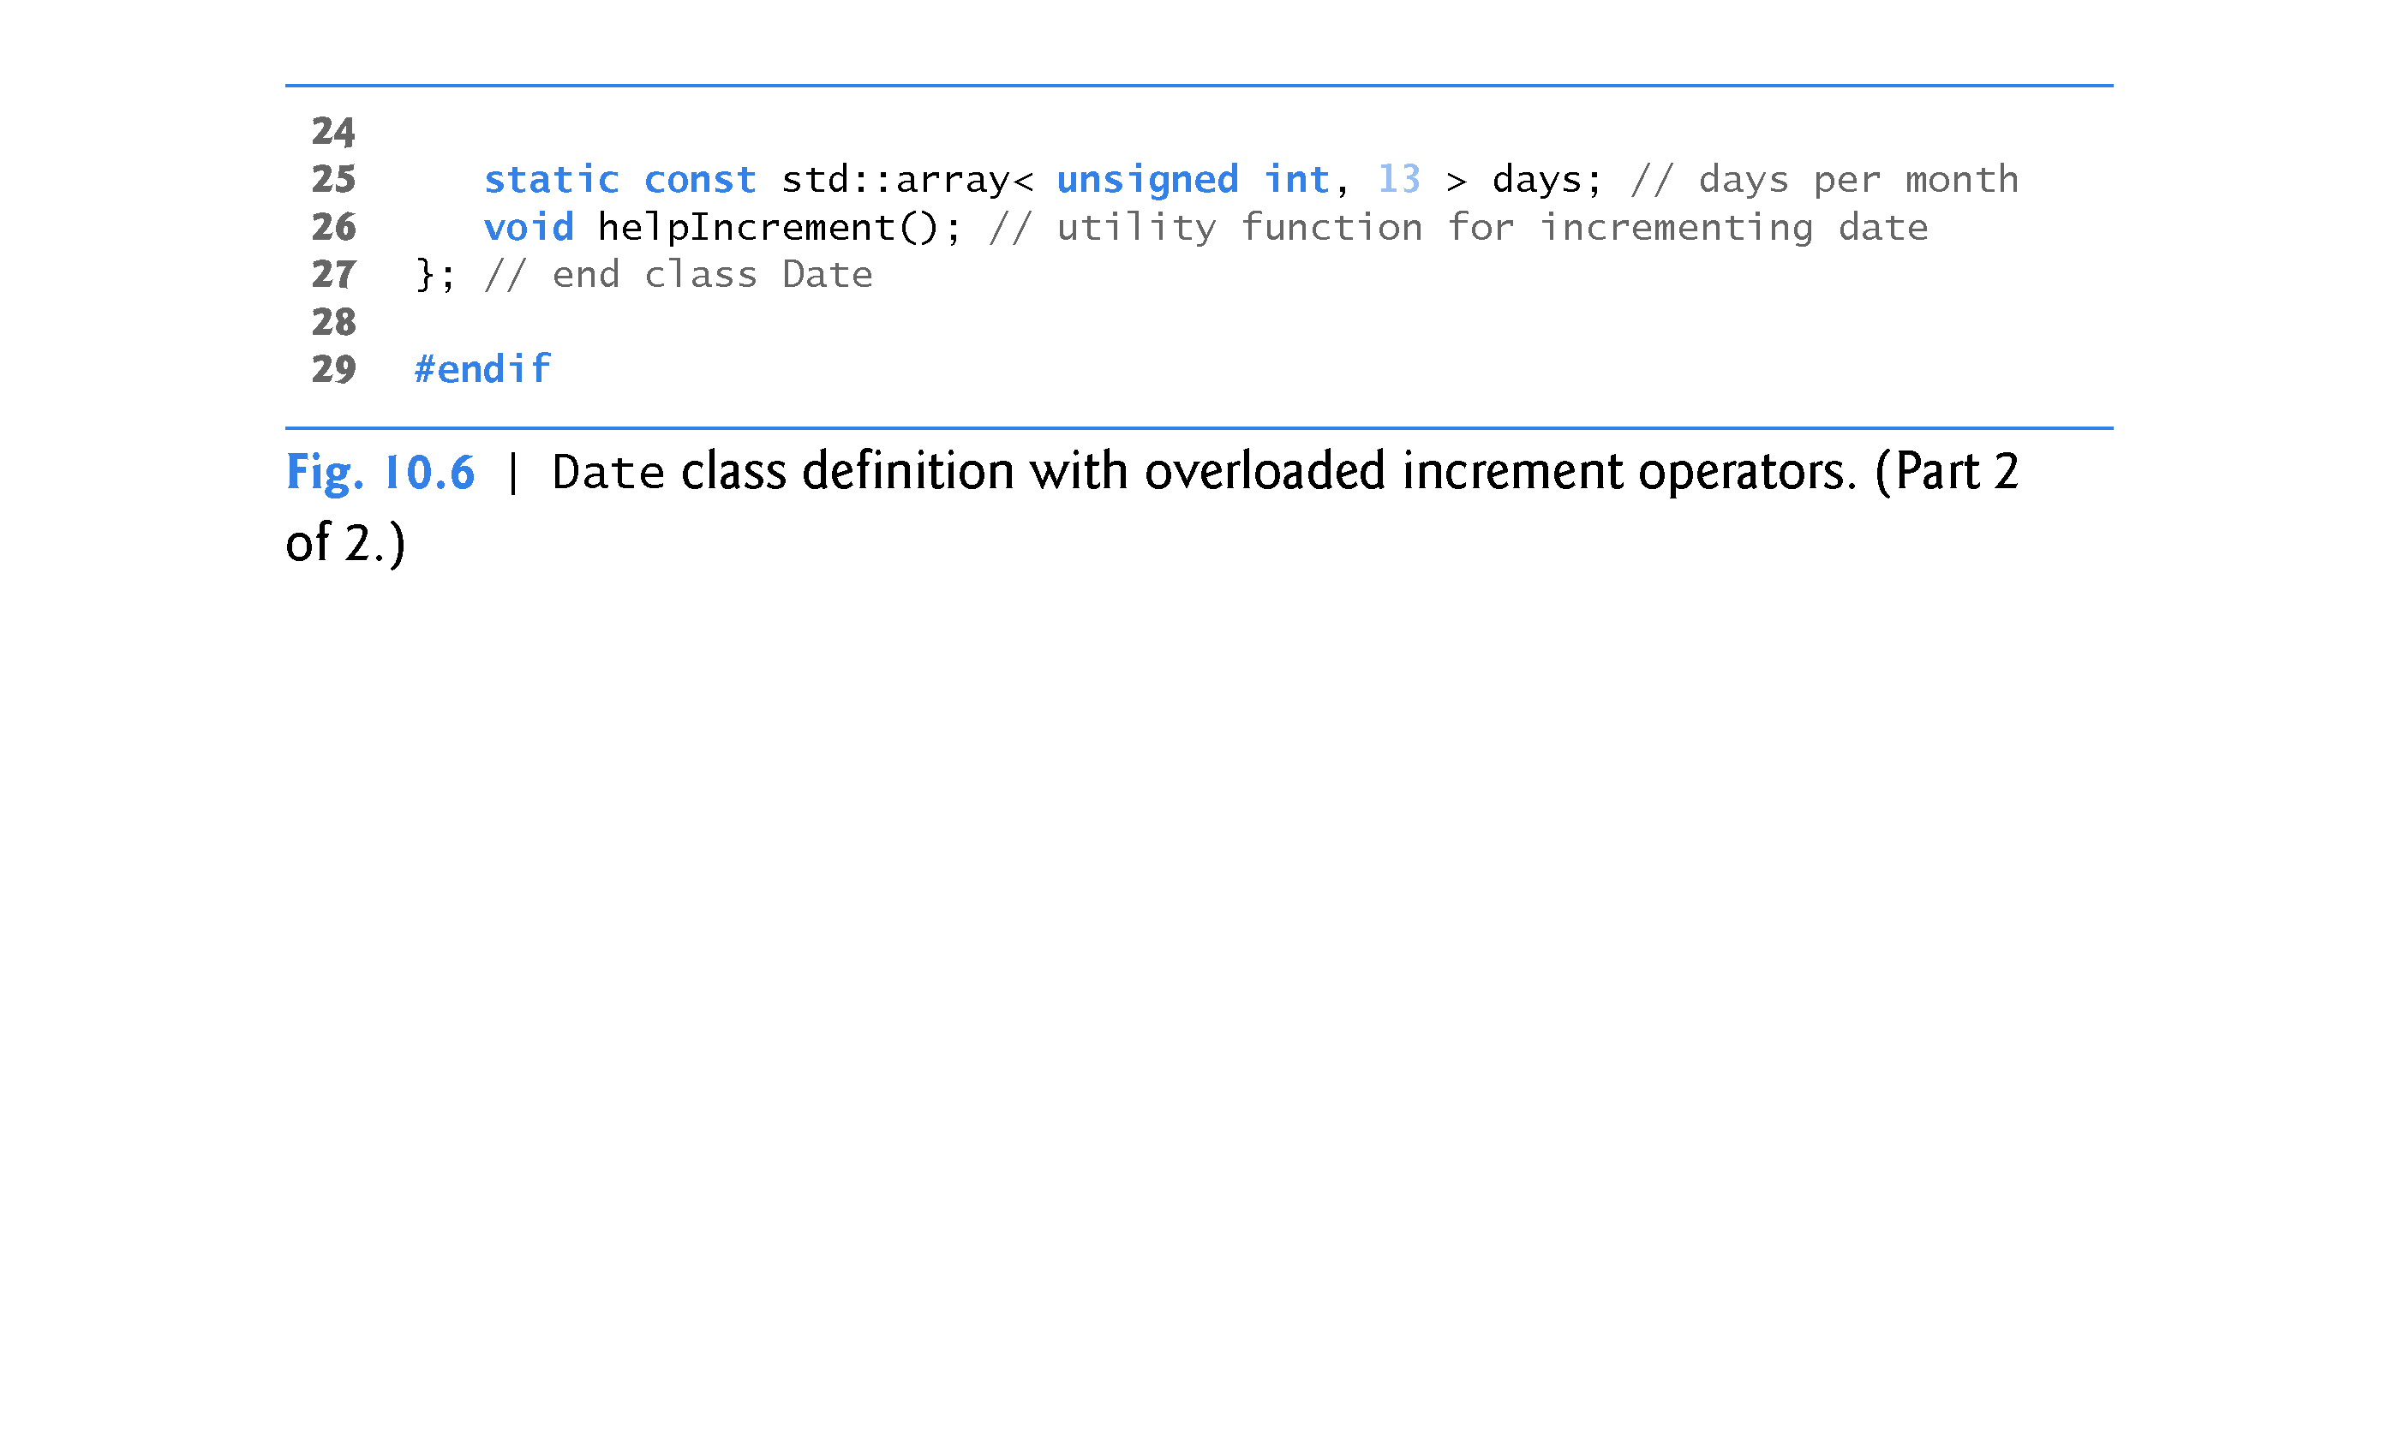

Slide 50
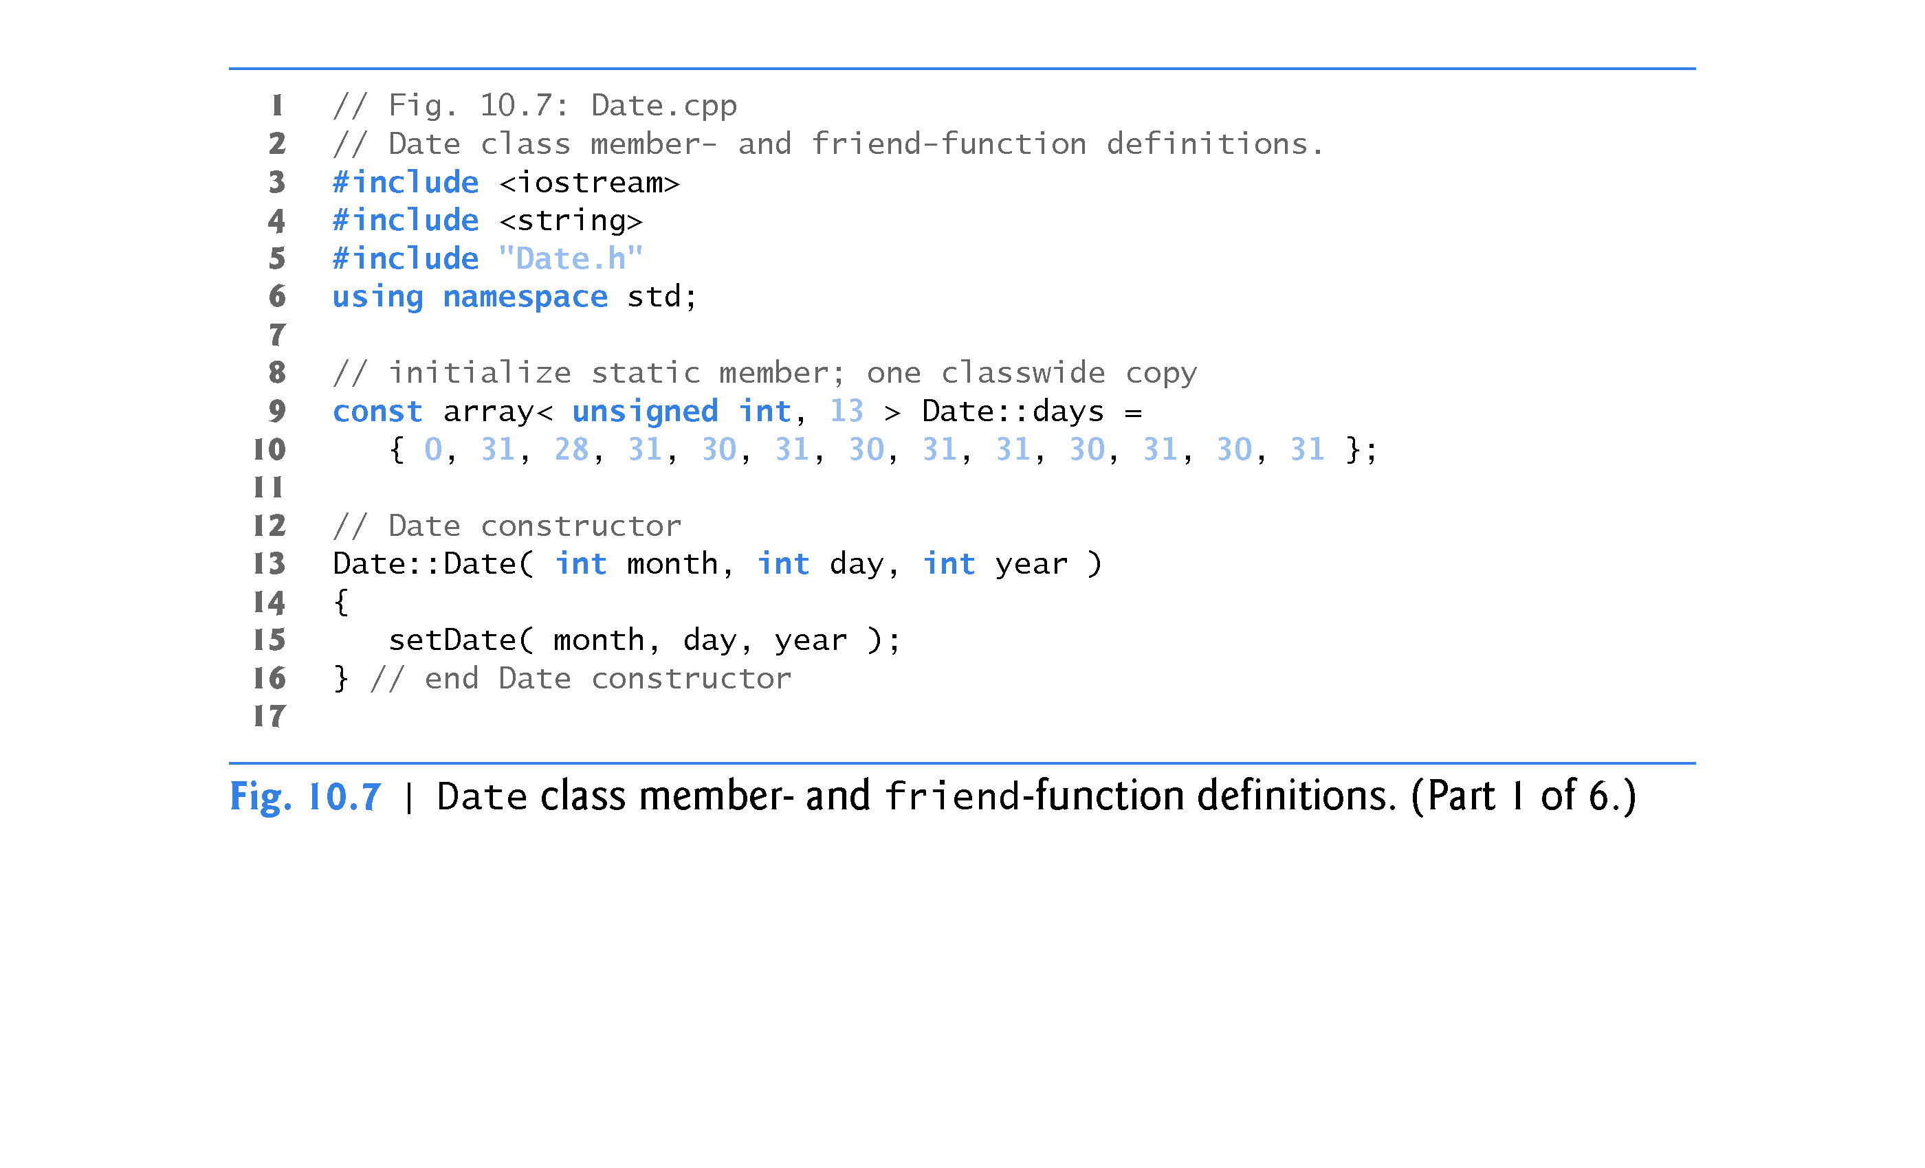

Slide 51
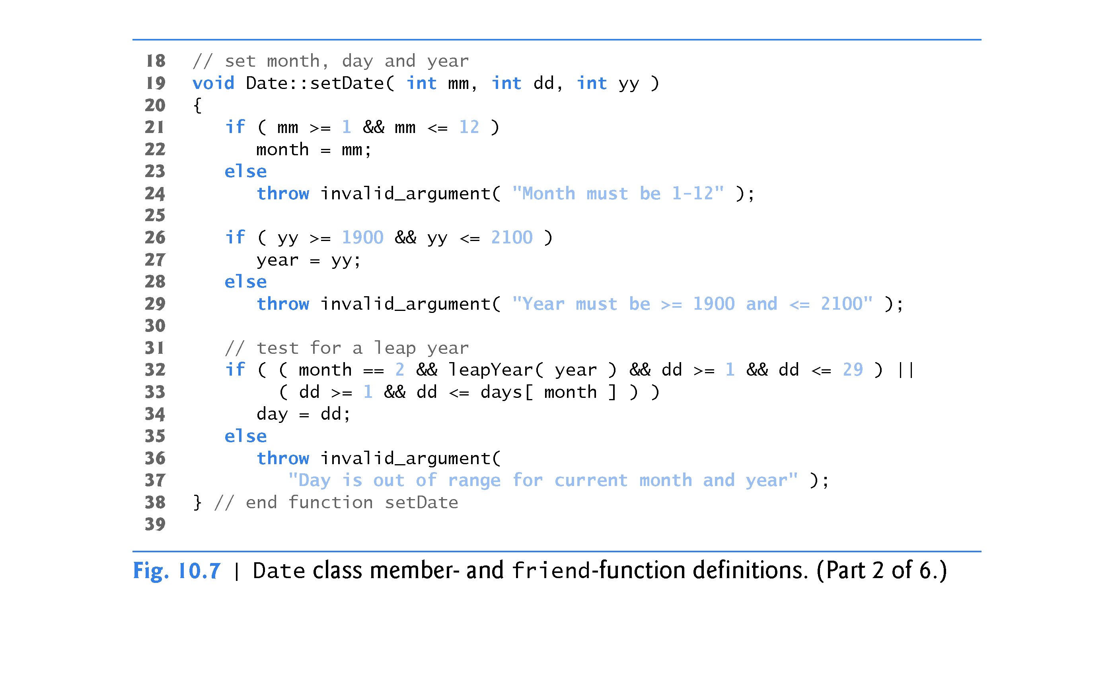

Slide 52
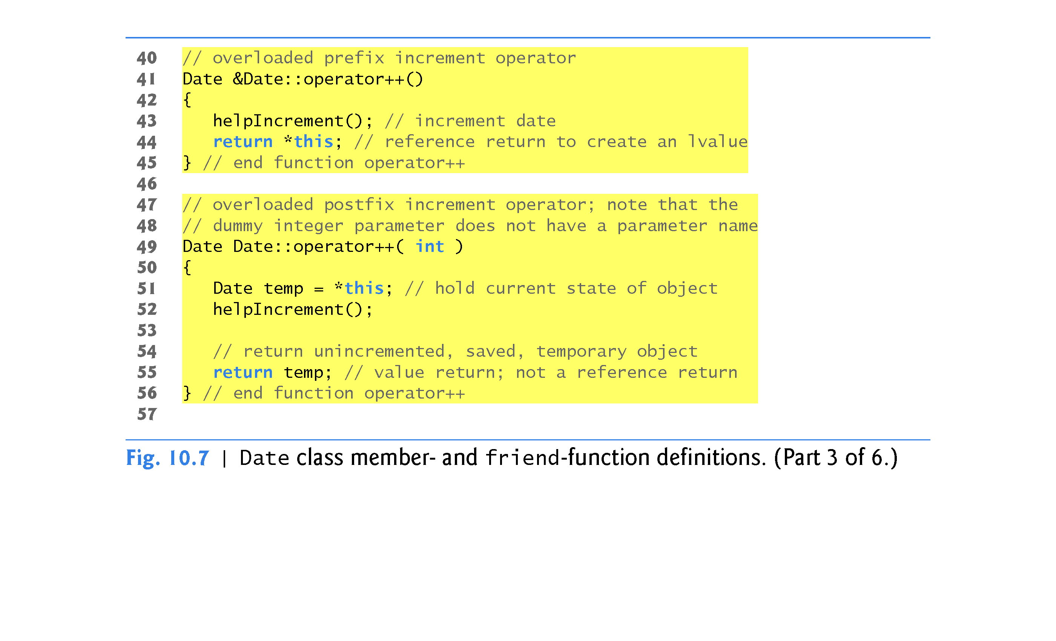

Slide 53
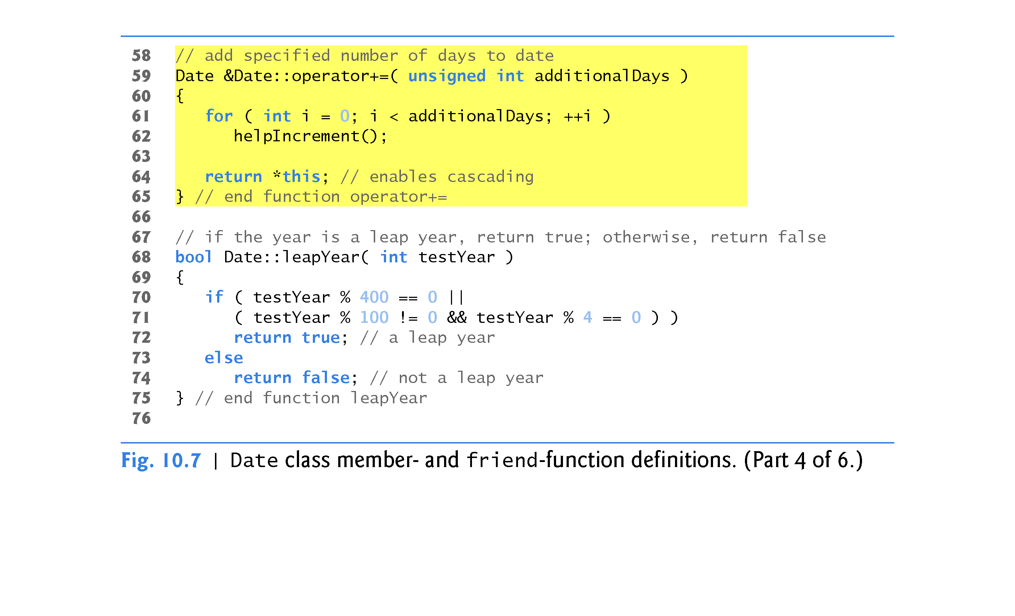

Slide 54
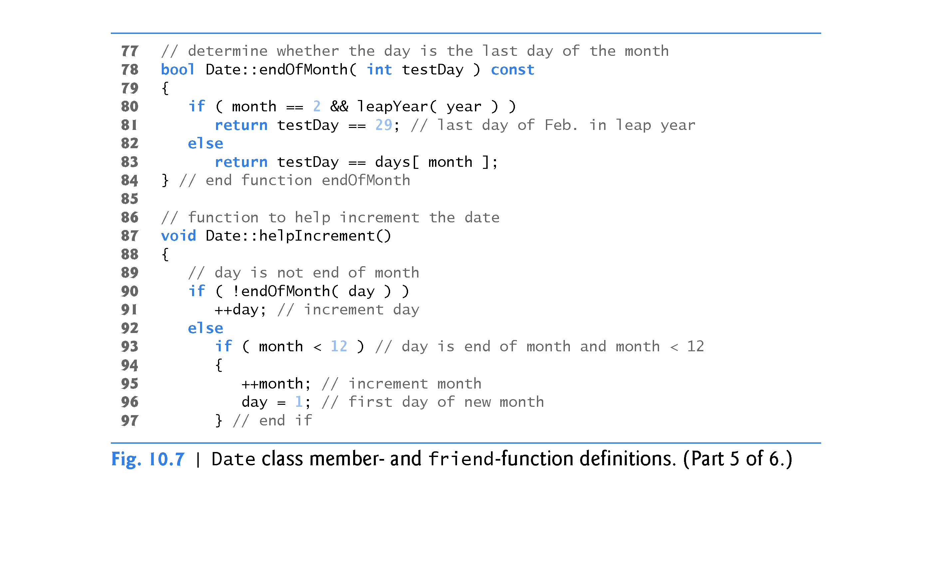

Slide 55
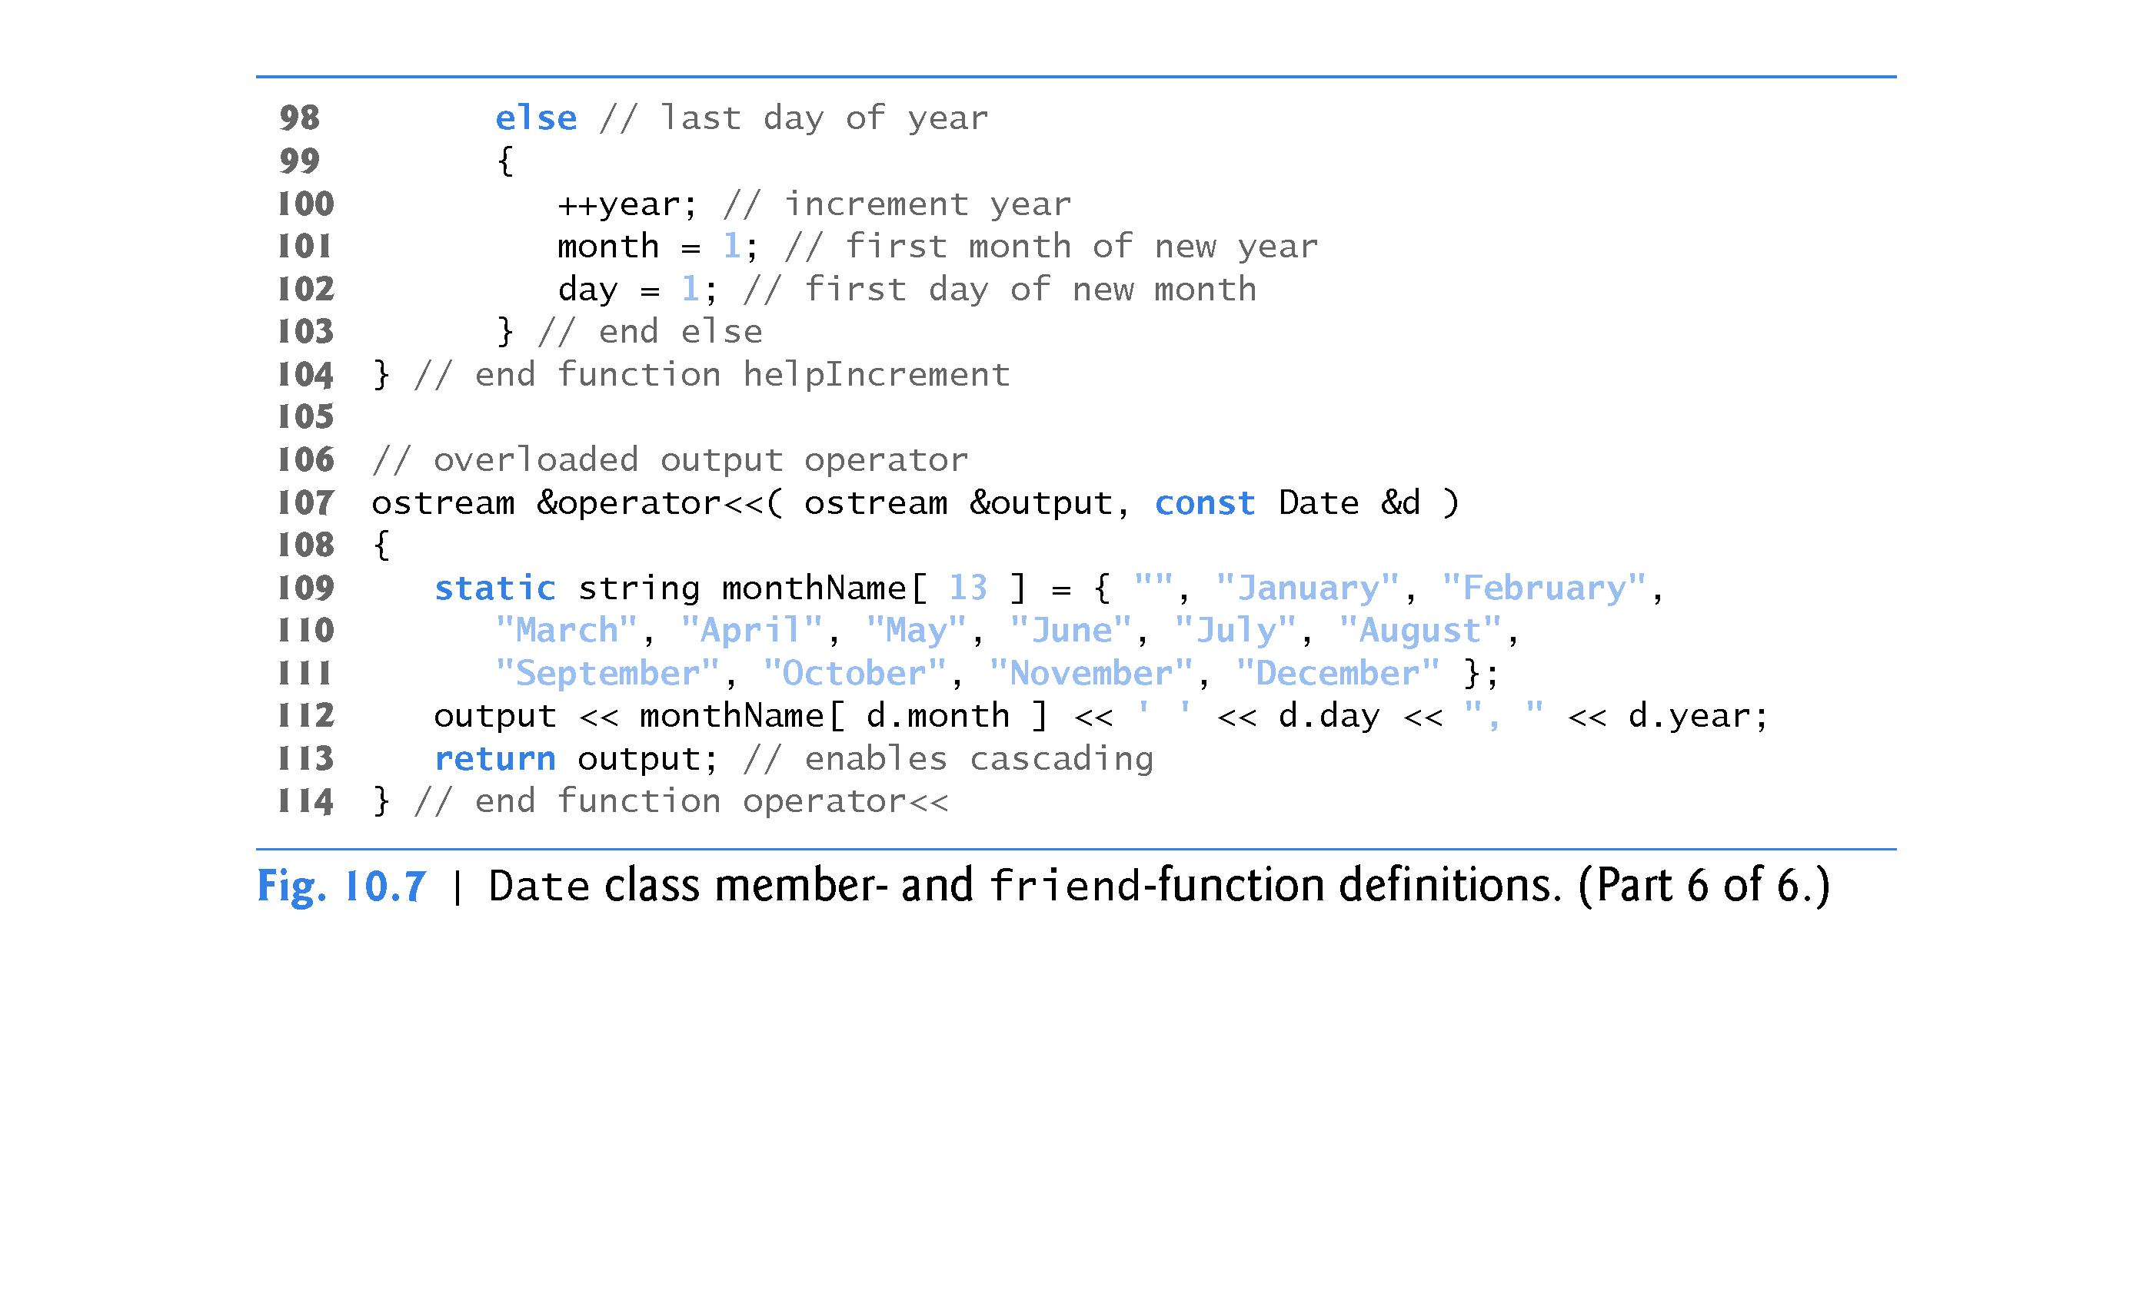

Slide 56
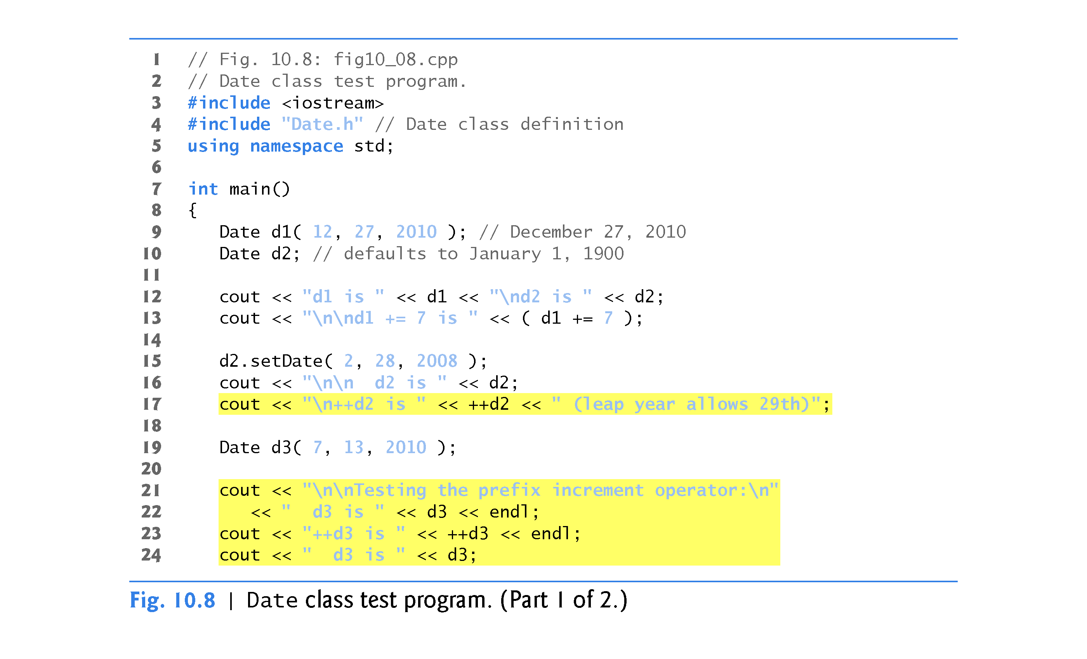

Slide 57
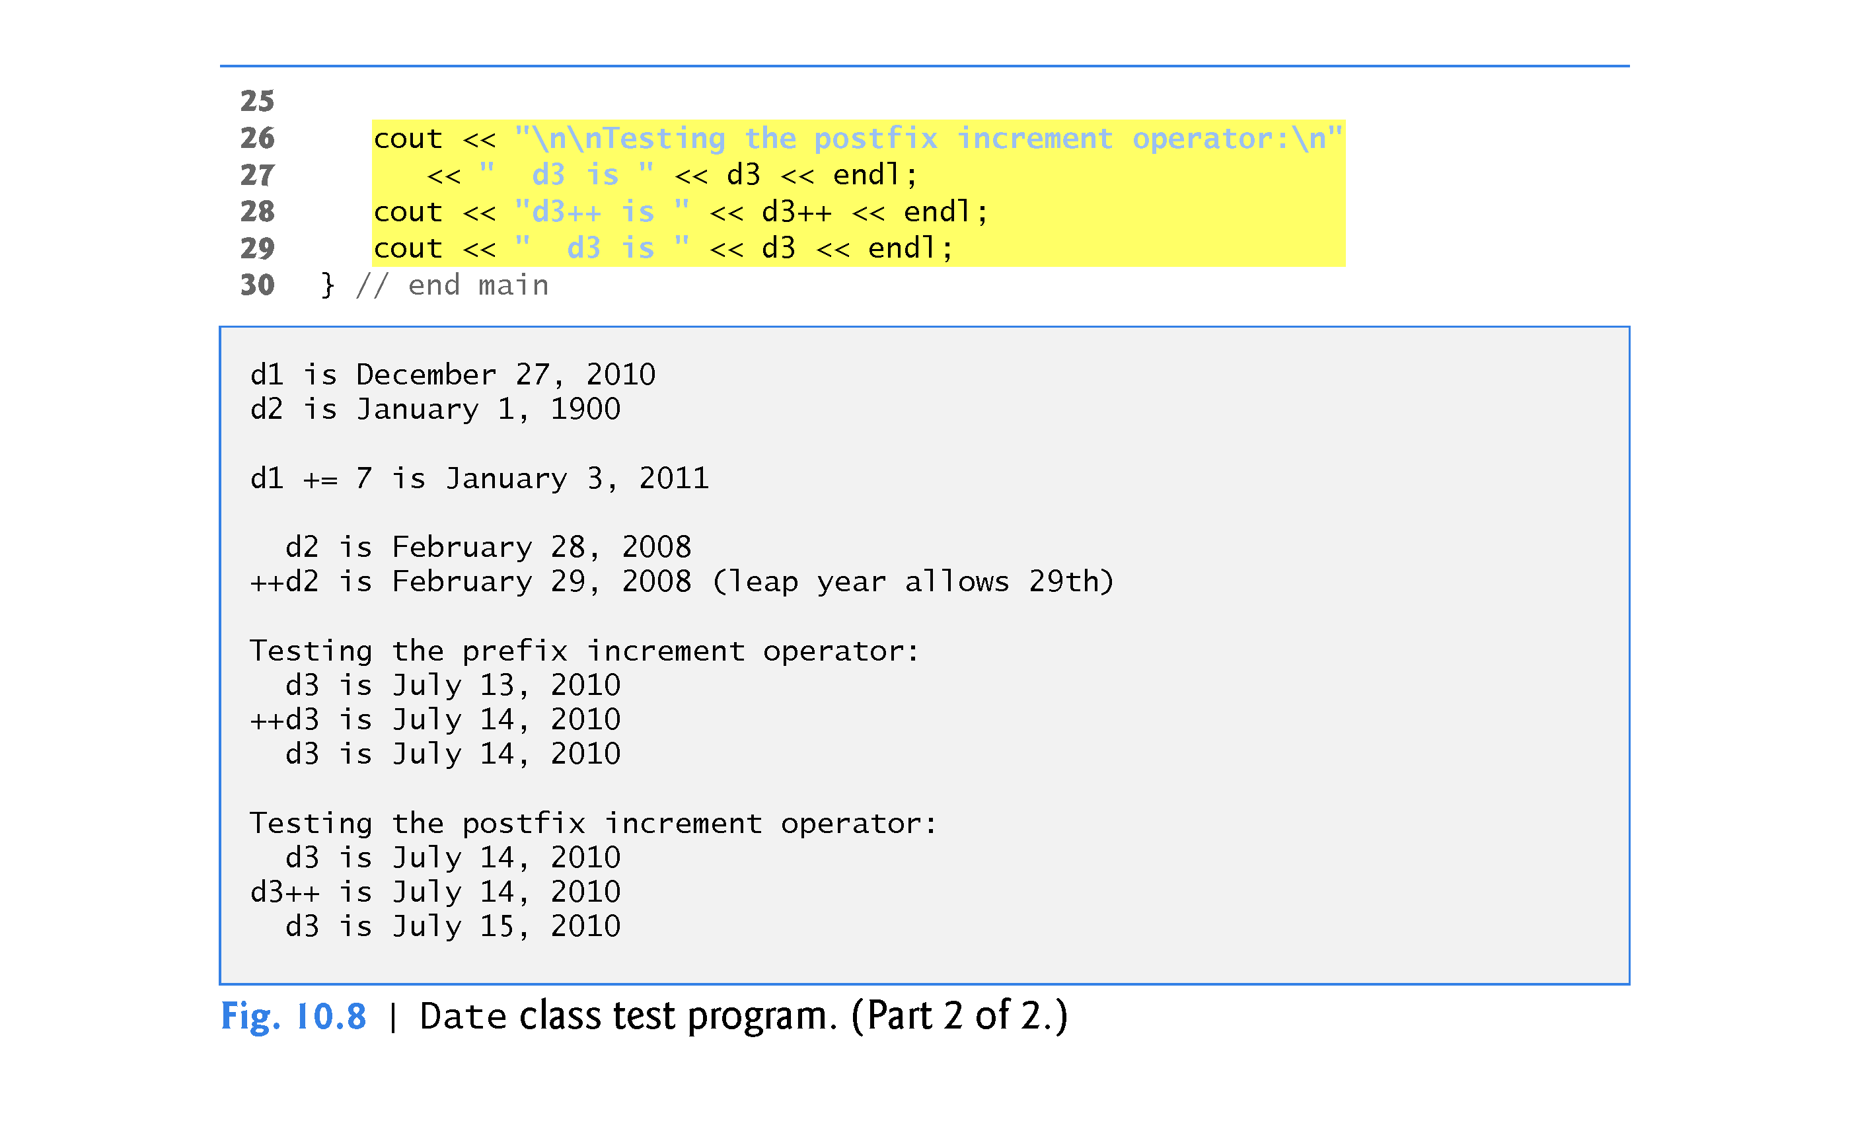

Slide 58
10.8 Case Study: A Date Class (cont.)
The Date constructor (defined in Fig. 10.7, lines 13–16) calls setDate to validate the month, day and year specified.
Invalid values for the month, day or year result in invalid_argument exceptions.

Slide 59
10.8 Case Study: A Date Class (cont.)
Date Class Prefix Increment Operator
Overloading the prefix increment operator.
The prefix increment operator (defined in Fig. 10.7, lines 41–45) calls utility function helpIncrement (defined in Fig. 10.7, lines 87–104) to increment the date.
This function deals with “wraparounds” or “carries” that occur when we increment the last day of the month.
These carries require incrementing the month.
If the month is already 12, then the year must also be incremented and the month must be set to 1.
Function helpIncrement uses function endOfMonth to determine whether the end of a month has been reached and increment the day correctly.

Slide 60
10.8 Case Study: A Date Class (cont.)
The overloaded prefix increment operator returns a reference to the current Date object (i.e., the one that was just incremented).
This occurs because the current object, *this, is returned as a Date &.
Enables a preincremented Date object to be used as an lvalue, which is how the built-in prefix increment operator works for fundamental types.

Slide 61
10.8 Case Study: A Date Class (cont.)
Date Class Postfix Increment Operator
Overloading the postfix increment operator (defined in Fig. 10.7, lines 49–56) is trickier.
To emulate the effect of the postincrement, we must return an unincremented copy of the Date object.
So we’d like our postfix increment operator to operate the same way on a Date object.
On entry to operator++, we save the current object (*this) in temp (line 51).
Next, we call helpIncrement to increment the current Date object.
Then, line 55 returns the unincremented copy of the object previously stored in temp.
This function cannot return a reference to the local Date object temp, because a local variable is destroyed when the function in which it’s declared exits.

Slide 62
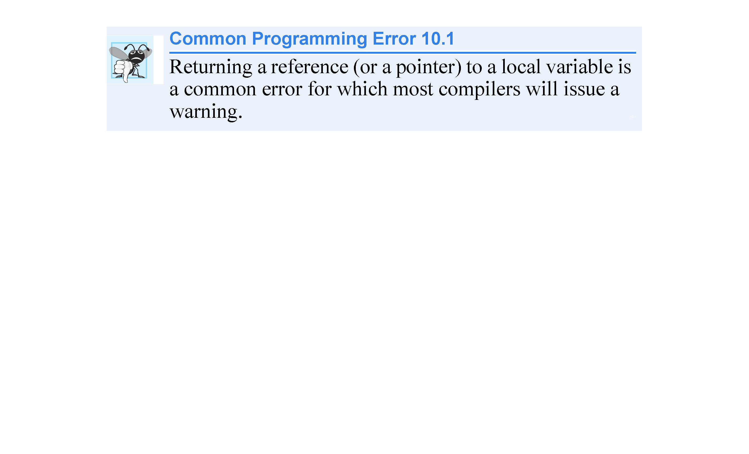

Slide 63
10.9 Dynamic Memory Management
You can control the allocation and deallocation of memory in a program for objects and for arrays of any built-in or user-defined type.
Known as dynamic memory management; performed with new and delete.
You can use the new operator to dynamically allocate (i.e., reserve) the exact amount of memory required to hold an object or built-in array at execution time.
The object or built-in array is created in the free store (also called the heap)—a region of memory assigned to each program for storing dynamically allocated objects.
Once memory is allocated in the free store, you can access it via the pointer that operator new returns.
You can return memory to the free store by using the delete operator to deallocate it.

Slide 64
10.9 Dynamic Memory Management
Obtaining Dynamic Memory with new
The new operator allocates storage of the proper size for an object of type Time, calls the default constructor to initialize the object and returns a pointer to the type specified to the right of the new operator (i.e., a Time *).
If new is unable to find sufficient space in memory for the object, it indicates that an error occurred by “throwing an exception.”

Slide 65
10.9 Dynamic Memory Management
Releasing Dynamic Memory with delete
To destroy a dynamically allocated object, use the delete operator as follows:
delete ptr; //delete [ ] ptr; for an array
This statement first calls the destructor for the object to which ptr points, then deallocates the memory associated with the object, returning the memory to the free store.

Slide 66
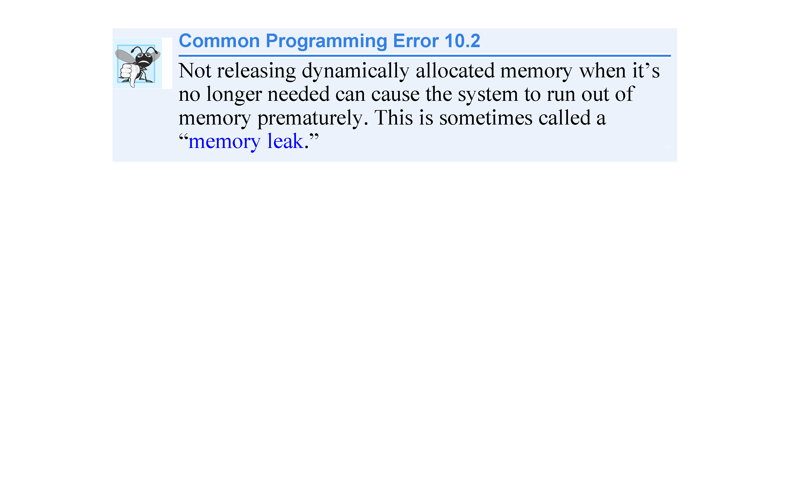

Slide 67
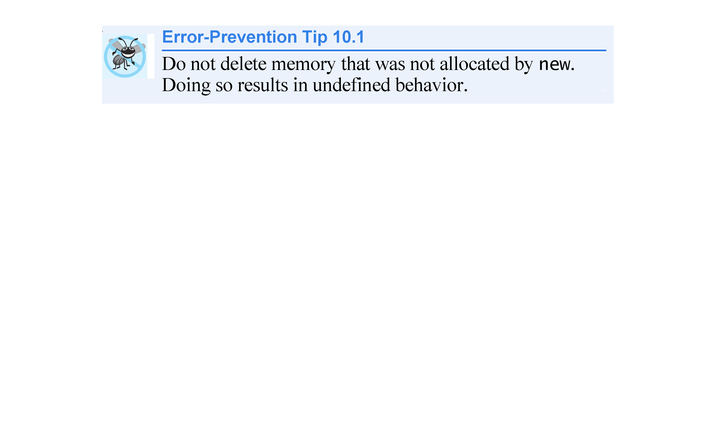

Slide 68
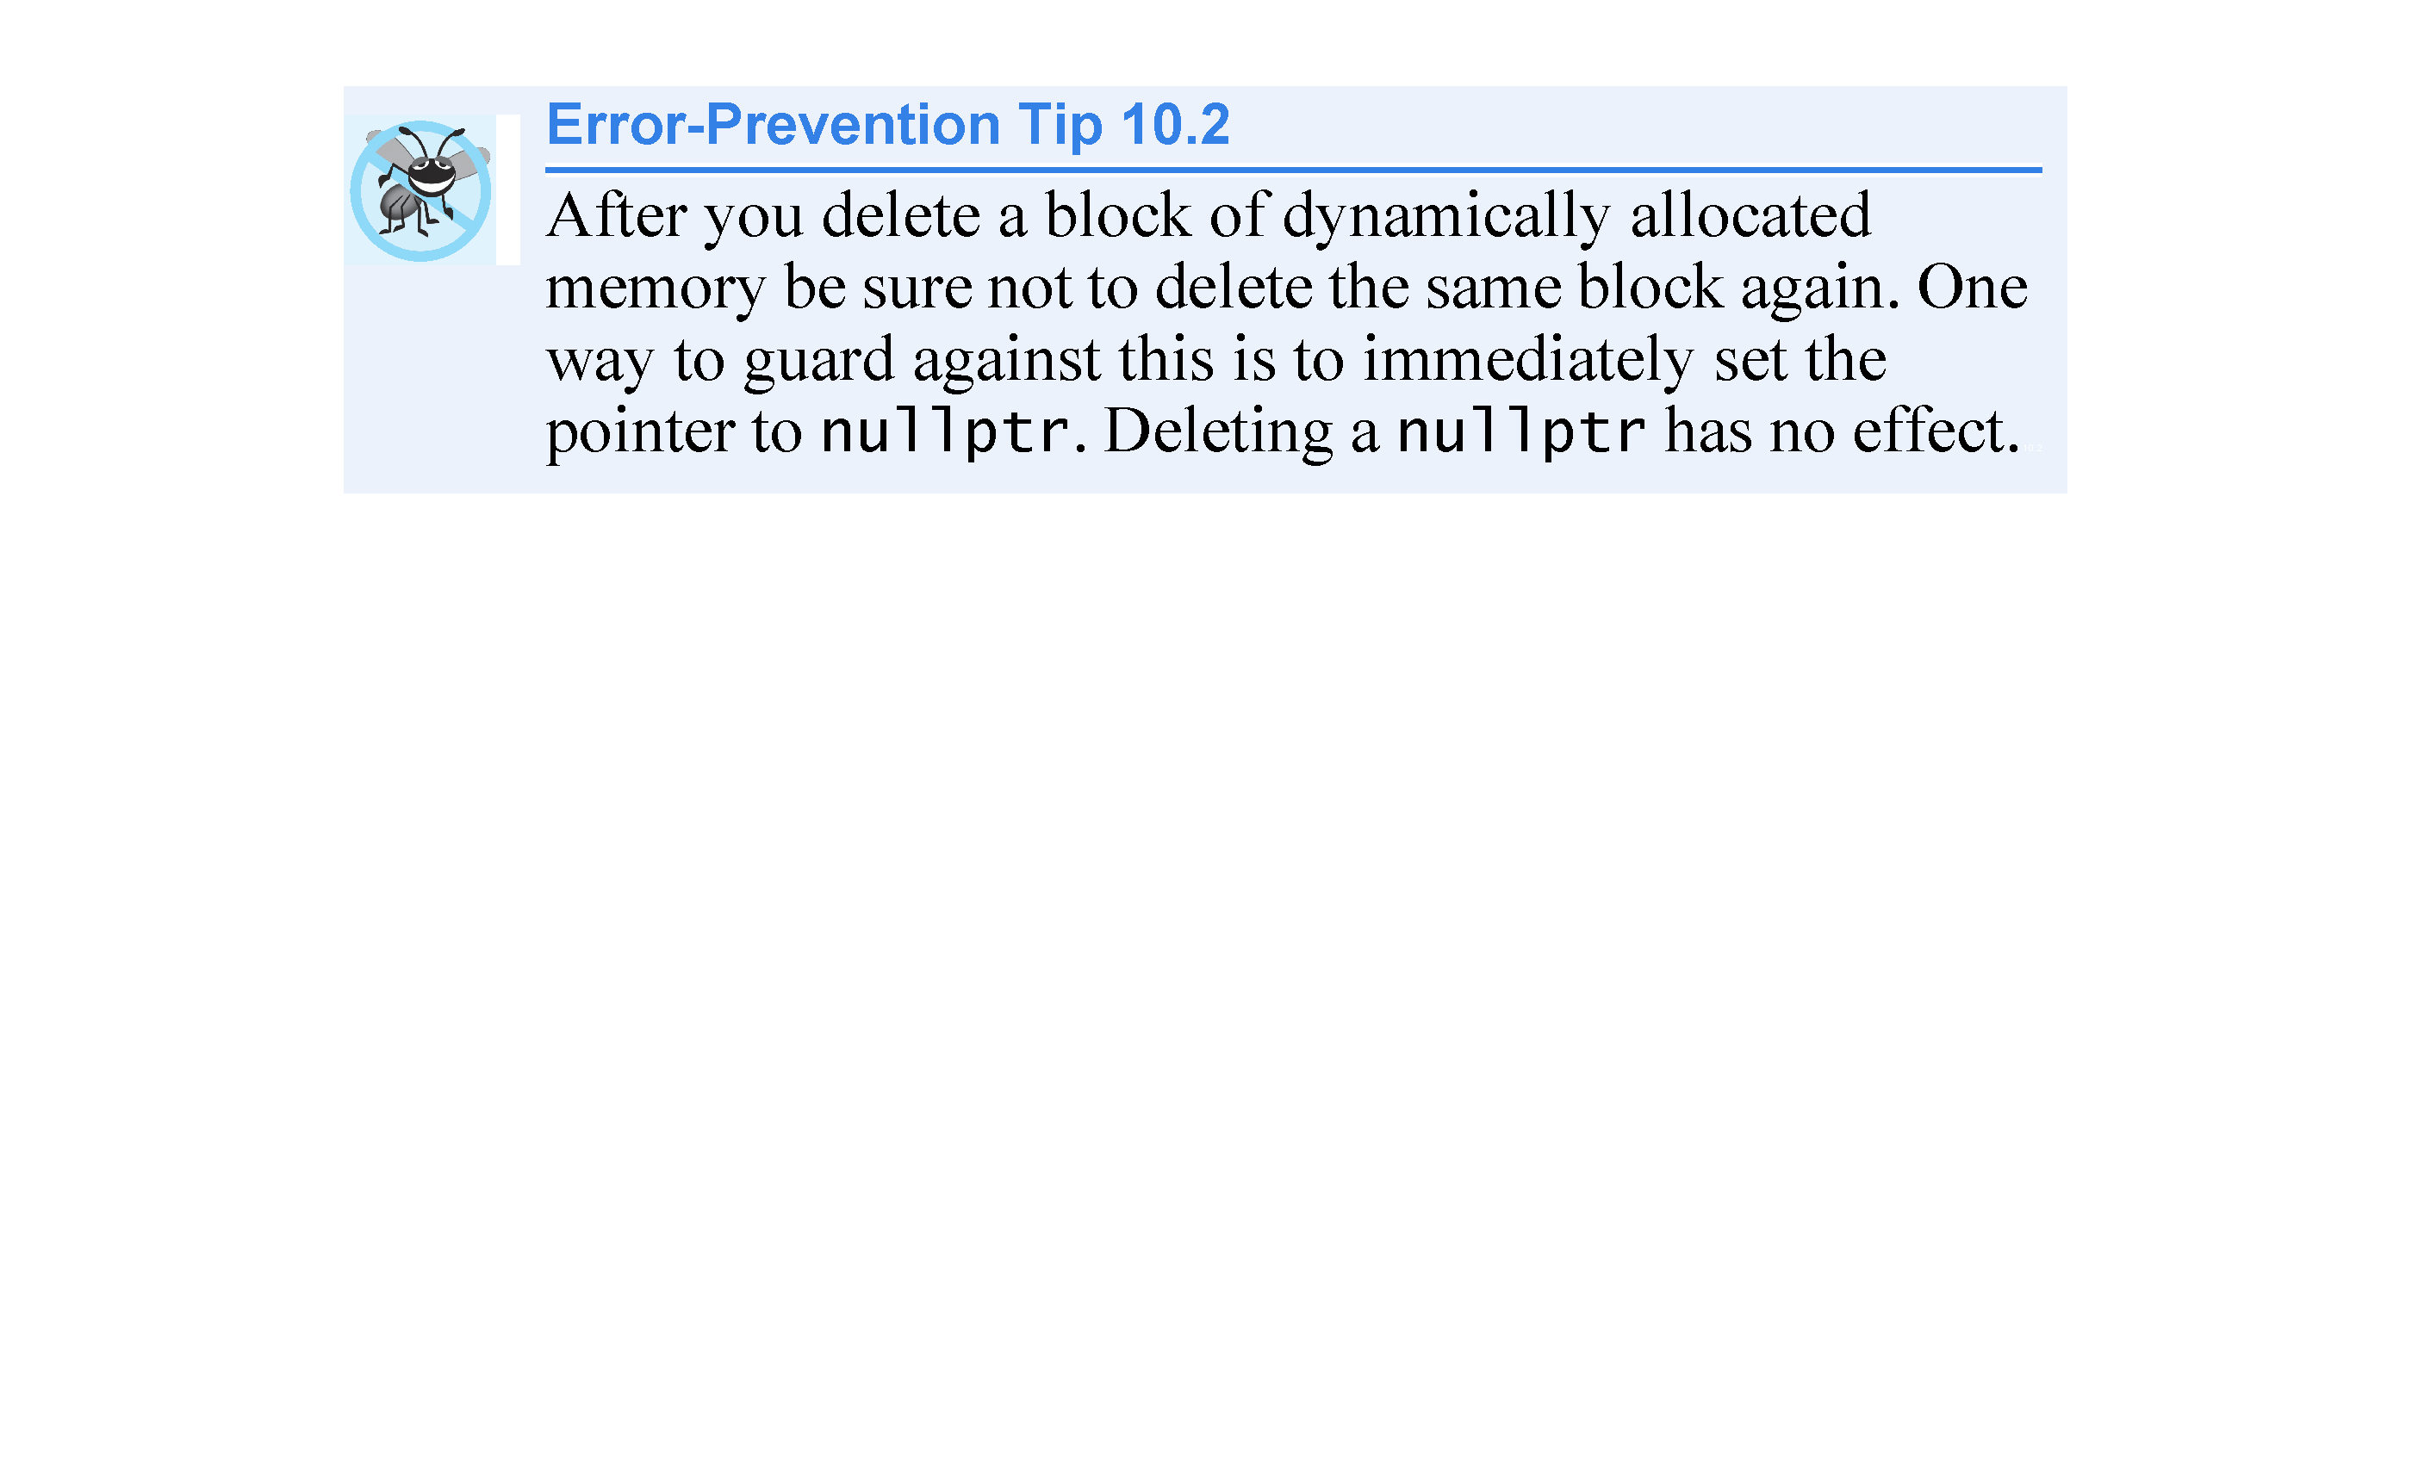

Slide 69
10.9 Dynamic Memory Management
Initializing Dynamic Memory
You can provide an initializer for a newly created fundamental-type variable, as in
Time *timePtr = new Time(); versus Time time = Time();
double *ptr = new double (3.14159); OR
double *ptr = new double {3.14159};
The same syntax can be used to specify a comma-separated list of arguments to the constructor of an object (constructor initializer syntax).

Slide 70
10.9 Dynamic Memory Management
Dynamically Allocating Built-In Arrays with new [ ]
You can also use the new operator to allocate built-in arrays dynamically.
For example, a 10-element integer array can be allocated and assigned to gradesArray as follows:
int *gradesArray = new int[10]
A dynamically allocated array’s size can be specified using any non-negative integral expression that can be evaluated at execution time.

Slide 71
10.9 Dynamic Memory Management
C++11: Using a List Initializer with a Dynamically Allocated Built-In Array
Prior to C++11, when allocating a built-in array of objects dynamically, you could not pass arguments to each object’s constructor—each object was initialized by its default constructor.
In C++11, you can use a list initializer to initialize the elements of a dynamically allocated built-in array, as in
int * numbers = new int[10]( ); or
int * numbers = new int[10]{1,2,3,4,5,6,7,8,9,10};
The parentheses following new int[10] value initialize the array’s elements—fundamental numeric types are set to 0, bools are set to false, pointers are set to nullptr and class objects are initialized by their default constructors.
An empty set of braces indicates that default initialization should be used for each element—for fundamental types each element is set to 0.
The braces may also contain a comma-separated list of initializers for the array’s elements.

Slide 72
10.9 Dynamic Memory Management
Releasing Dynamically Allocated Built-In Arrays with delete [ ]
To deallocate a dynamically allocated array, use the statement
delete [ ] ptr; ptr = nullptr;
If the pointer points to a built-in array of objects, the statement first calls the destructor for every object in the array, then deallocates the memory.
Using delete or [ ] on a nullptr has no effect.

Slide 73
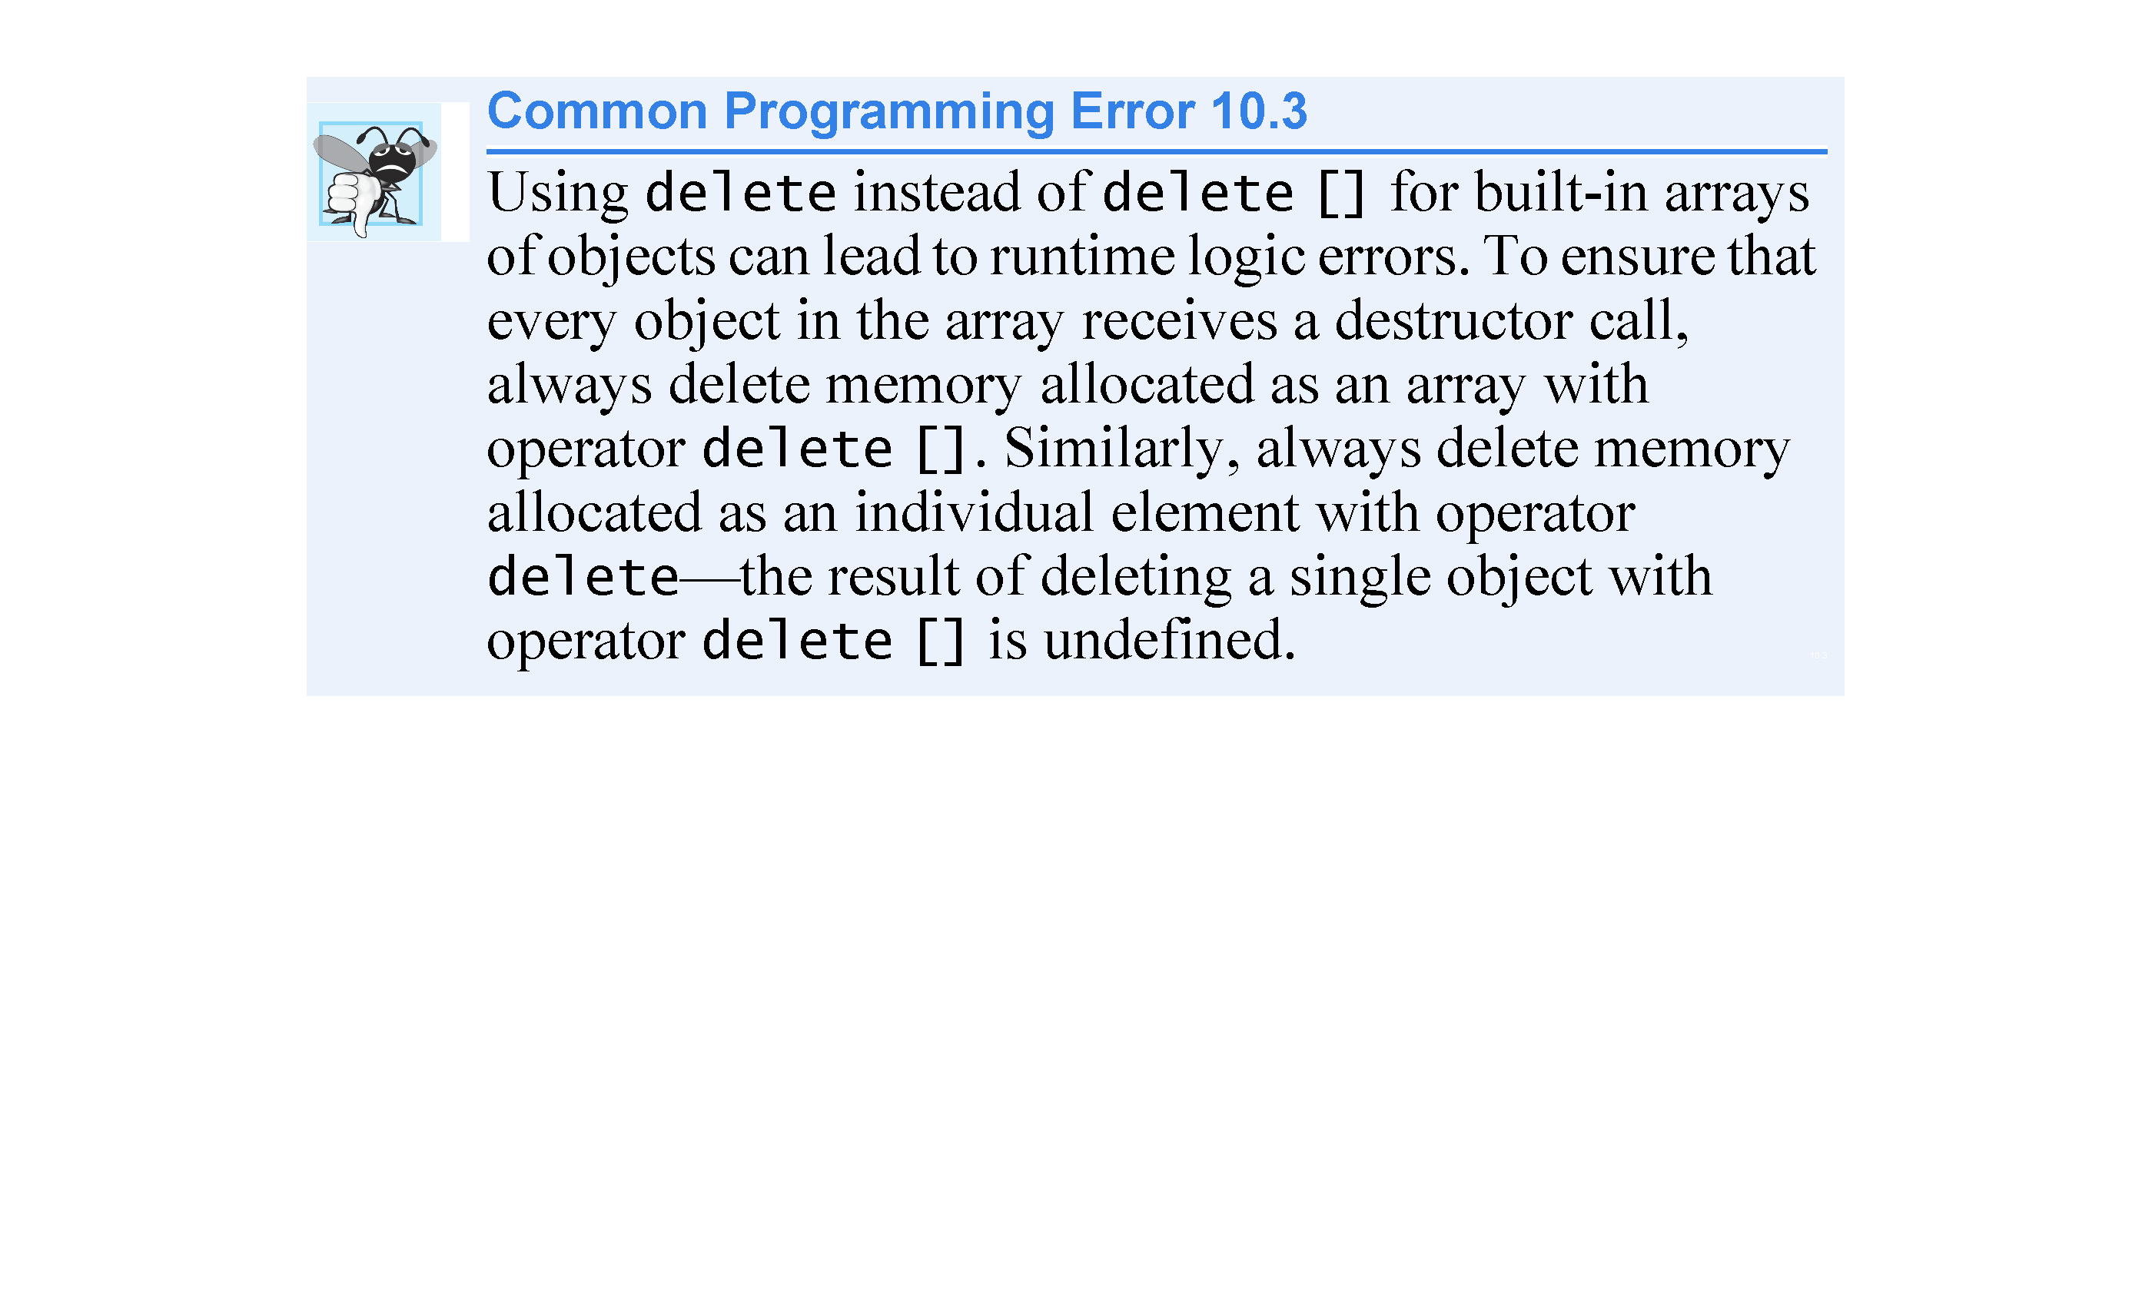

Slide 74
10.9 Dynamic Memory Management (cont.)
C++11: Managing Dynamically Allocated Memory with unique_ptr
C++11’s new unique_ptr is a “smart pointer” for managing dynamically allocated memory.
When a unique_ptr goes out of scope, its destructor automatically returns the managed memory to the free store.

Slide 75
Class unique_ptr Examples
class template unique_ptr //use for pointer to dynamically allocated memory
#include<memory>
unique_ptr<type> identifier(allocation expression)
unique_ptr< double[] > ptrToDouble( new double[5]() );
//Note: you cannot use a ranged for loop with a dynamically allocated c-style array
for (int i=0; i<5; ++i) cout << ptrToDouble)[i] << “ “;
cout << endl << endl;
//Note: class unique_ptr does not overloaded the [ ] operator! unique_ptr< array<int,5> > ptrToArray( new array<int,5> { 1,2,3,4,5 } );
for ( int &i : *ptrToArray ) cout << i *= 2 << “ “; cout << endl << endl; unique_ptr< vector<int> > ptrToVector( new vector<int> { 6,7,8,9,10 } ); for ( int &i : *ptrToVector ) cout << i *= 3 << “ “; cout << endl << endl;

Slide 76
10.10 Case Study: Array Class
Pointer-based arrays have many problems, including:
A program can easily “walk off” either end of a built-in array, because C++ does not check whether subscripts fall outside the range of the array.
Built-in arrays of size n must number their elements 0, …, n – 1; alternate subscript ranges- are not allowed.
An entire built-in array cannot be input or output at once.
Two built-in arrays cannot be meaningfully compared with equality or relational operators.
When an array is passed to a general-purpose function designed to handle arrays of any size, the array’s size must be passed as an additional argument.
One built-in array cannot be assigned to another with the assignment operator.

Slide 77
10.10 Case Study: Array Class (cont.)
With C++, you can implement more robust array capabilities via classes and operator overloading as has been done with class templates array and vector in the C++ Standard Library.
In this section, we’ll develop our own custom array class that’s preferable to built-in arrays.
In this example, we create a powerful Array class:
Performs range checking.
Allows one Array object to be assigned to another with the assignment operator.
Objects know their own size.
Input or output entire arrays with the stream extraction and stream insertion operators, respectively.
Compare Arrays with the equality operators == and !=.
C++ Standard Library class template vector provides many of these capabilities as well.

Slide 78
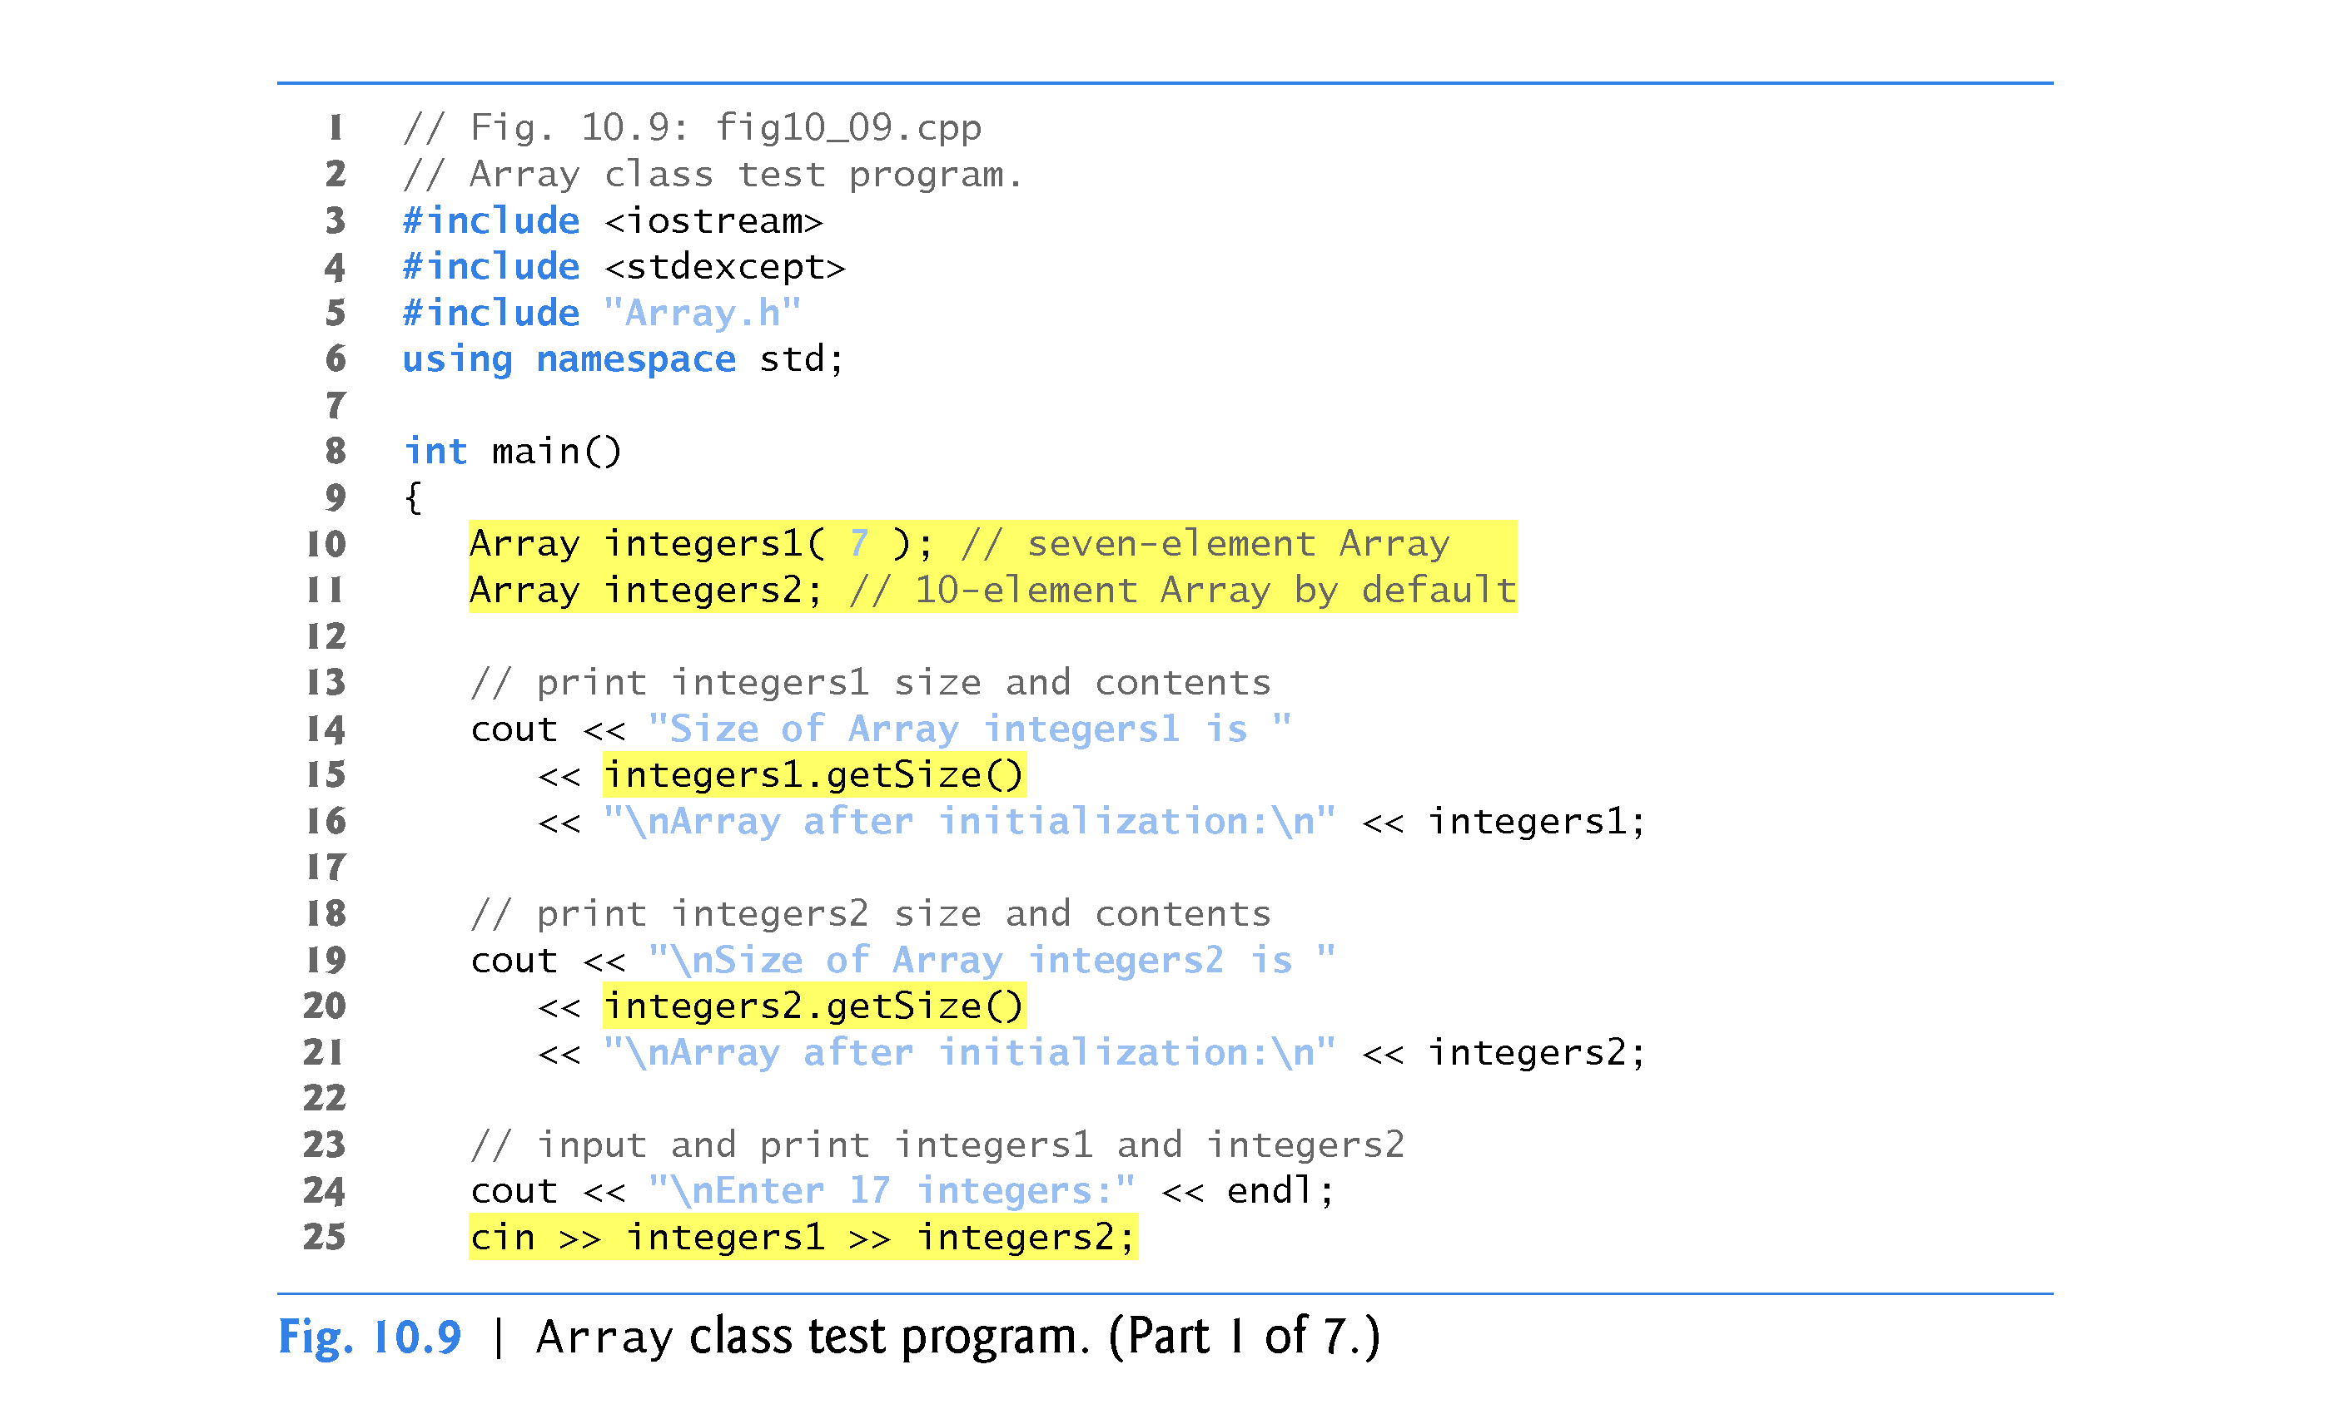

Slide 79
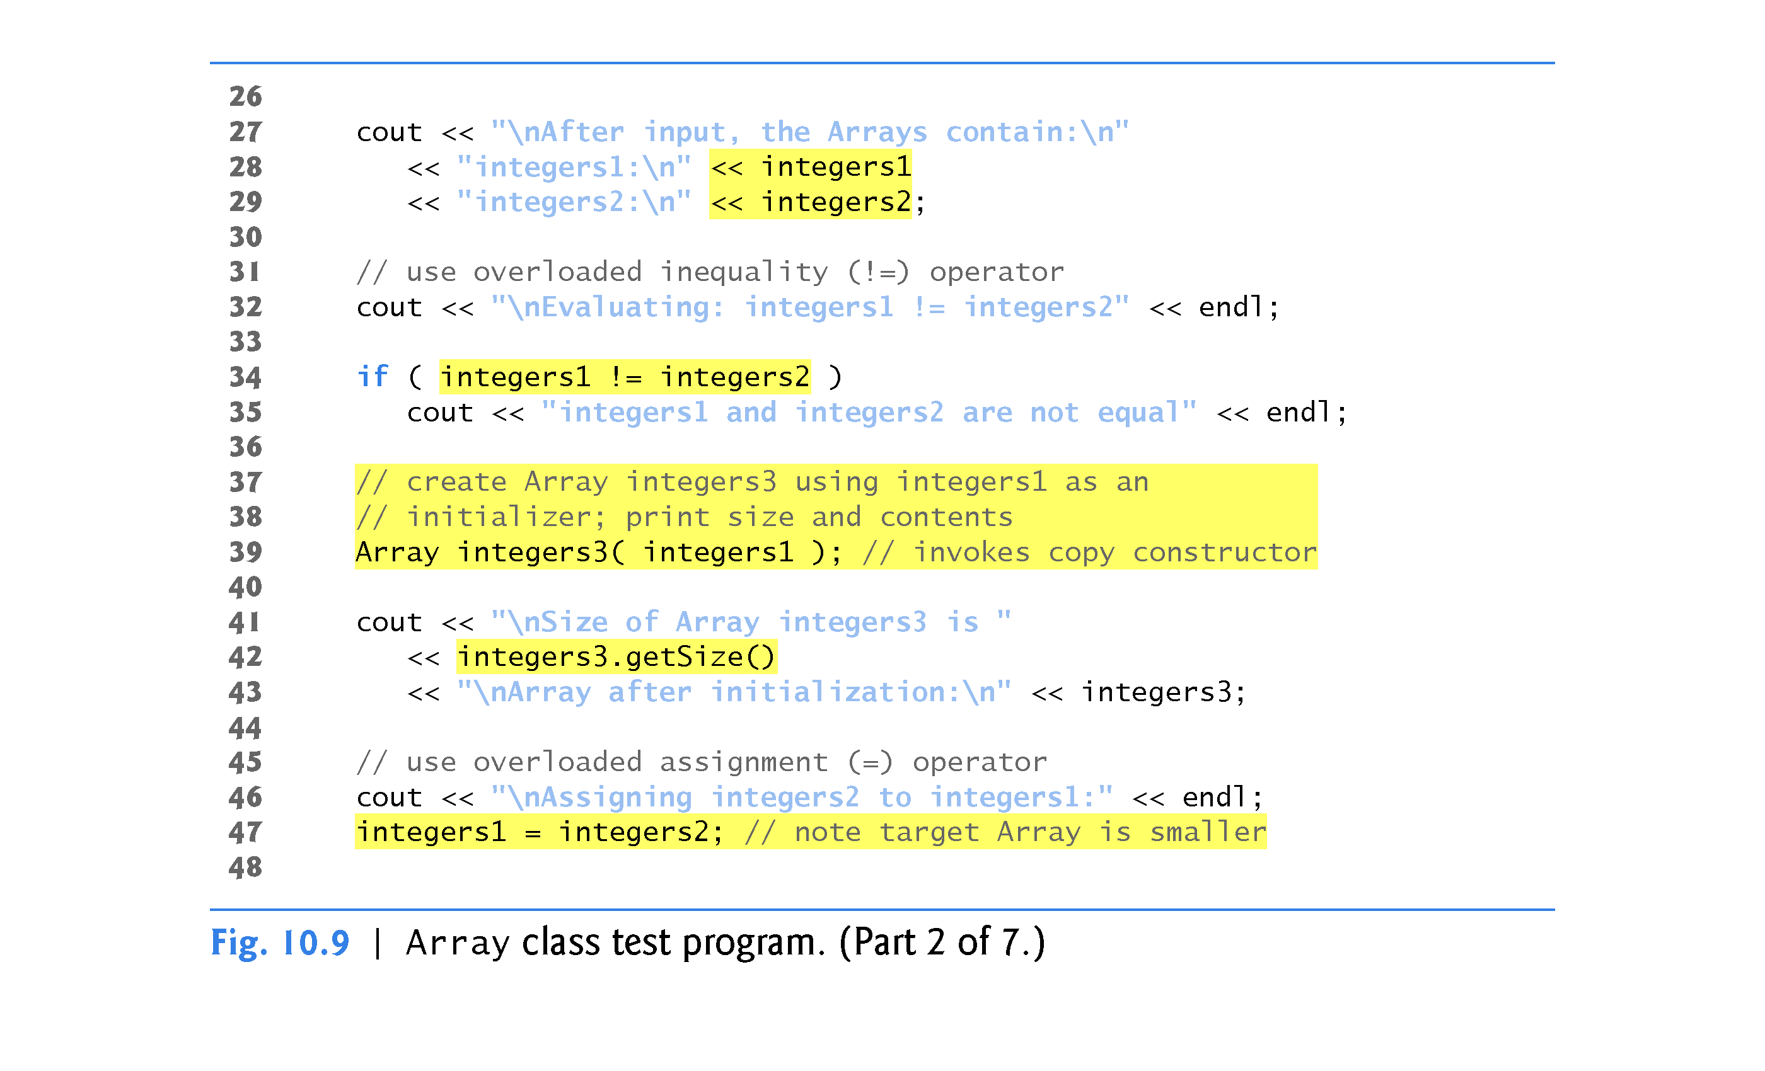

Slide 80
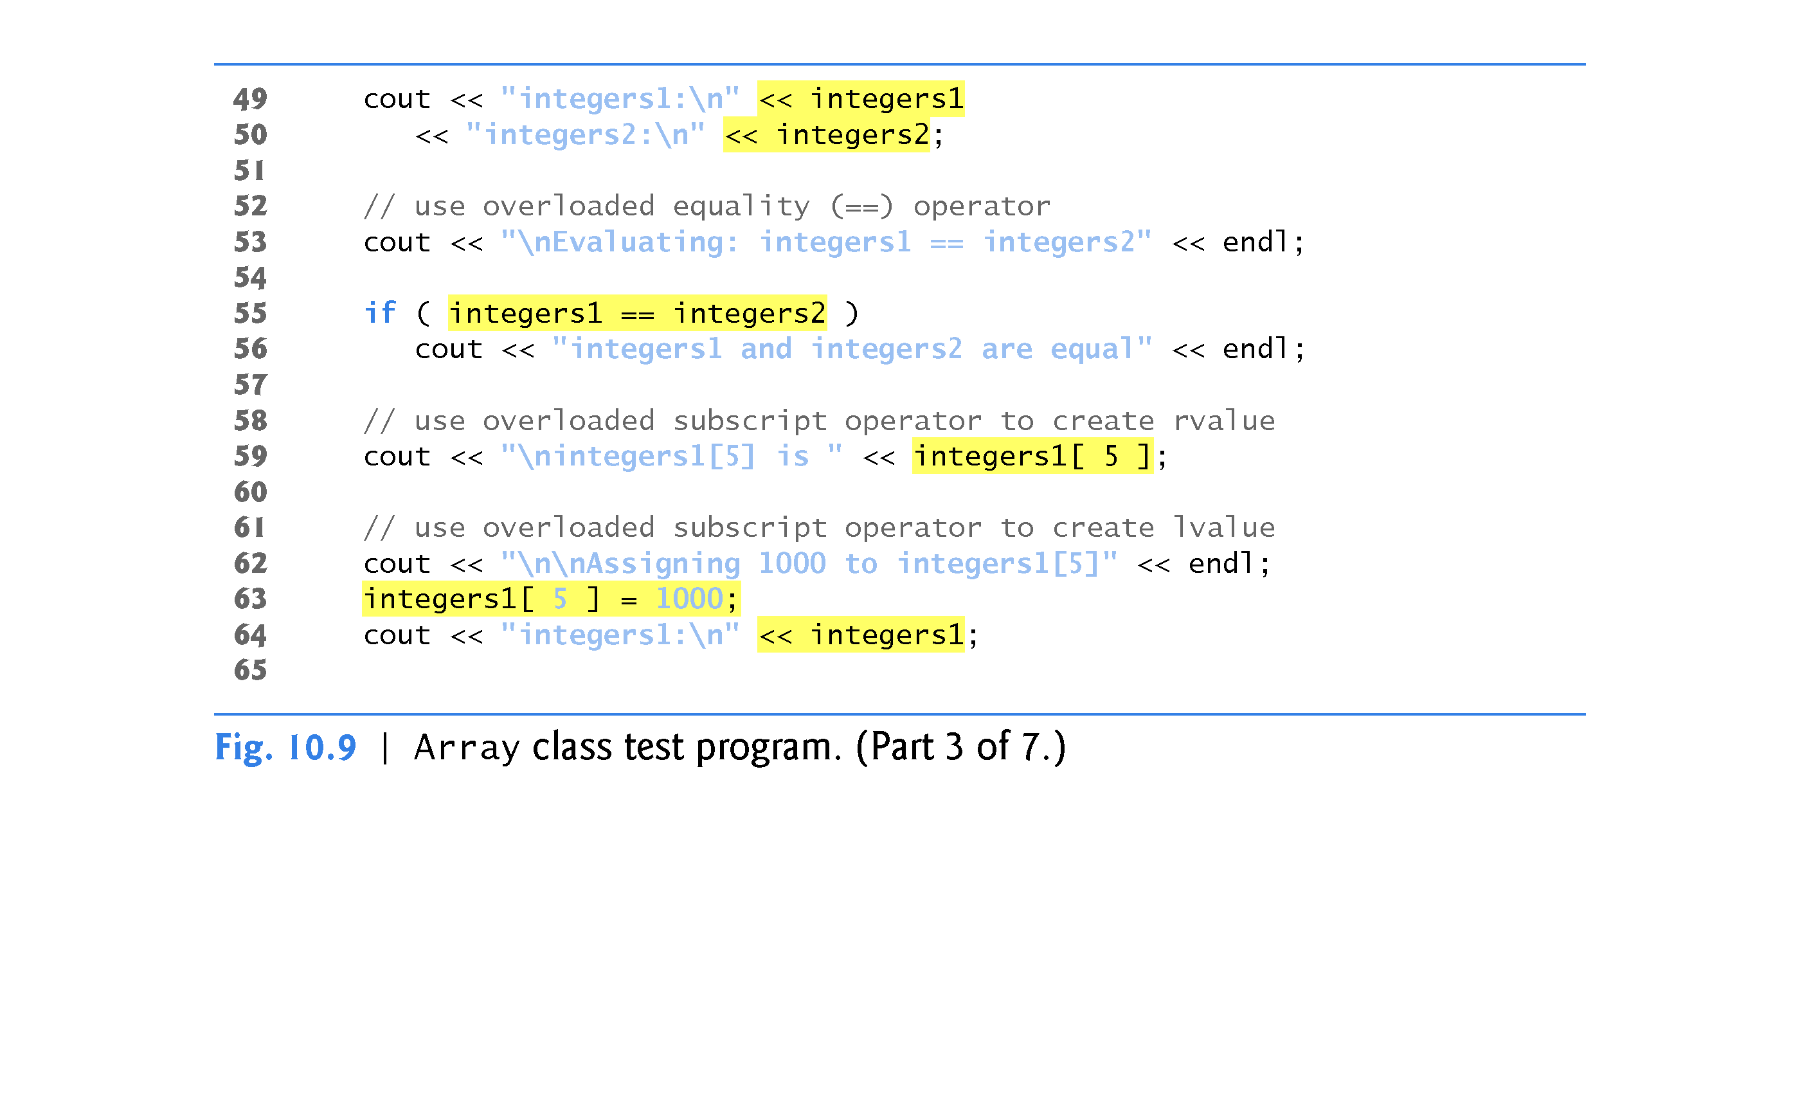

Slide 81
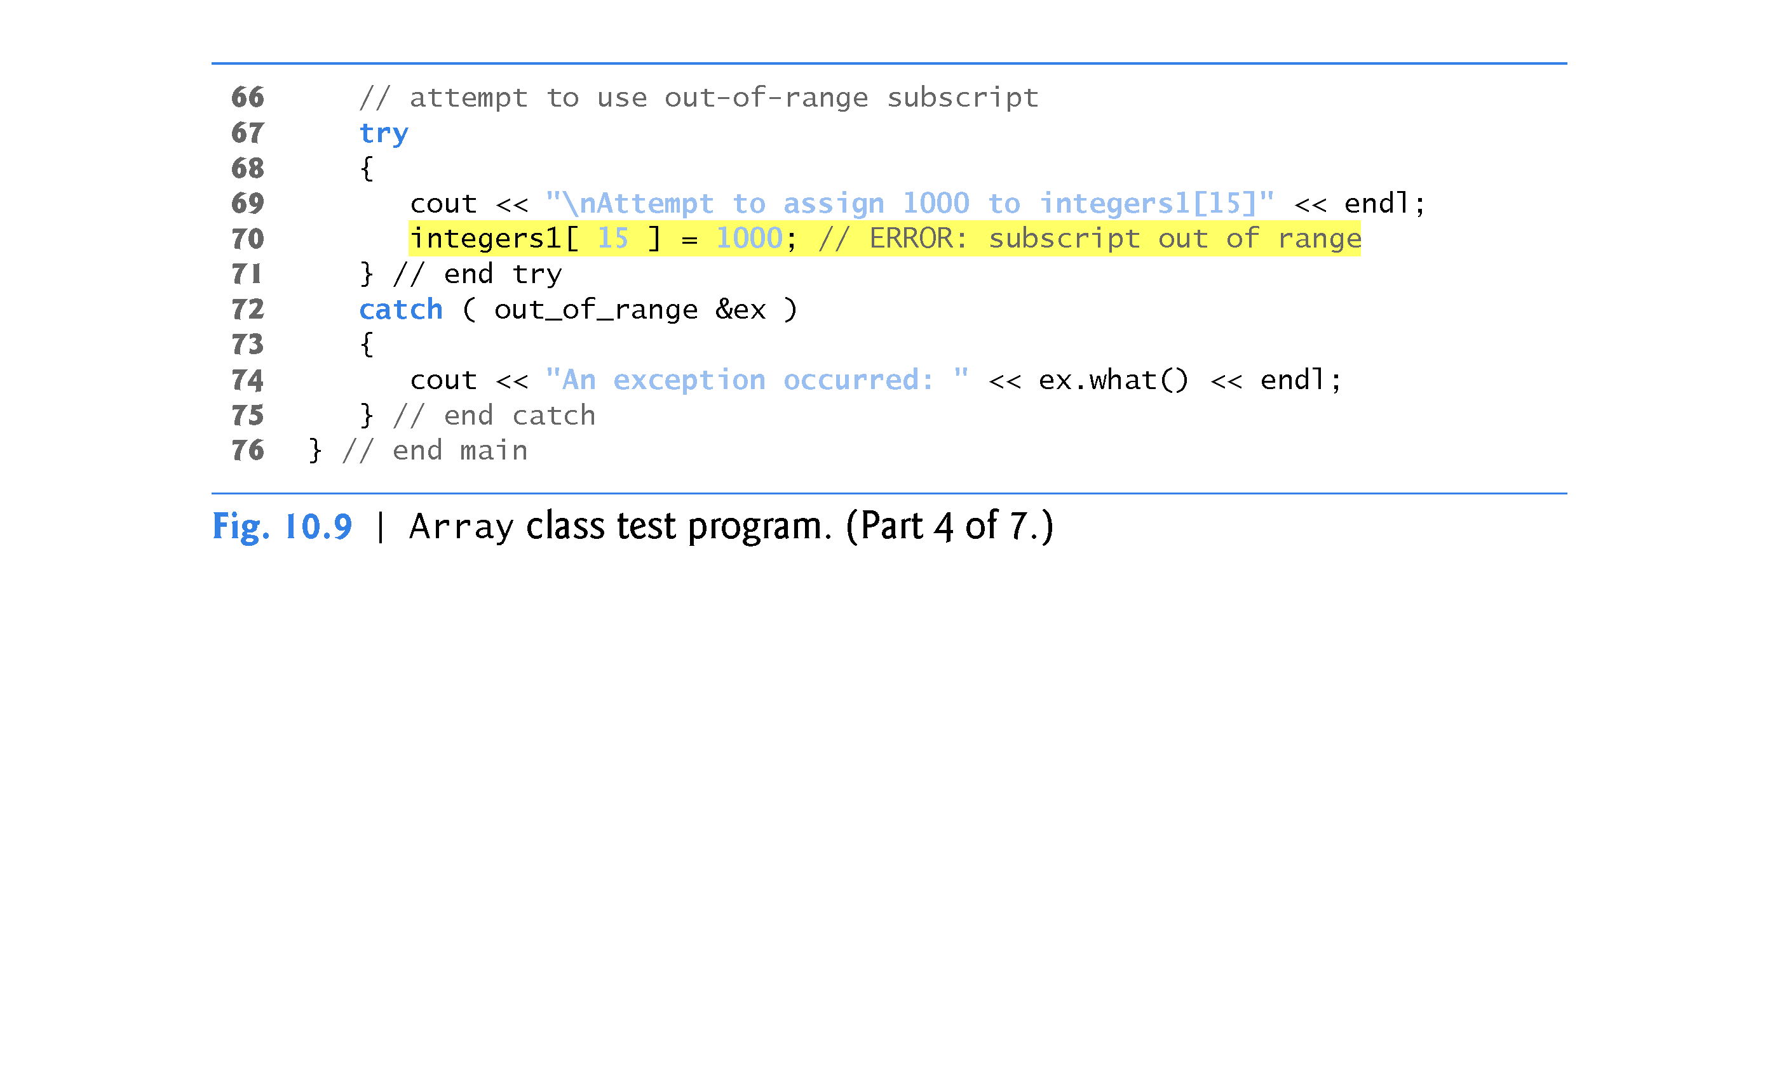

Slide 82
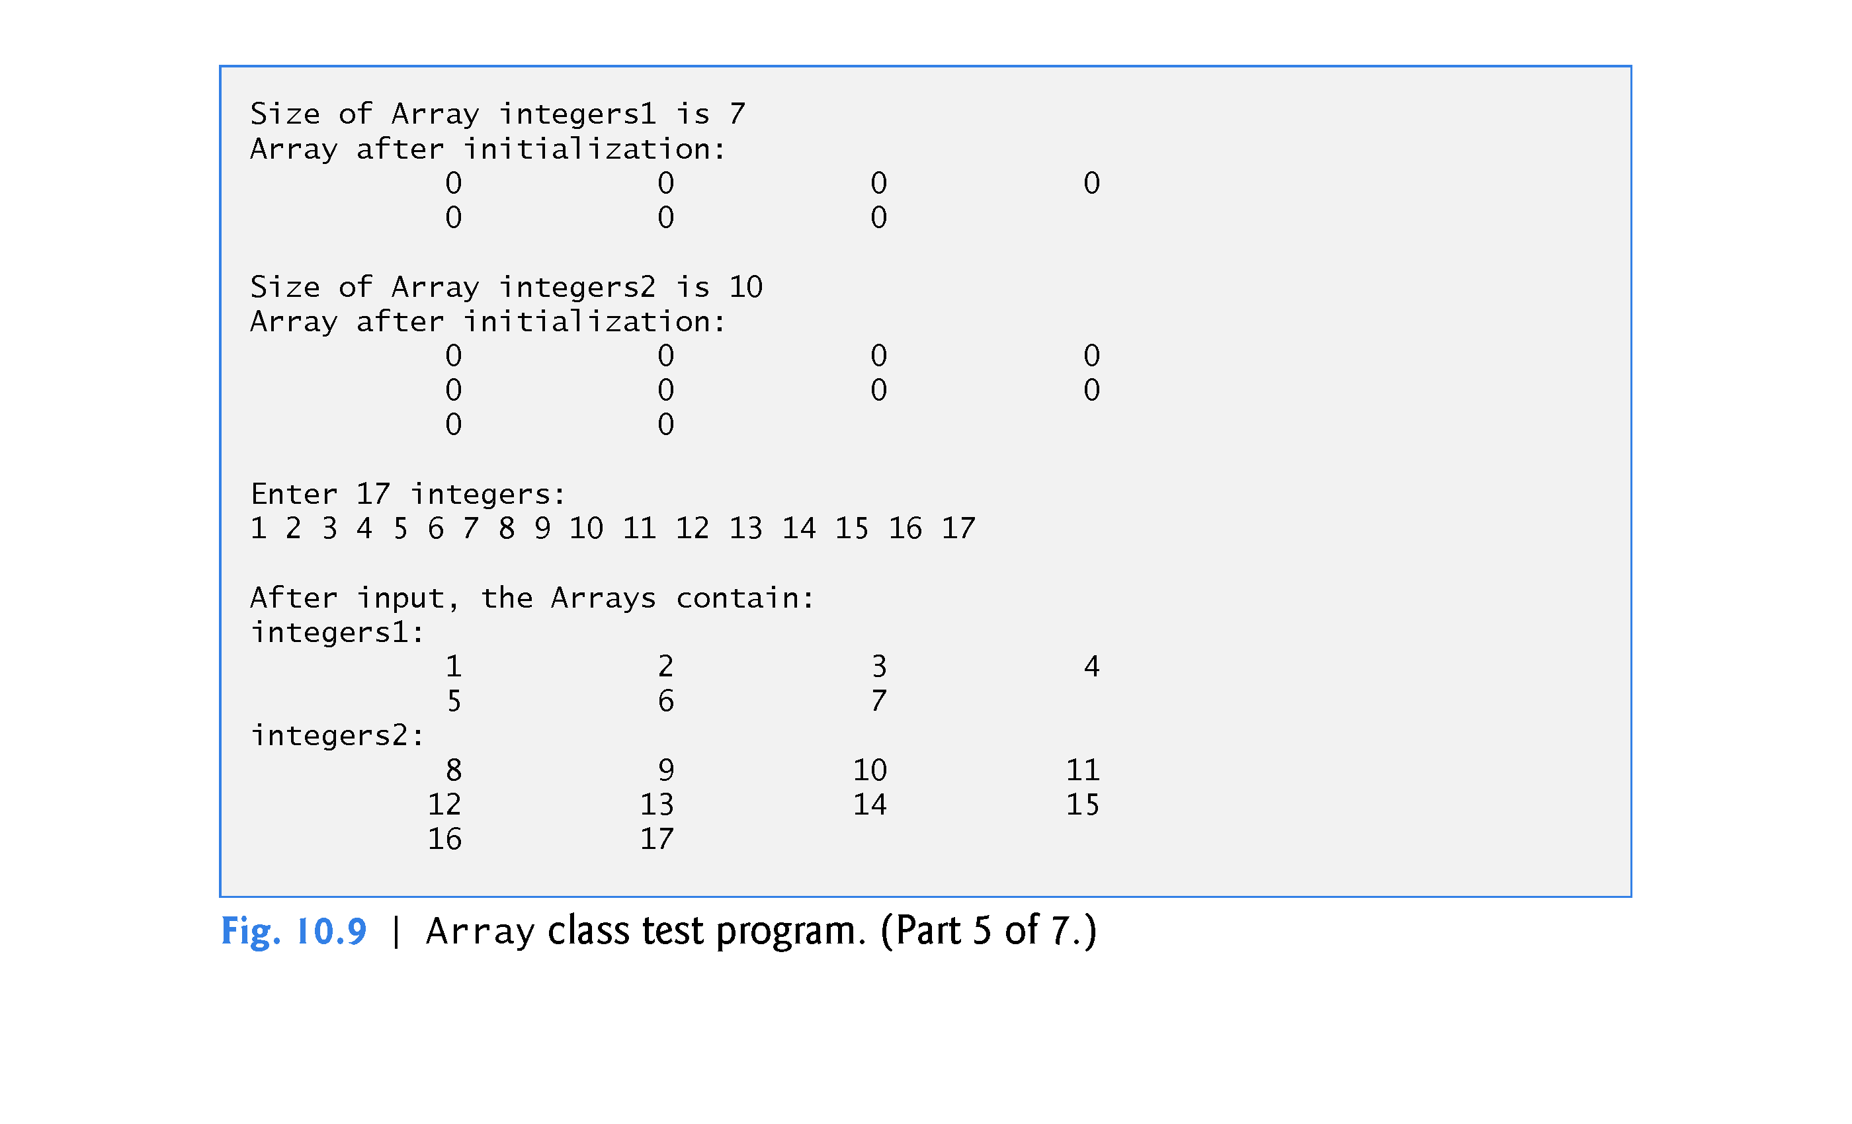

Slide 83
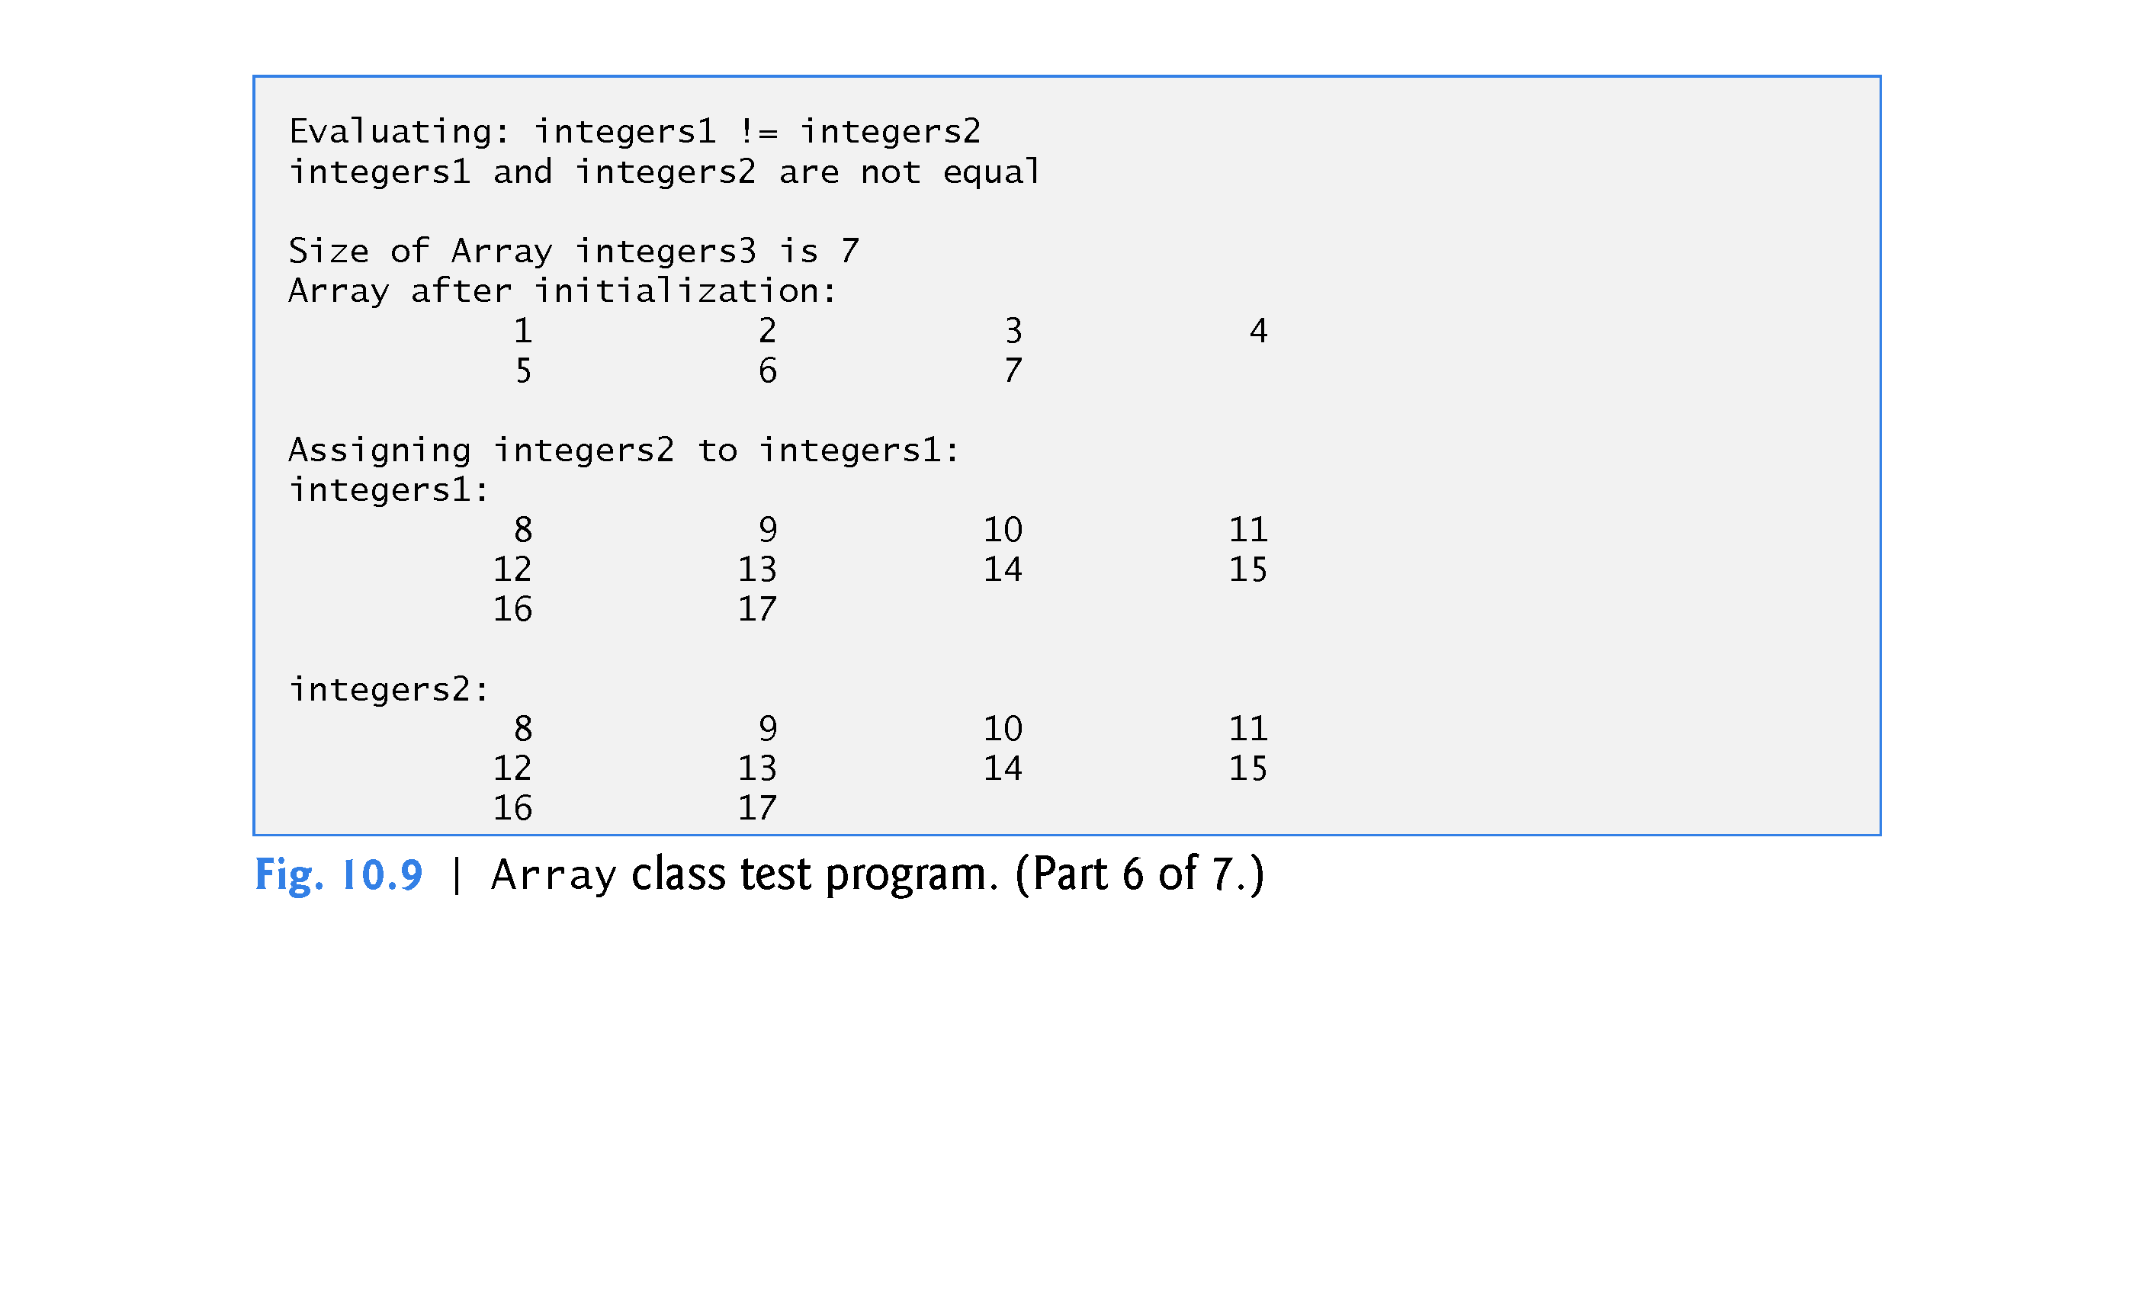

Slide 84
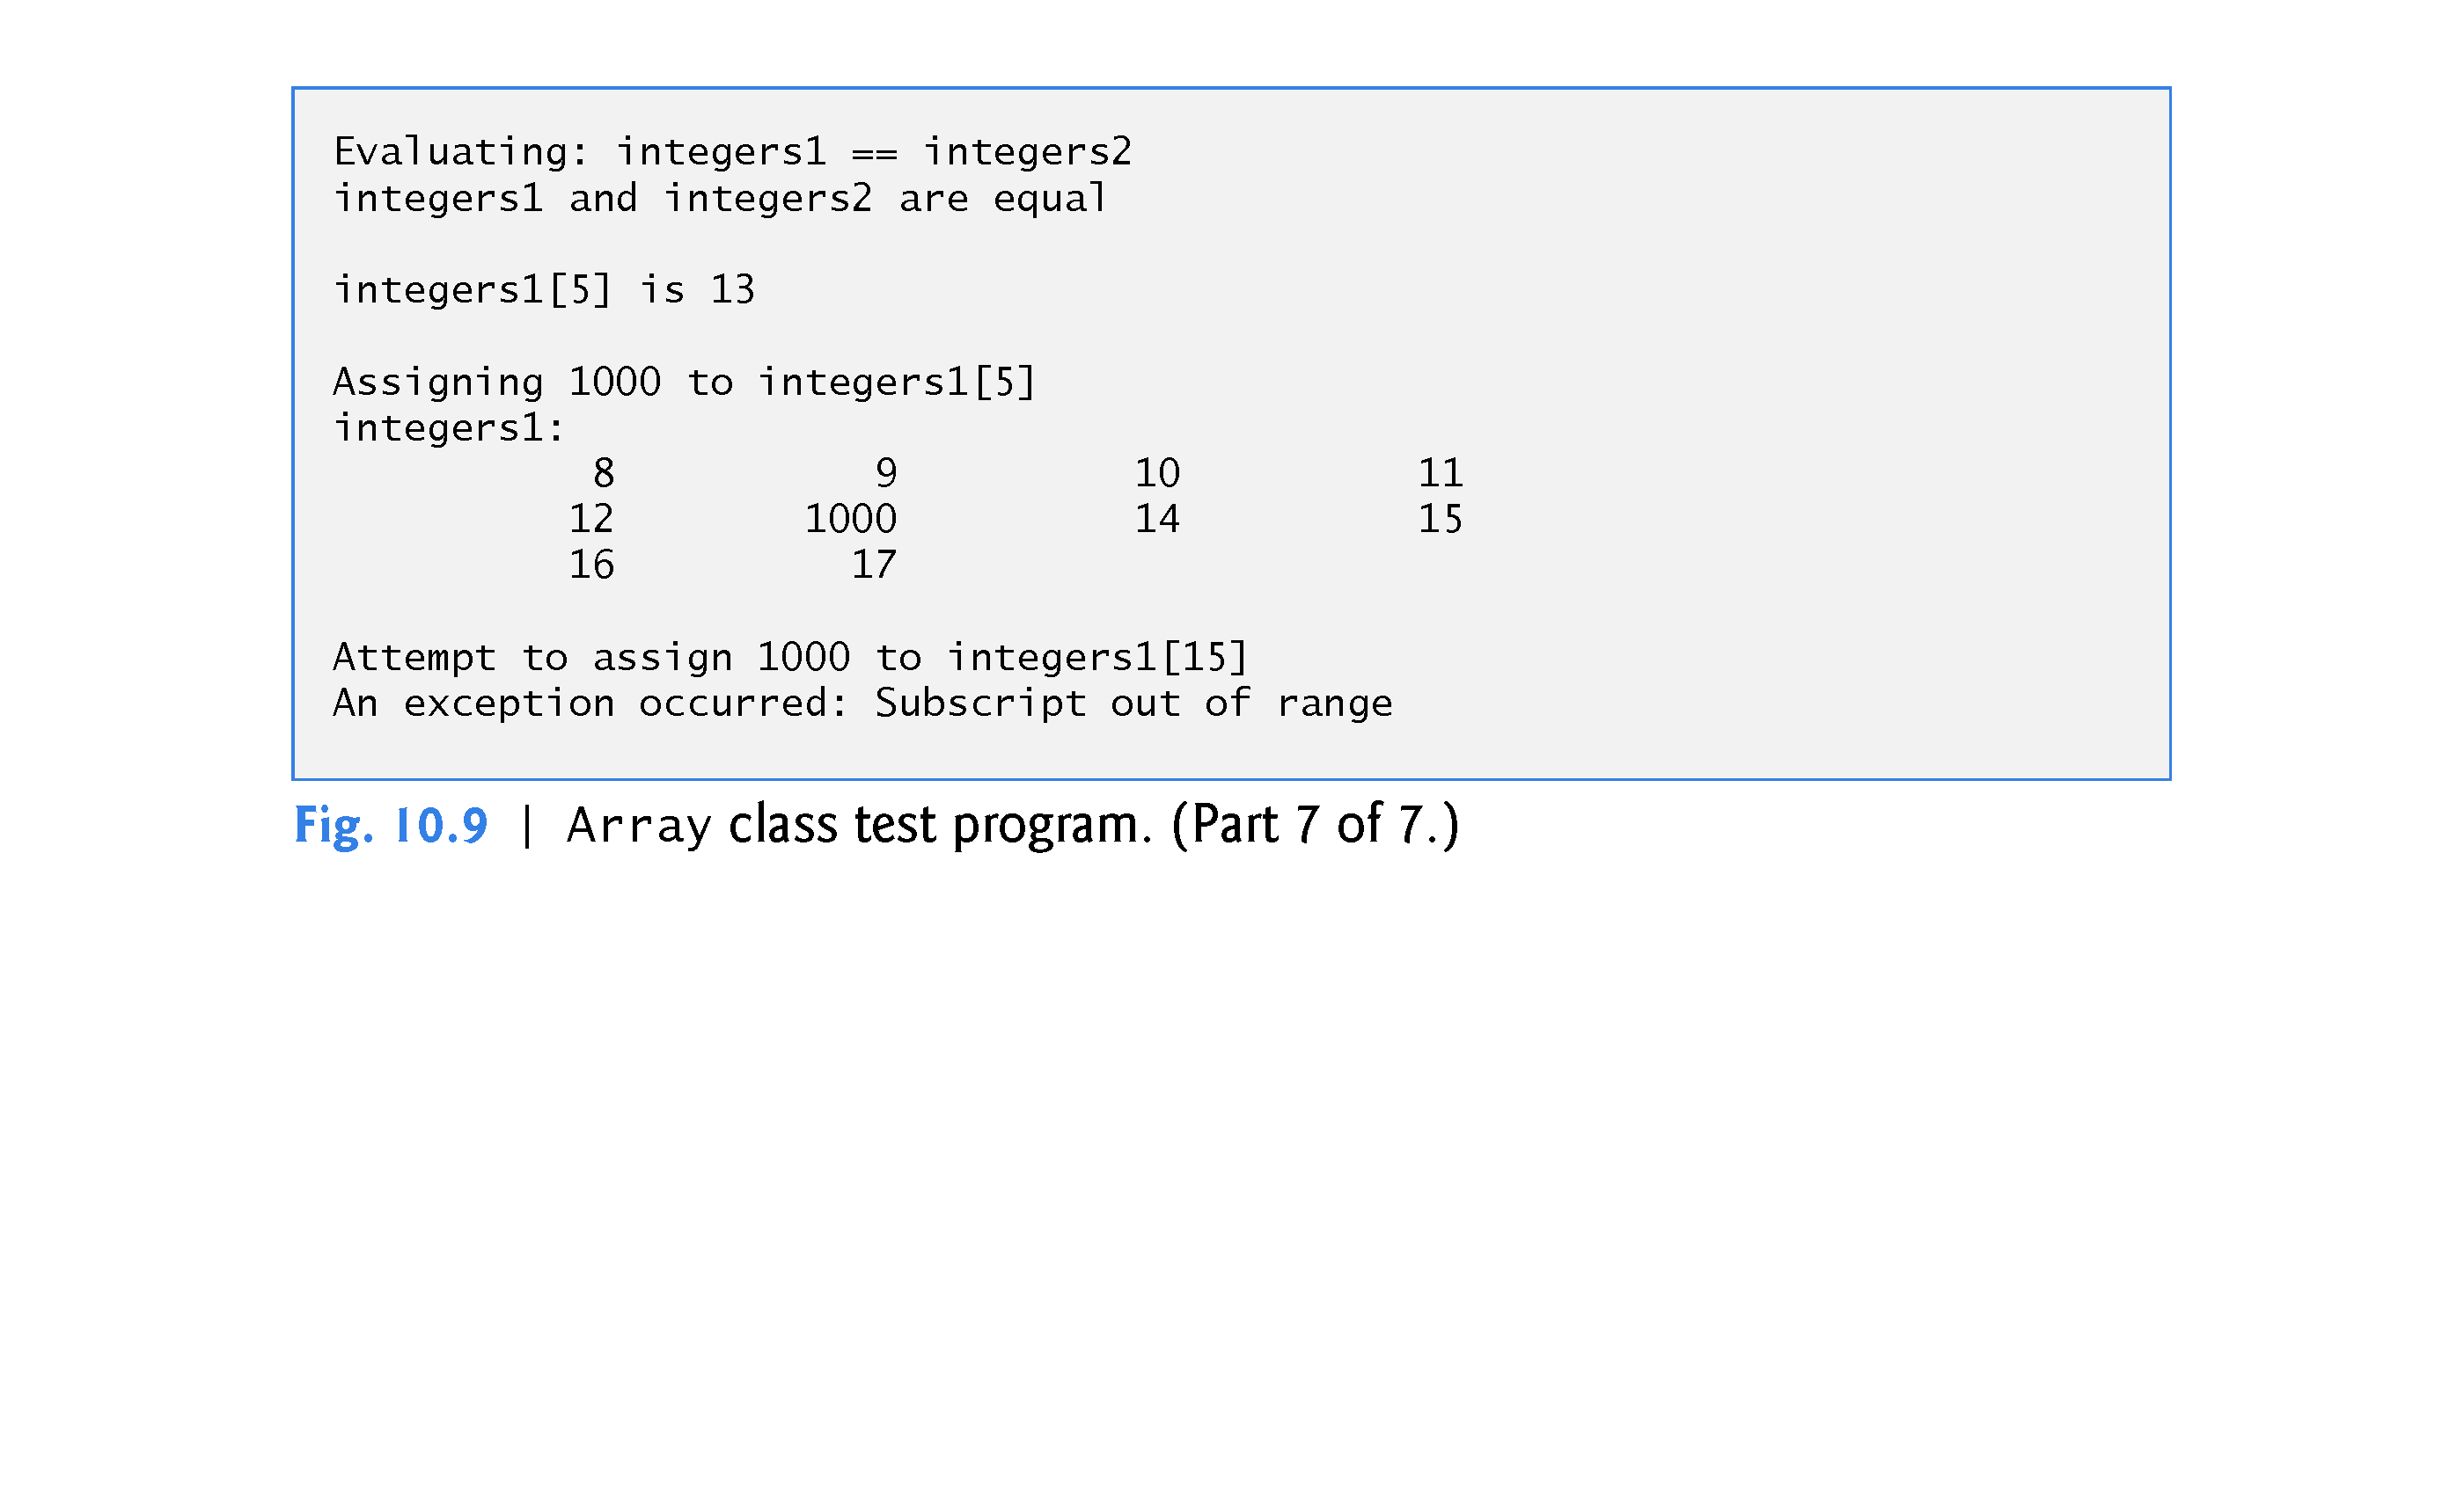

Slide 85
10.10 Case Study: Array Class (cont.)
The Array copy constructor copies the elements of one Array into another.
The copy constructor can also be invoked by writing line 39 as follows:
Array integers3 = integers1;
The equal sign in the preceding statement is not the assignment operator.
When an equal sign appears in the declaration of an object, it invokes the copy constructor for that object.
This form can be used to pass only a single argument to a constructor.

Slide 86
10.10 Case Study: Array Class (cont.)
A copy constructor is invoked whenever a copy of an object is needed:
Passing an object by value to a function
Returning an object by value from a function
Initializing an object with a copy of another object of the same class
Array integers3 = Integers1; //declaration!
Array integers3(integers1);

Slide 87
10.10 Case Study: Array Class (cont.)
The array subscript operator [ ] is not restricted for use only with arrays; it also can be used, for example, to select elements from other kinds of container classes, such as strings and dictionaries.
Also, when operator[ ] functions are defined, subscripts no longer have to be integers—characters, strings, floats or even objects of user-defined classes also could be used.

Slide 88
10.10 Case Study: Array Class (cont.)
Each Array object consists of a size member indicating the number of elements in the Array and an int pointer—ptr—that points to the dynamically allocated pointer-based array of integers managed by the Array object.
When the compiler sees an expression like cout << arrayObject, it invokes the non-member function operator<< with the call
operator << (cout, arrayObject)
When the compiler sees an expression like cin >> arrayObject, it invokes non-member function operator>> with the call
operator >> (cin, arrayObject)
These stream insertion and stream extraction operator functions cannot be members of class Array, because the Array object is always mentioned on the right side of the stream insertion operator and the stream extraction operator.

Slide 89
10.10 Case Study: Array Class (cont.)
You might be tempted to replace the counter-controlled for statement in lines 104–105 and many of the other for statements in class Array’s implementation with the C++11 range-based for statement.
Unfortunately, range-based for loops do not work with dynamically allocated built-in arrays.

Slide 90
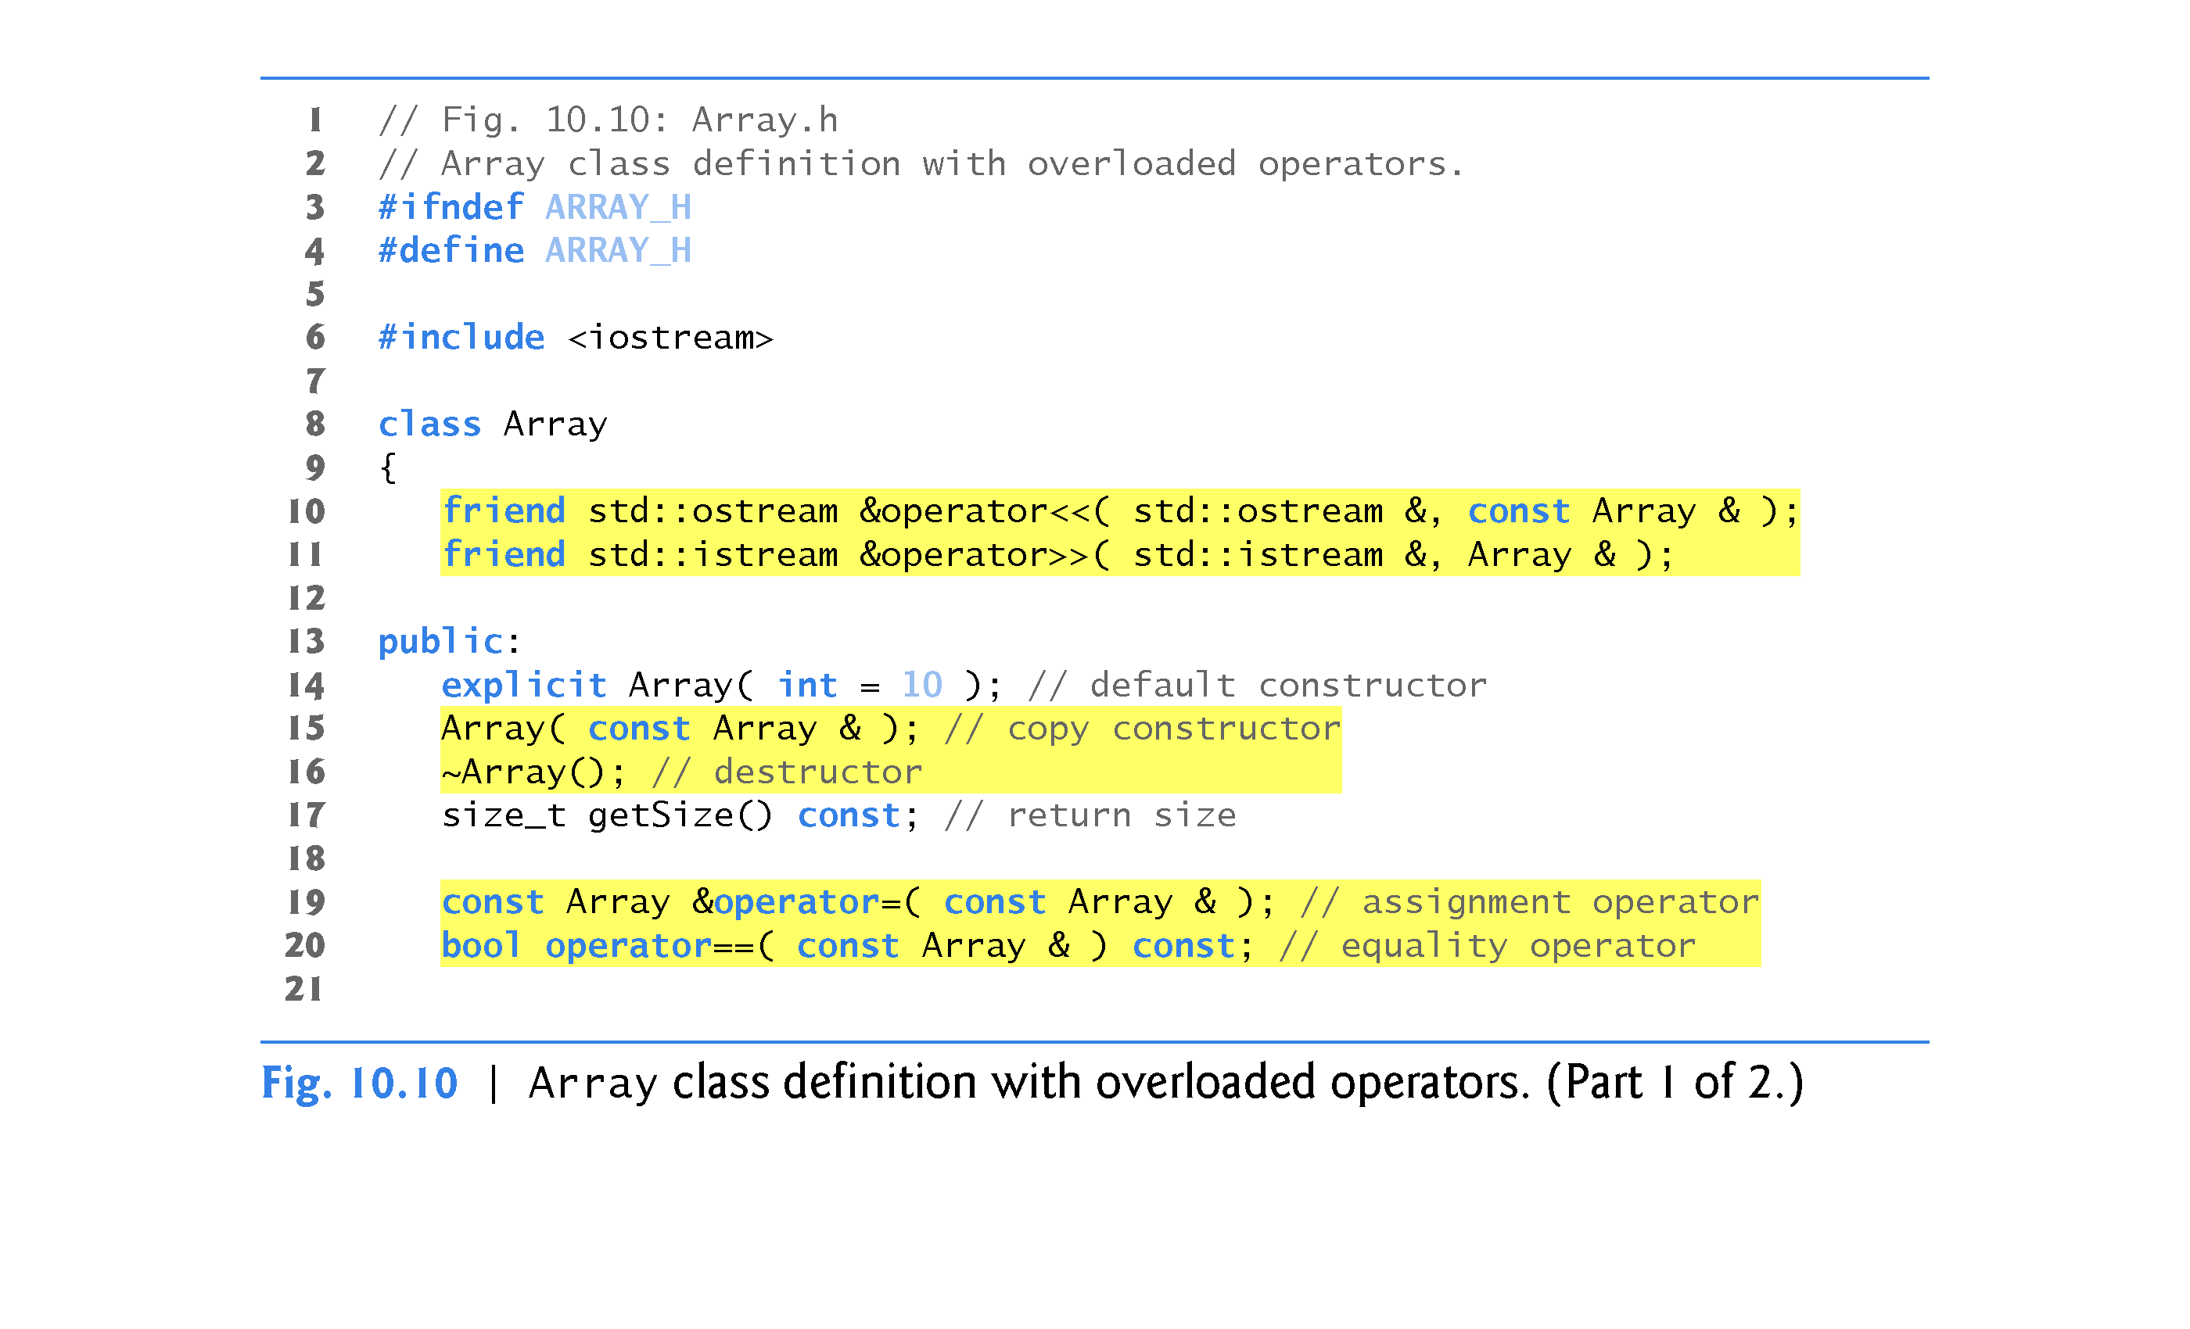
arrayA = arrayB = arrayC;

Slide 91
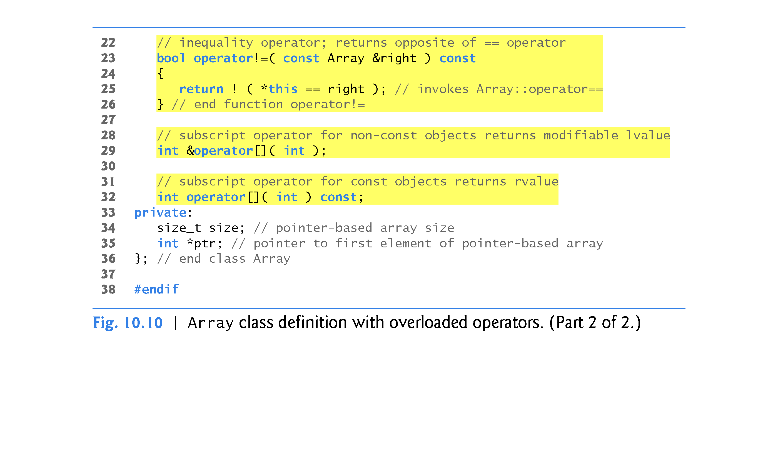

Slide 92
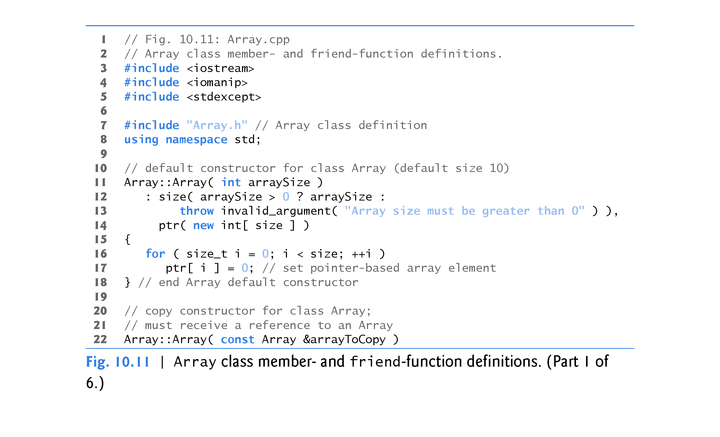

Slide 93
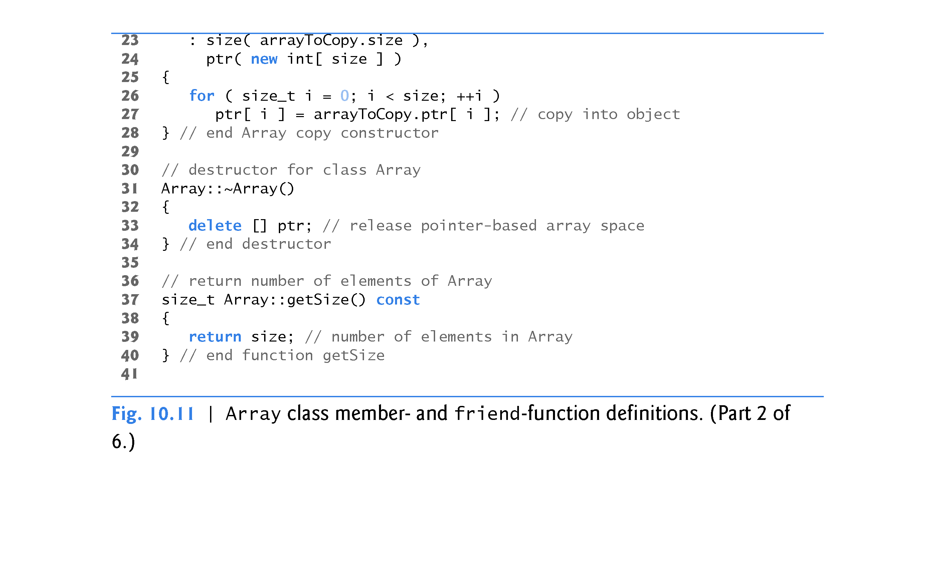

Slide 94
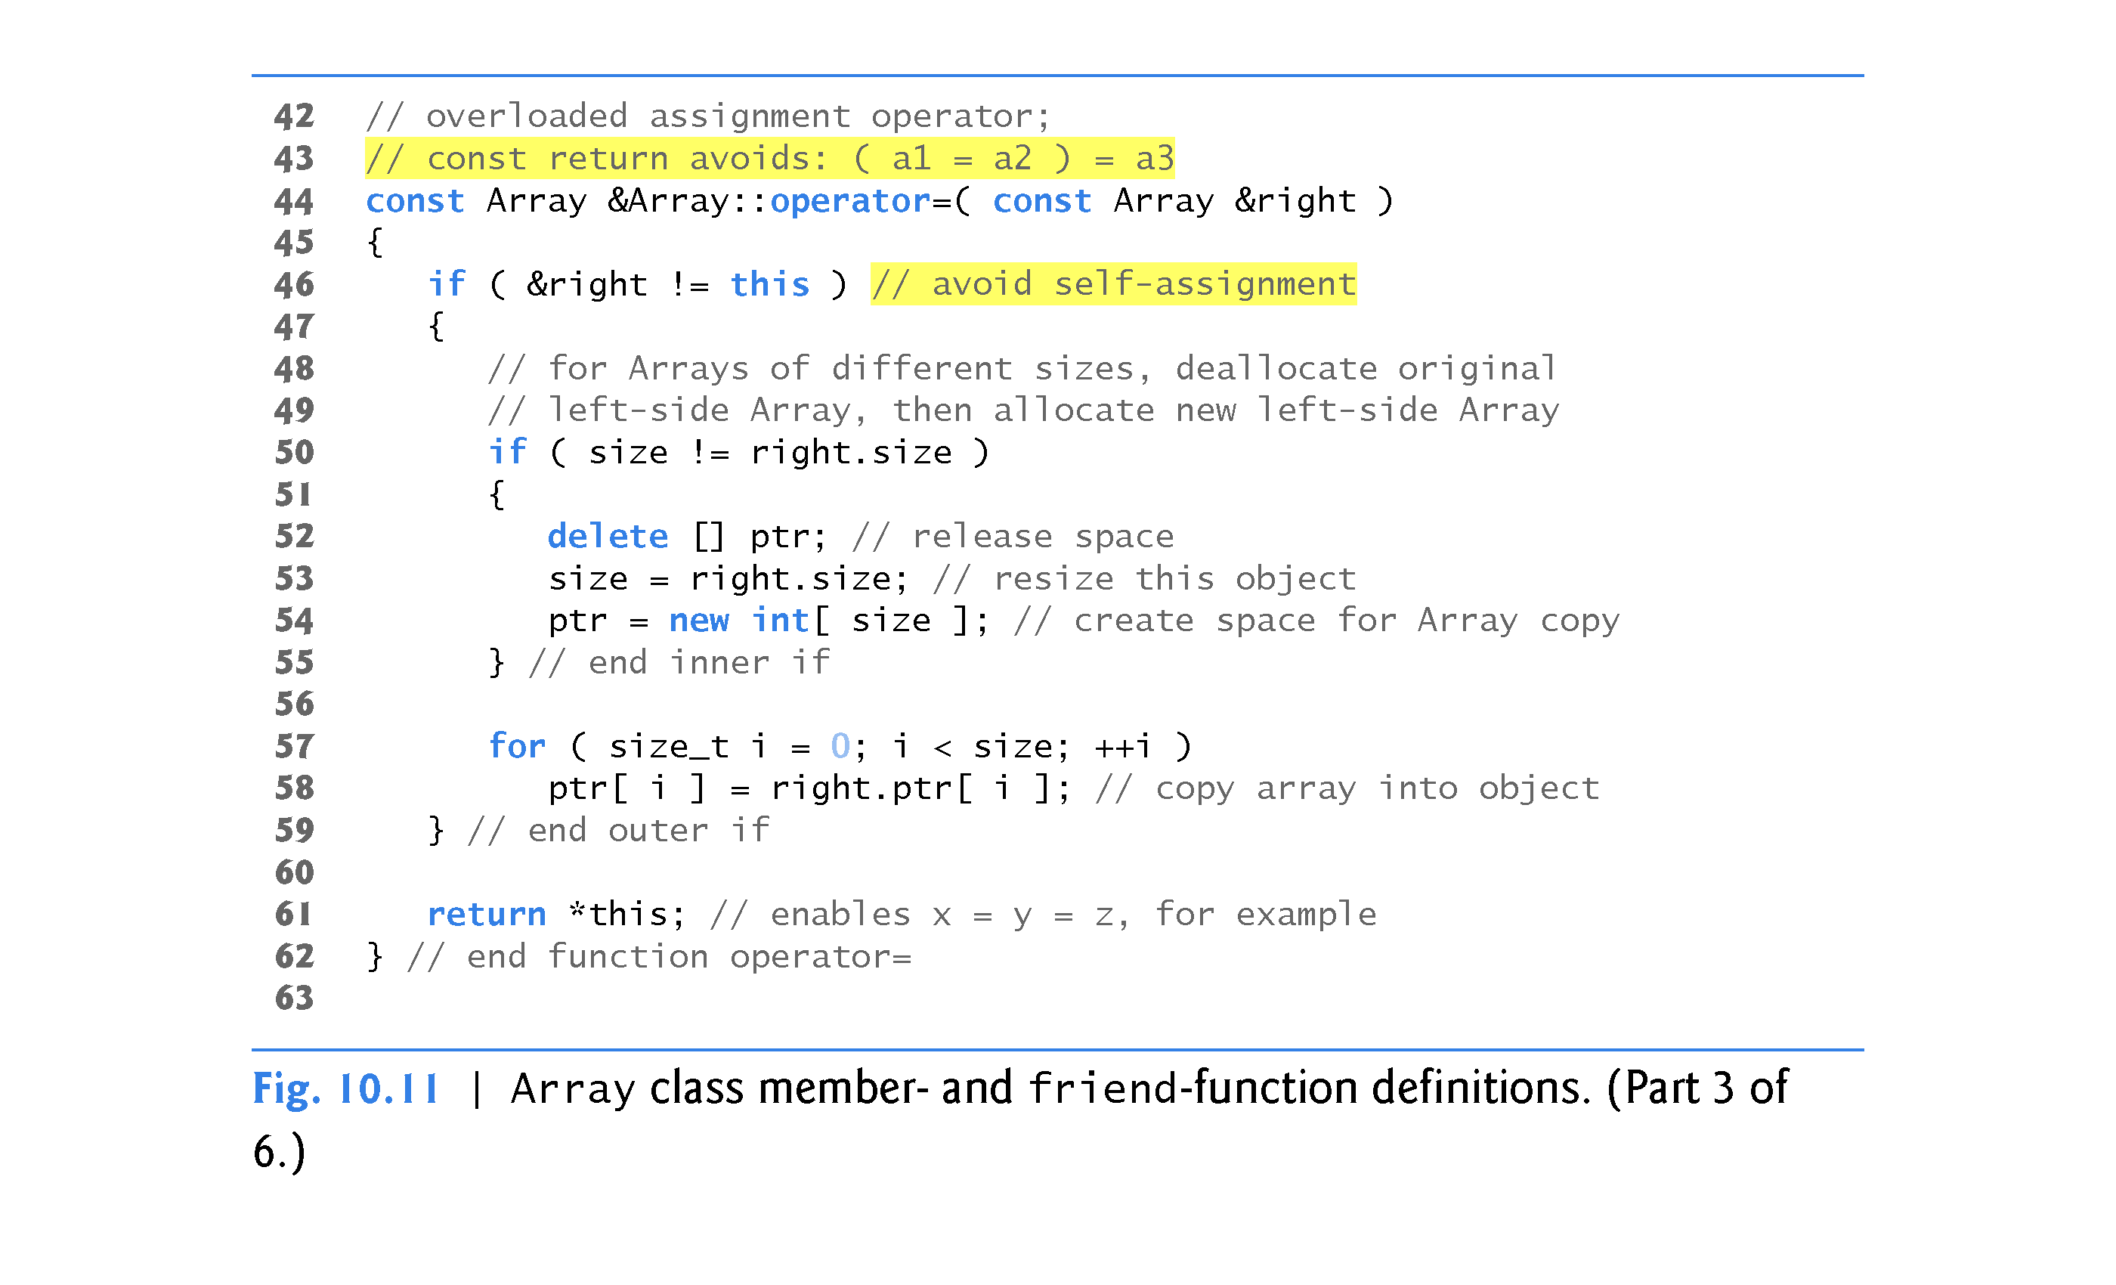

Slide 95
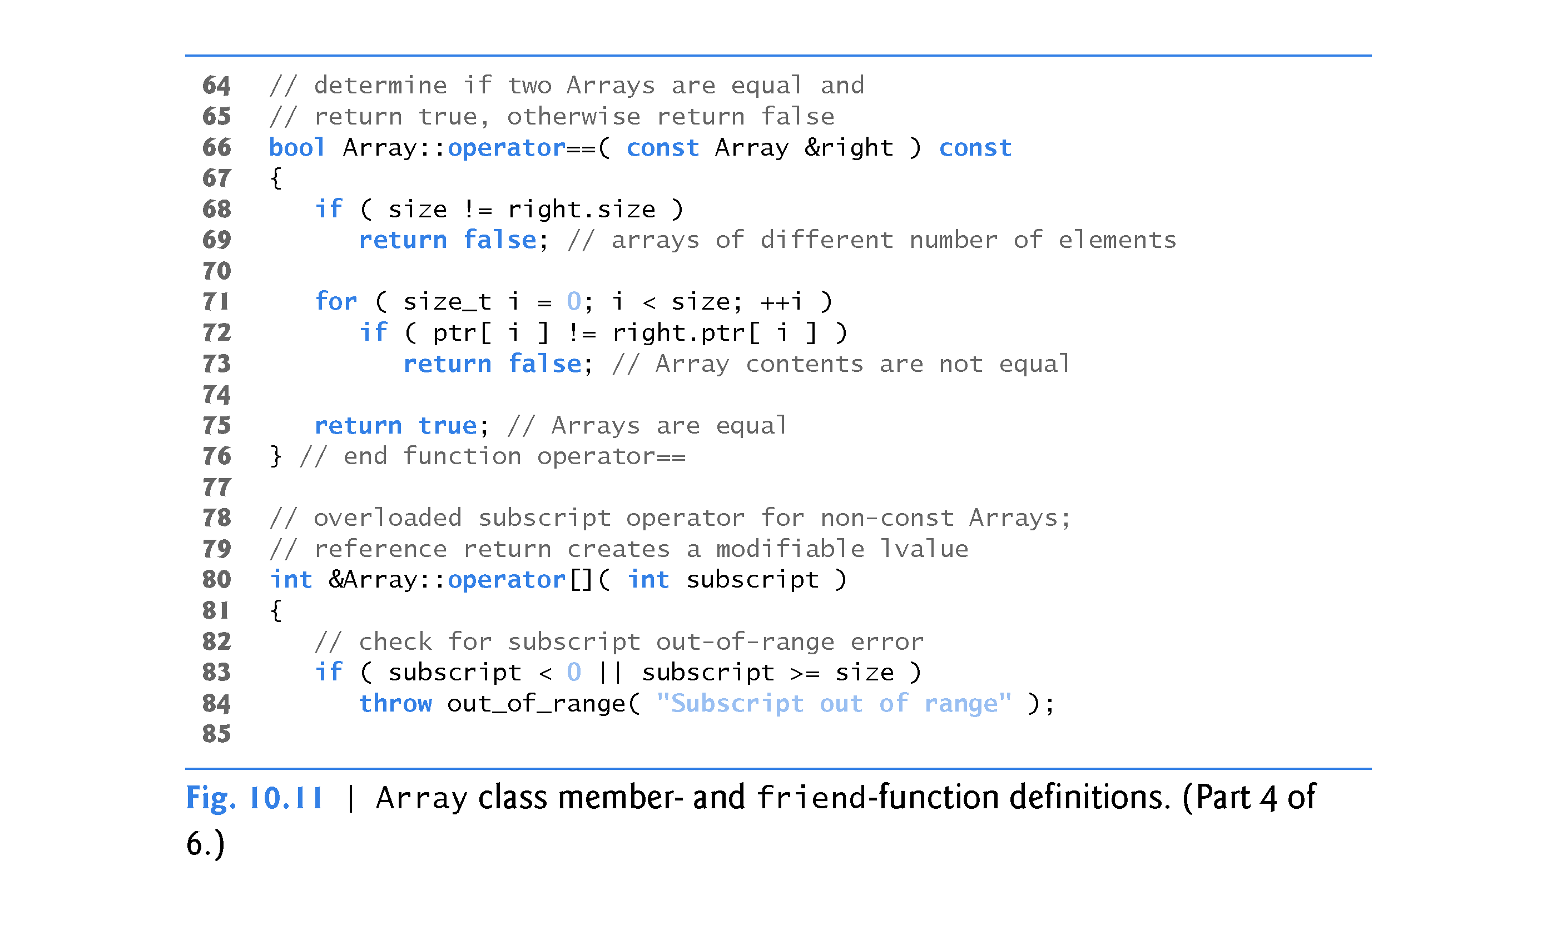

Slide 96
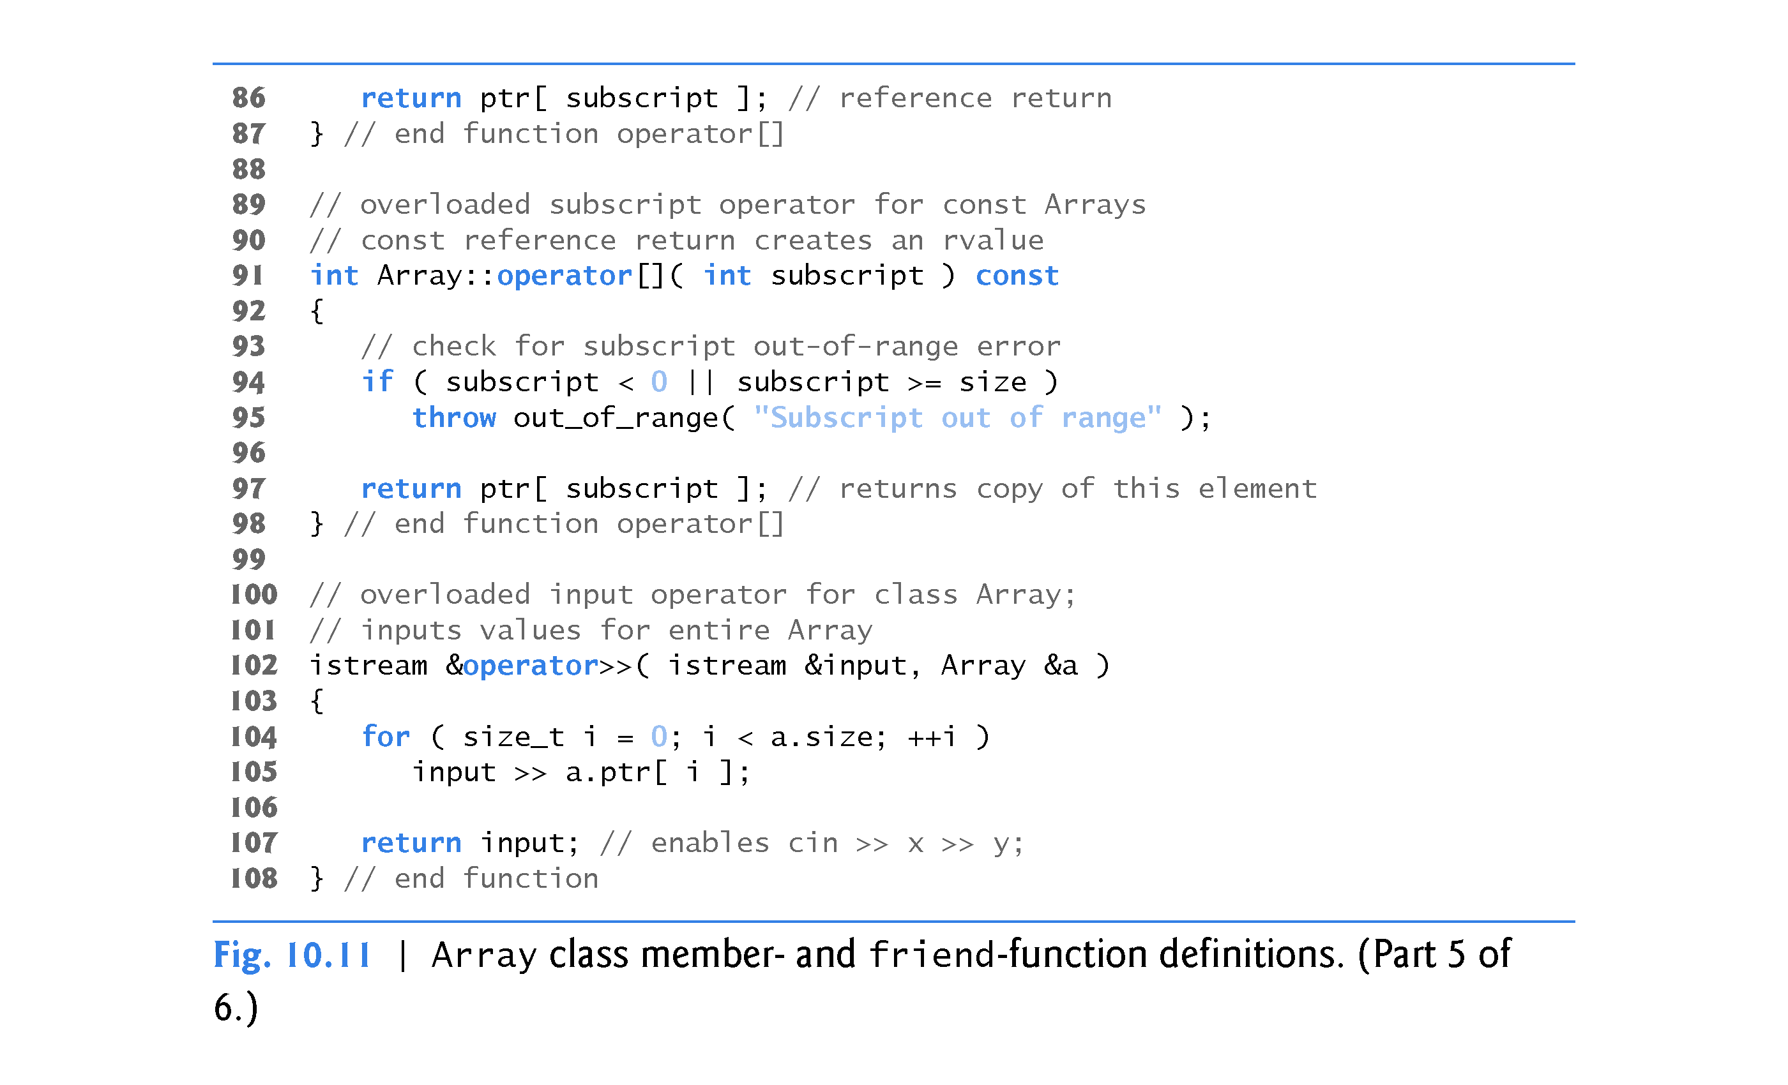

Slide 97
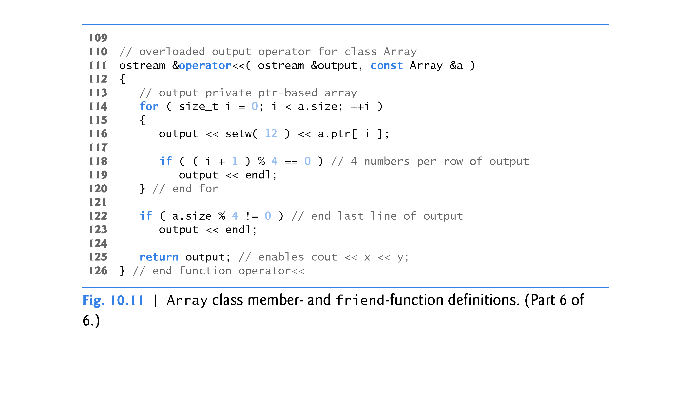

Slide 98
10.10 Case Study: Array Class (cont.)
Array class Default Constructor
Line 14 of Fig. 10.10 declares the default constructor for the class and specifies a default size of 10 elements.
The default constructor (defined in Fig. 10.11, lines 11–18) validates and assigns the argument to data member size, uses new to obtain the memory for the internal pointer-based representation of this Array and assigns the pointer returned by new to data member ptr.
Then the constructor uses a for statement to set all the elements of the array to zero.

Slide 99
10.10 Case Study: Array Class (cont.)
Array Copy Constructor
Line 15 of Fig. 10.10 declares a copy constructor (defined in Fig. 10.11, lines 22–28) that initializes an Array by making a copy of an existing Array object.
Such copying must be done carefully to avoid the pitfall of leaving both Array objects pointing to the same dynamically allocated memory.
This is exactly the problem that would occur with default memberwise copying, if the compiler is allowed to define a default copy constructor for this class.

Slide 100
10.10 Case Study: Array Class (cont.)
The copy constructor for Array copies the size of the initializer Array into data member size, uses new to obtain the memory for the internal pointer-based representation of this Array and assigns the pointer returned by new to data member ptr.
Then the copy constructor uses a for statement to copy all the elements of the initializer Array into the new Array object.
An object of a class can look at the private data of any other object of that class (using a handle that indicates which object to access).

Slide 101
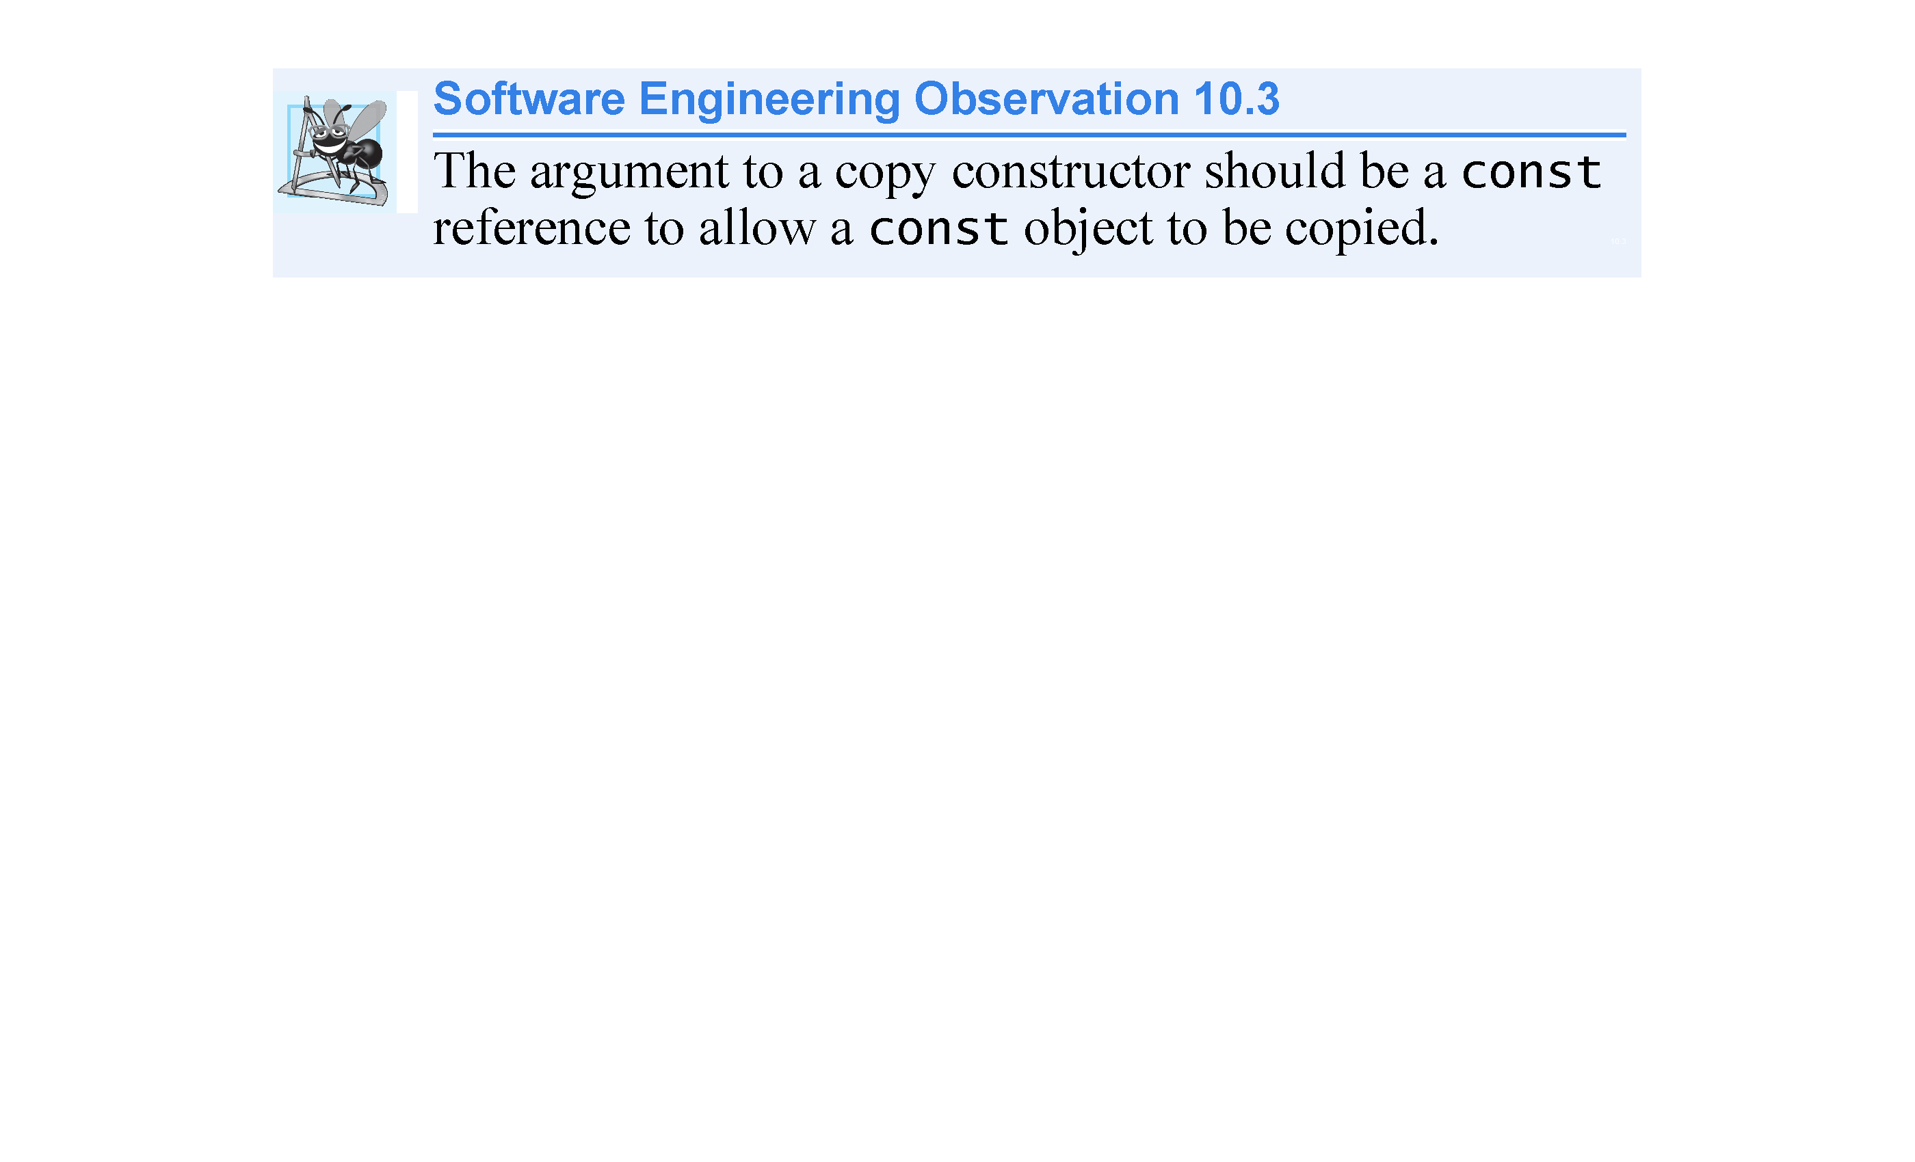

Slide 102


Slide 103
10.10 Case Study: Array Class (cont.)
Array Destructor
Line 16 of Fig. 10.10 declares the class’s destructor (defined in Fig. 10.11, lines 31–34).
The destructor is invoked when an object of class Array goes out of scope.
The destructor uses delete [ ] to release the memory allocated dynamically by new in the constructor.

Slide 104


Slide 105
10.10 Case Study: Array Class (cont.)
Overloaded Assignment Operator
Line 19 of Fig. 10.10 declares the overloaded assignment operator function for the class.
When the compiler sees the expression integers1 = integers2 in line 47 of Fig. 10.9, the compiler invokes member function operator= with the call
integers1.operator=( integers2 )
Member function operator=’s implementation (Fig. 10.11, lines 44–62) tests for self-assignment (line 46) in which an Array object is being assigned to itself.
When this is equal to the right operand’s address, a self-assignment is being attempted, so the assignment is skipped.

Slide 106
10.10 Case Study: Array Class (cont.)
operator= determines whether the sizes of the two Arrays are identical (line 50); in that case, the original array of integers in the left-side Array object is not reallocated.
Otherwise, operator= uses delete [ ] (line 52) to release the memory, copies the size of the source array to the size of the target Array (line 53), uses new to allocate memory for the target Array and places the pointer returned by new into the Array’s ptr member.
Regardless of whether this is a self-assignment, the member function returns the current object (i.e., *this in line 61) as a constant reference; this enables cascaded Array assignments such as x = y = z, but prevents ones like (x = y) = z because z cannot be assigned to the const Array reference that is returned by (x = y).

Slide 107


Slide 108


Slide 109
10.10 Case Study: Array Class (cont.)
C++11: Deleting Unwanted Member Functions from Your Class
Prior to C++11, you could prevent class objects from being copied or assigned by declaring as private the class’s copy constructor and overloaded assignment operator.
As of C++11, you can simply delete these functions from your class.
To do so in class Array, replace the prototypes in lines 15 and 19 of Fig. 10.10 with:
Array(const Array&) = delete; //copy constructor
const Array& operator= (const Array &) = delete;
Though you can delete any member function, it’s most commonly used with member functions that the compiler can auto-generate—the default constructor, copy constructor, assignment operator, and in C++ 11, the move constructor and move assignment operator.

Slide 110
10.10 Case Study: Array Class (cont.)
Overloaded Equality and Inequality Operators
Line 20 of Fig. 10.10 declares the overloaded equality operator (==) for the class.
When the compiler sees the expression integers1 == integers2 in line 55 of Fig. 10.9, the compiler invokes member function operator== with the call
integers1.operator== ( integers2 )
Member function operator== (defined in Fig. 10.11, lines 66–76) immediately returns false if the size members of the Arrays are not equal.
Otherwise, operator== compares each pair of elements.
If they’re all equal, the function returns true.
The first pair of elements to differ causes the function to return false immediately.

Slide 111
10.10 Case Study: Array Class (cont.)
Lines 23–26 Fig. 10.9 define the overloaded inequality operator (!=) for the class.
Member function operator != uses the overloaded operator == function to determine whether one Array is equal to another, then returns the opposite of that result.
Writing operator != in this manner enables you to reuse operator ==, which reduces the amount of code that must be written in the class.
Also, the full function definition for operator != is in the Array header.
Allows the compiler to inline the definition.

Slide 112
10.10 Case Study: Array Class (cont.)
Overloaded Subscript Operators
Lines 29 and 32 of Fig. 10.10 declare two overloaded subscript operators (defined in Fig. 10.11 in lines 80–87 and 91–98).
When the compiler sees the expression integers1[5] (Fig. 10.9, line 59), it invokes the appropriate overloaded operator[ ] member function by generating the call
integers1.operator[](5)
The compiler creates a call to the const version of operator[ ] (Fig. 10.11, lines 91–98) when the subscript operator is used on a const Array object.

Slide 113
10.10 Case Study: Array Class (cont.)
Each definition of operator[ ] determines whether the subscript it receives as an argument is in range.
If it isn’t, each function prints an error message and terminates the program with a call to function exit.
If the subscript is in range, the non-const version of operator[ ] returns the appropriate Array element as a reference so that it may be used as a modifiable lvalue.
If the subscript is in range, the const version of operator[ ] returns a copy of the appropriate element of the Array.

Slide 114
10.10 Case Study: Array Class (cont.)
C++11: Managing Dynamically Allocated Memory with unique_ptr
In this case study, class Array’s destructor used delete [ ] to return the dynamically allocated built-in array to the free store.
As you recall, C++11 enables you to use unique_ptr to ensure that this dynamically allocated memory is deleted when the Array object goes out of scope.

Slide 115
10.10 Case Study: Array Class (cont.)
C++11: Passing a List Initializer to a Constructor
In Fig. 7.4, we showed how to initialize an array object with a comma-separated list of initializers in braces, as in
array< int, 5 > n = { 32, 27, 64, 18, 95 };
C++11 now allows any object to be initialized with a list initializer and that the preceding statement can also be written without the =, as in
array< int, 5 > n{ 32, 27, 64, 18, 95 };

Slide 116
10.10 Case Study: Array Class (cont.)
C++11 also allows you to use list initializers when you declare objects of your own classes.
For example, you can now provide an Array constructor that would enable the following declarations:
Array integers = { 1, 2, 3, 4, 5 };
or
Array integers{ 1, 2, 3, 4, 5 };
each of which creates an Array object with five elements containing the integers from 1 to 5.

Slide 117
10.10 Case Study: Array Class (cont.)
To support list initialization, you can define a constructor that receives an object of the class template initializer_list. For class Array, you’d include the <initializer_list> header.
Then, you’d define a constructor with the first line:
Array::Array( initializer_list<int> list )
You can determine the number of elements in the list parameter by calling its size member function.
To obtain each initializer and copy it into the Array object’s dynamically allocated built-in array, you can use a range-based for as follows:
size_t i = 0;
for ( int item : list )
ptr[ i++ ] = item; //ptr is the pointer variable

Slide 118
10.11 Operators as Member vs. Non-Member Functions
Whether an operator function is implemented as a member function or as a non-member function, the operator is still used the same way in expressions.
When an operator function is implemented as a member function, the leftmost (or only) operand must be an object (or a reference to an object) of the operator’s class.
If the left operand must be an object of a different class or a fundamental type, this operator function must be implemented as a non-member function (as we did in Section 10.5 when overloading << and >> as the stream insertion and extraction operators, respectively).
A non-member operator function can be made a friend of a class if that function must access private or protected members of that class directly.
Operator member functions of a specific class are called only when the left operand of a binary operator is specifically an object of that class, or when the single operand of a unary operator is an object of that class.

Slide 119
10.11 Operators as Member vs. Non-Member Functions
You might choose a non-member function to overload an operator to enable the operator to be commutative.
The operator+ function that deals with the HugeInt on the left, can still be a member function.
The non-member function simply swaps its arguments and calls the member function.

Slide 120
10.12 Converting Between Types
Sometimes all the operations “stay within a type.” For example, adding an int to an int produces an int.
It’s often necessary, however, to convert data of one type to data of another type.
The compiler knows how to perform certain conversions among fundamental types.
You can use cast operators to force conversions among fundamental types.
The compiler cannot know in advance how to convert among user-defined types, and between user-defined types and fundamental types, so you must specify how to do this.

Slide 121
10.12 Converting Between Types (cont.)
Such conversions can be performed with conversion constructors
constructors that can be called with a single argument (we’ll refer to these as single-argument constructors).
Such constructors can turn objects of other types (including fundamental types) into objects of a particular class.

Slide 122
10.12 Converting Between Types (cont.)
Conversion Operators
A conversion operator (also called a cast operator) can be used to convert an object of one class to another type.
Such a conversion operator must be a non-static member function.
The function prototype
MyClass::operator char *() const;
declares an overloaded cast operator function for converting an object of class MyClass into a temporary char * object.
The operator function is declared const because it does not modify the original object.

Slide 123
10.12 Converting between Types (cont.)
The return type of an overloaded cast operator function is implicitly the type to which the object is being converted.
If s is a class object, when the compiler sees the expression static_cast<char *>(s), the compiler generates the call
s.operator char*()

Slide 124
10.12 Converting between Types (cont.)
Overloaded Cast Operator Functions
Overloaded cast operator functions can be defined to convert objects of user-defined types into fundamental types or into objects of other user-defined types.
Implicit Calls to Cast Operators and Conversion Constructors
One of the nice features of cast operators and conversion constructors is that, when necessary, the compiler can call these functions implicitly to create temporary objects.

Slide 125


Slide 126
10.13 explicit Constructors and Conversion Operators
Recall that we’ve been declaring as explicit every constructor that can be called with one argument.
With the exception of copy constructors, any constructor that can be called with a single argument and is not declared explicit can be used by the compiler to perform an implicit conversion.
The conversion is automatic and you need not use a cast operator.
In some situations, implicit conversions are undesirable or error-prone.
For example, our Array class in Fig. 10.10 defines a constructor that takes a single int argument.
The intent of this constructor is to create an Array object containing the number of elements specified by the int argument.
However, if this constructor were not declared explicit it could be misused by the compiler to perform an implicit conversion.

Slide 127


Slide 128
10.13 explicit Constructors and Conversion Operators (cont.)
The program (Fig. 10.12) uses the Array class of Figs. 10.10–10.11 to demonstrate an improper implicit conversion.
Line 13 calls function outputArray with the int value 3 as an argument.
This program does not contain a function called outputArray that takes an int argument.
The compiler determines whether class Array provides a conversion constructor that can convert an int into an Array.
The compiler assumes the Array constructor that receives a single int is a conversion constructor and uses it to convert the argument 3 into a temporary Array object that contains three elements.
Then, the compiler passes the temporary Array object to function outputArray to output the Array’s contents.

Slide 129


Slide 130


Slide 131
10.13 explicit Constructors and Conversion Operators (cont.)
Preventing Implicit Conversions with Single-Argument Constructors
The reason we’ve been declaring every single-argument constructor preceded by the keyword explicit is to suppress implicit conversions via conversion constructors when such conversions should not be allowed.
A constructor that is declared explicit cannot be used in an implicit conversion.
In the example if Figure 10.13, we use the original version of Array.h from Fig. 10.10, which included the keyword explicit in the declaration of the single-argument constructor in line 14.

Slide 132
10.13 explicit Constructors and Conversion Operators (cont.)
Figure 10.13 presents a slightly modified version of the program in Fig. 10.12.
When this program is compiled, the compiler produces an error message indicating that the integer value passed to outputArray in line 13 cannot be converted to a const Array &.
The compiler error message (from Visual C++) is shown in the output window.
Line 14 demonstrates how the explicit constructor can be used to create a temporary Array of 3 elements and pass it to function outputArray.

Slide 133


Slide 134


Slide 135


Slide 136
10.13 explicit Constructors and Conversion Operators (cont.)
C++11: explicit Conversion Operators
As of C++11, similar to declaring single-argument constructors explicit, you can declare conversion operators explicit to prevent the compiler from using them to perform implicit conversions.
For example, the prototype:
explicit MyClass::operator char *() const;
declares MyClass’s char * cast operator explicit.

Slide 137
10.14 Overloading the Function Call Operator ( )
Overloading the function call operator ( ) is powerful, because functions can take an arbitrary number of comma-separated parameters.
In a customized String class, for example, you could overload this operator to select a substring from a String—the operator’s two integer parameters could specify the start location and the length of the substring to be selected.
The operator( ) function could check for such errors as a start location out of range or a negative substring length.
The overloaded function call operator must be a non-static member function and could be defined with the first line:
String String::operator()(size_t index, size_t length) const
String s = “abcde”; cout << s(0,3) << endl; ======> abc

Slide 138
10.14 Overloading the Function Call Operator ( )
In this case, it should be a const member function because obtaining a substring should not modify the original String object.
Suppose string1 is a String object containing the string "AEIOU".
When the compiler encounters the expression string1(2, 3), it generates the member-function call
string1.operator()(2,3)
which returns a String containing "IOU".
Another possible use of the function call operator is to enable an alternate Array subscripting notation.
Instead of using C++’s double-square-bracket notation, such as in chessBoard[row][column], you might prefer to overload the function call operator to enable the notation chessBoard(row, column), where chessBoard is an object of a modified two-dimensional Array class.

